Slide 1

Are We Happy?
Philippians 4:1-7
Richie Thetford www.thetfordcountry.com

Slide 2
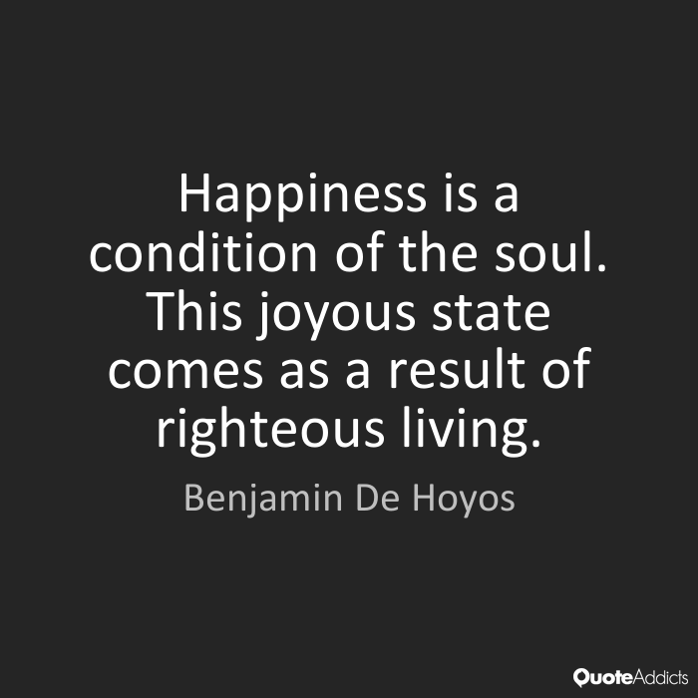
Happiness found in living for God
Righteous living
  Titus 2:11-12
  Philippians 4:8
  Romans 13:3
  Psalms 97:11-12
  Psalms 37:3-6
Richie Thetford www.thetfordcountry.com

Slide 3

Happiness found in living for God
Worshiping God
  Psalms 95:1-3
  Psalms 119:24
  Jude 24-25
Contentment
  Philippians 4:11-13
  James 1:2-4
  2 Corinthians 1:3-7
Richie Thetford www.thetfordcountry.com

Slide 4

Happiness found in living for God
Effort
  Psalms 128:2
  Ecclesiastes 5:18-19
  1 Corinthians 15:58
Richie Thetford www.thetfordcountry.com

Slide 5
Conclusion
Happiness is not in things
“If then you were raised with Christ, seek those things which are above, where Christ is, sitting at the right hand of God. Set your mind on things above,
not on things on the earth. For you died, and
your life is hidden with Christ in God.”
Colossians 3:1-3
Richie Thetford www.thetfordcountry.com

