Slide 1
Answering the call of god
“And I also say to you that you are Peter, and on this rock I will build My church, and the gates of Hades shall not prevail against it.”
Matthew 16:18
Richard Thetford www.thetfordcountry.com

Slide 2

Jesus built His church
One body – the church
  Ephesians 4:4
  Ephesians 1:22-23
  Colossians 1:18, 24
Richard Thetford www.thetfordcountry.com

Slide 3
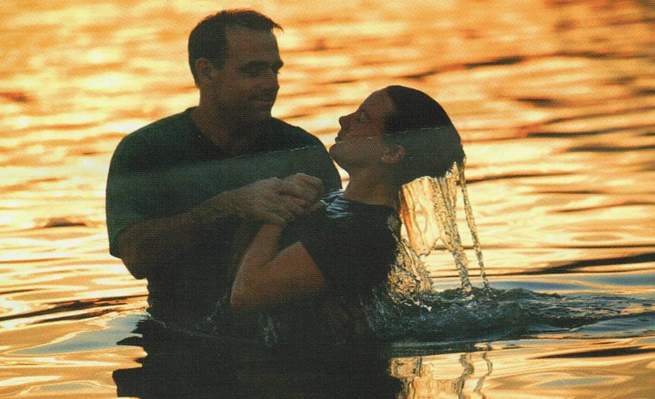
Jesus built His church
The church universal
  Added through baptism
    1 Corinthians 12:12-13
The church local
  Composed of the baptized
  Worship faithfully together
  Lay by into a common treasury
    1 Corinthians 1:2
Richard Thetford www.thetfordcountry.com

Slide 4

Ways in which god calls us
To walk in the steps of Jesus
  1 Peter 2:21
By the gospel
  2 Thessalonians 2:13-14
  1 Peter 1:10-11
  1 Corinthians 2:6-8
To the hope of eternal life
  1 Timothy 6:12
Richard Thetford www.thetfordcountry.com

Slide 5

Ways in which god calls us
Out of Darkness
  1 Peter 2:9
Out of Satan’s domain
  Colossians 1:13
  Matthew 15:13-14
  1 John 4:1
  Romans 6:16-18
Richard Thetford www.thetfordcountry.com

Slide 6
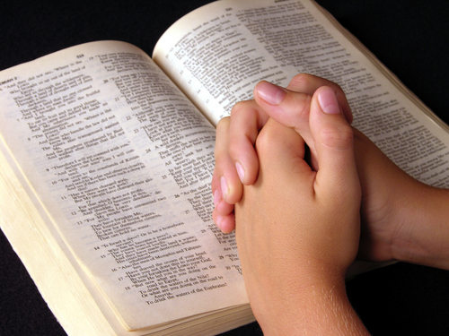
Ways in which god calls us
“called out”
  Stresses separation from the world
  “in the church” means set apart for God
    2 Corinthians 6:17
    James 4:4
Richard Thetford www.thetfordcountry.com

Slide 7

Facts concerning the call of god
Everyone is called the same way
  By the gospel
    2 Thessalonians 2:13-14
  God is no respecter of persons
    Romans 2:11
    Acts 10:34
  To reject the gospel is to reject His call
    1 Thessalonians 4:7-8
    Hebrews 1:1-3
Richard Thetford www.thetfordcountry.com

Slide 8
conclusion
Purpose of our calling is seen
in God’s goodness
  Philippians 3:14
Make our call and election sure
  2 Peter 1:10-11
Those added to the church have answered the “call” of God
Richard Thetford www.thetfordcountry.com

