Slide 1
Acts 26:24-32
Richie Thetford www.thetfordcountry.com

Slide 2
Paul’s Persuasion of Agrippa
To become a Christian
Acts 11:26
John 3:5
Romans 6:3
1 Corinthians 12:13
Mark 16:16
Acts 2:38; 22:16
John 3:16-17
Richie Thetford www.thetfordcountry.com

Slide 3
Persuaded to Become a Christian
Because of the terror of the Lord
2 Corinthians 5:11
Romans 1:27
Luke 12:4-5
To gain eternal life
Revelation 21:1-4
Gratitude to God
1 John 4:10, 19
Richie Thetford www.thetfordcountry.com

Slide 4
Why Not Become a Christian?
Love of the world
1 John 2:15-17
Matthew 7:13-14
Procrastination
Acts 24:25
Joshua 24:15
Richie Thetford www.thetfordcountry.com

Slide 5
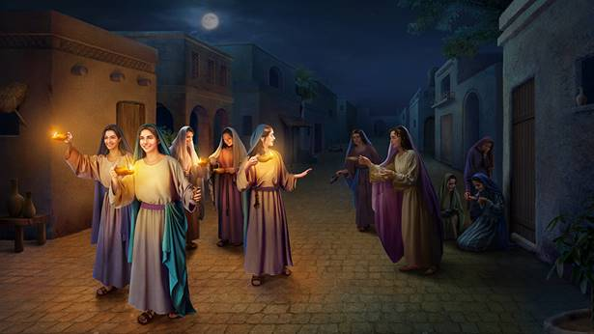
Almost is Not Enough
Rich young ruler
Mark 10:17-22
Foolish Virgins
Matthew 25:1-13
Richie Thetford www.thetfordcountry.com

Slide 6
Conclusion
We only have this moment!
“Come to Me, all you who labor and are heavy laden, and I will give you rest. Take My yoke upon you and learn from Me, for I am gentle and lowly in heart, and you will find rest for your souls. For My yoke is easy and My burden is light.”
Matthew 11:28-30
Richie Thetford www.thetfordcountry.com

