Slide 1

“All That the Lord Has Spoken We Will Do”
Exodus 19:1-8
Richie Thetford www.thetfordcountry.com

Slide 2
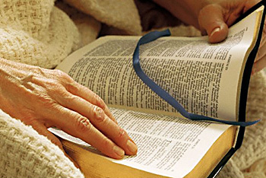
“All That the Lord Has Spoken We Will Do”
Deliverance
  John 8:33-34
  Romans 11:26
  Colossians 1:13-14
  1 Peter 1:18-19
Obedience
  Romans 6:17-18
  Hebrews 5:8-9
Richie Thetford www.thetfordcountry.com

Slide 3
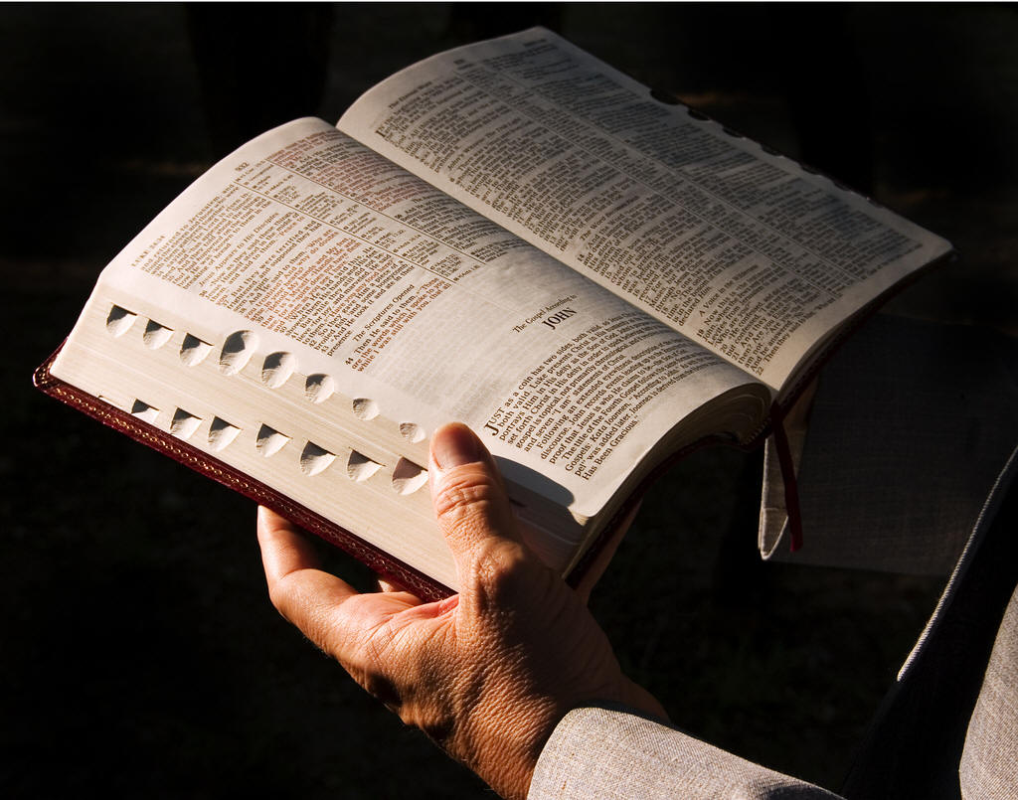
“All That the Lord Has Spoken We Will Do”
Special Treasure
  Isaiah 43:1-4
  Titus 2:14
  1 Peter 2:9-10
Kingdom of Priests
  Revelation 1:6
  1 Peter 2:9
Richie Thetford www.thetfordcountry.com

Slide 4

“All That the Lord Has Spoken We Will Do”
Holy Nation
  Leviticus 19:2
  1 Peter 1:15-16
Mediator
  1 Timothy 2:5
  Hebrews 7:25
  Philippians 2:5-11
Richie Thetford www.thetfordcountry.com

Slide 5
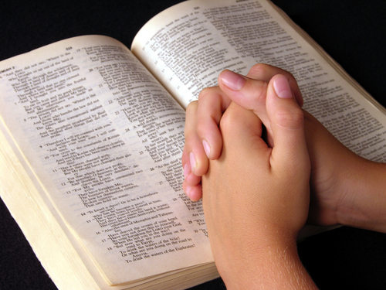
“All That the Lord Has Spoken We Will Do”
Sanctification
  John 17:17-19
Awe and Respect
  Hebrews 12:18-24, 28
Trumpet Sound
  1 Thessalonians 4:13-18
  1 Corinthians 15:52
Richie Thetford www.thetfordcountry.com

Slide 6
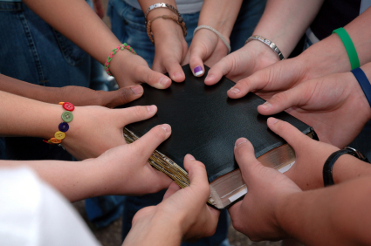
“All That the Lord Has Spoken We Will Do”
Richie Thetford www.thetfordcountry.com

