Slide 1

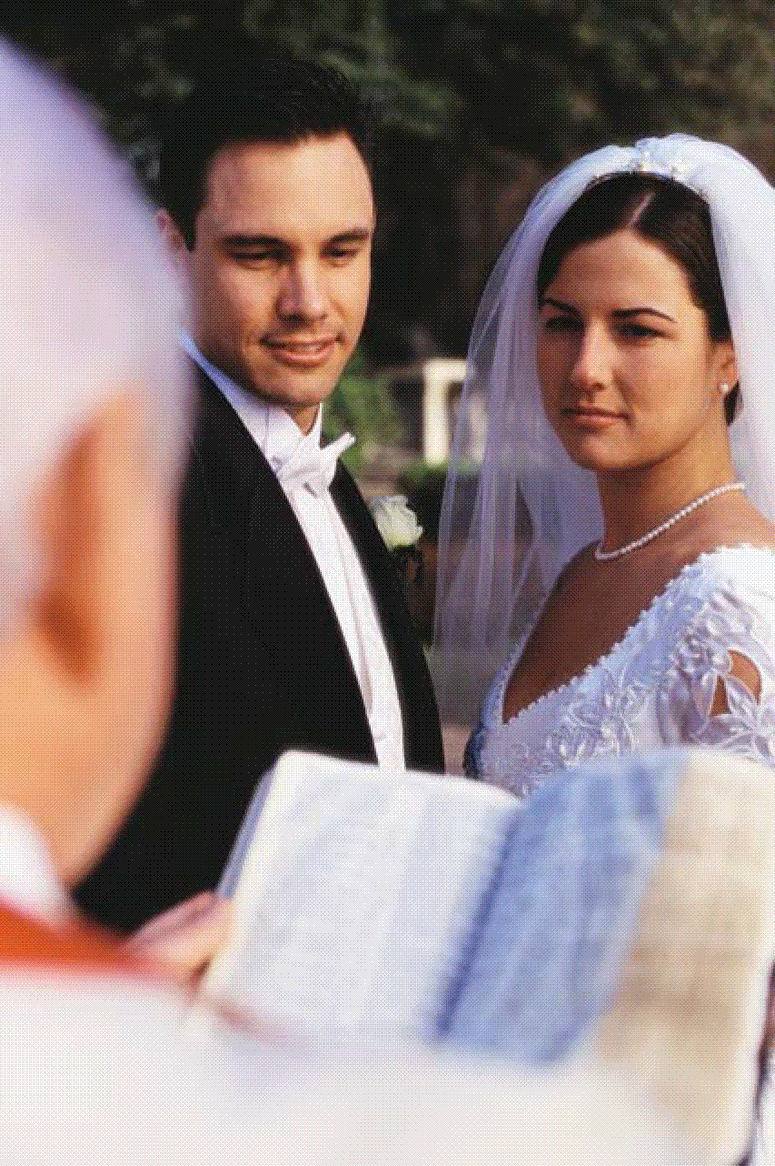
The Alien Sinner
And
Marriage
Is the alien sinner accountable to
God’s law on marriage?
Richard Thetford www.thetfordcountry.com

Slide 2
All Mankind is Accountable to God
God created us
  Isaiah 64:8
We belong to God
  Psalms 24:1; 2 Corinthians 5:10
Only a fool says “There is no God.”
  Psalms 14:1-2; Romans 1:18-21
If we deny Him, He’ll deny us (Matthew 10:33)
Richard Thetford www.thetfordcountry.com

Slide 3
All of Mankind Has Always Been Subject to God’s Law
Before the Flood – all subject
Law of Moses – all subject
  Galatians 3:10;
  Romans 1:28-32; 2:12-16
Law of Christ – all subject
  Daniel 7:13-14; John 12:48;
  Acts 3:22-23; Matthew 28:18
Richard Thetford www.thetfordcountry.com

Slide 4
Does the Lord’s Law of
Jesus teaches that
marriage is to be
regulated by God’s
original plan
Matthew 19:4-9
Colossians 3:5-7
1 Corinthians 6:9-11
Marriage
Apply to ALL Today?
Richard Thetford www.thetfordcountry.com

Slide 5
Does the Lord’s Law of
As long as she is
married to another man
(whom she is not
bound by God),
she shall continue to be called an adulteress
  Romans 7:2-3
Marriage
Apply to ALL Today?
Richard Thetford www.thetfordcountry.com

Slide 6
Does the Lord’s Law of
Repentance is
“A change of mind
coupled with a
change of action.”
Matthew 21:28-30
Marriage
Apply to ALL Today?
Richard Thetford www.thetfordcountry.com

Slide 7
Rule for all Mankind | Present Condition | Result after Baptized
One Man for One Woman Matthew 19:5-6 | Adultery = SIN | Quit Adultery
Don’t Steal Ephesians 4:28 | Steals = SIN | Quit Stealing
Don’t Lie Colossians 3:9 | Lies = SIN | Quit Lying
Be Baptized Acts 2:38; Mark 16:16 | Not Baptized = LOST | Saved
Richard Thetford www.thetfordcountry.com

Slide 8
God’s Law is for ALL of Mankind
God has established the rules for us
to follow in order to be saved and to be
free from sin in our life. We have the
FREEDOM TO CHOOSE
to obey His laws or reject them.
“And having been perfected, He became the author of eternal salvation to all who obey Him.”
HEBREWS 5:9
Richard Thetford www.thetfordcountry.com

