Slide 1
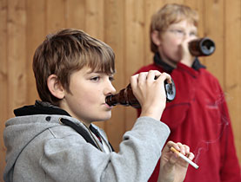
ADDICTED:
To the Ways of the World,
or the Ways of the Lord?

Slide 2
ADDICTED: To the Ways of the World?
Must not be an excuse maker
Luke 14:15-33
What are some of the things of this world that we can become addicted to?

Slide 3
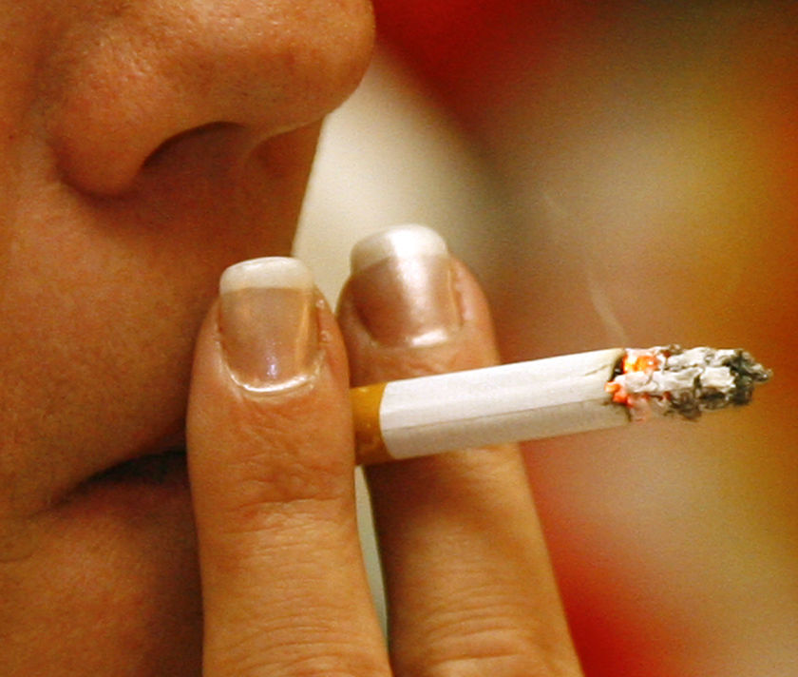
ADDICTED: To the Ways of the World?
Tobacco products
Proven to cause early death
Proven to cause innocent people to suffer
Hurts our influence on others
Matthew 5:16
1 Timothy 4:12
1 Corinthians 6:12, 19-20
Romans 6:12; 8:13
John 2:19-21

Slide 4
ADDICTED: To the Ways of the World?
Alcohol
Proven to cause early death
Proven to cause innocent people to suffer
Hurts our influence on others
Leviticus 10:9-10
1 Peter 1:15-16
1 Peter 2:5
1 Peter 2:9
2 Peter 3:11

Slide 5
ADDICTED: To the Ways of the World?
The things we choose to view
Can defile our mind
Hurts our influence
Luke 11:34-36
Any other worldly device
Things that lead us away, not closer to the eternal kingdom of God
Are we doing EVERYTHING in our body, God’s temple, for the glory of God?

Slide 6
ADDICTED: To the Ways of the LORD?
Be determined to serve God
Do what God has asked of us
1 Corinthians 15:58
Run the race to receive the crown!
1 Corinthians 9:24-27
Hebrews 12:1-3
2 Timothy 4:7-8
Our body to be a living sacrifice
Romans 12:1-2

Slide 7
Conclusion
Take away any form of worldliness that we may have
Become addicted to serving the Lord!
“Not everyone who says to Me, ‘Lord, Lord,’ shall enter the kingdom of heaven, but he who does the will of My Father in heaven.”
Matthew 7:21

