Slide 1
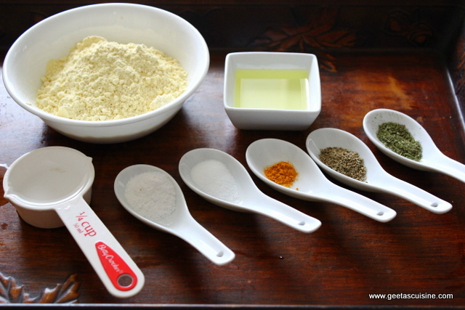
Active ingredients of godly sorrow
2 Corinthians 7:8-11
Richard Thetford www.thetfordcountry.com

Slide 2
Acknowledgment of sin
Will not run away from exposure
John 3:19-21
Must admit wrongdoing
2 Samuel 12:13
“He who covers his sins will not prosper, But whoever confesses and forsakes them will have mercy.”
Proverbs 28:13
Richard Thetford www.thetfordcountry.com

Slide 3
Hatred of the sin itself
Godly sorrow is more than embarrassment
Psalms 51:1-4
Must see sin as God sees it
Penitence
Psalms 38:1-8
Richard Thetford www.thetfordcountry.com

Slide 4
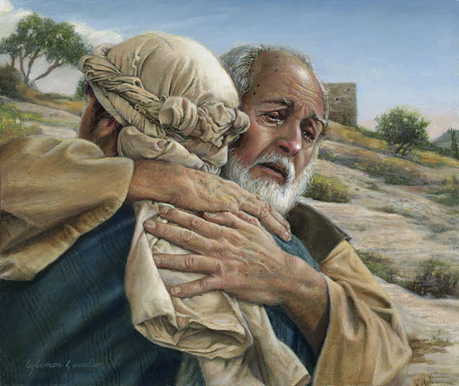
Shame
Some deeds are shameful
Prodigal son
Luke 15:17-21
Pharisee and the tax collector
Luke 18:9-14
Richard Thetford www.thetfordcountry.com

Slide 5
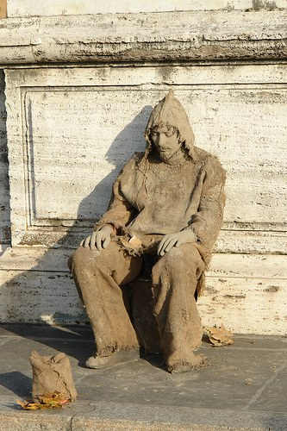
Remorse
Anguish of the soul
In the Old Testament it was often outwardly expressed in deep grief
Joel 2:12-13
Psalms 32:1-2
Richard Thetford www.thetfordcountry.com

Slide 6
Humility
Pride is at the heart of most sin
Godly Sorrow and humility go together
“draw near to God and He will draw near to you. Cleanse your hands, you sinners; and purify your hearts, you double-minded ….humble yourselves in the sight of the Lord….”
James 4:8-10
Richard Thetford www.thetfordcountry.com

Slide 7
conclusion
God promises relief to those who sorrow in a godly way
Isaiah 61:1-3
A Healthy Conscience
A Love for God
Honesty about the Truth
Richard Thetford www.thetfordcountry.com

