Slide 1
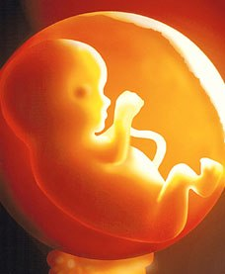
Abortion

Slide 2
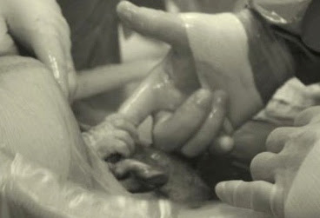
Holding Hands
The tiny hand of a fetus reaches out from a mother’s womb to clasp a surgeon’s healing finger.
Fetus is 21 weeks old, the legal age in which it could still be aborted. This baby is about to undergo a spine operation designed to save it from serious brain damage. The surgery will be performed without removing the tiny fetus from the womb. While this tiny baby is trying to be saved, thousands of others are aborted at this age in America every year.
Man is killing God’s breath of life!

Slide 3
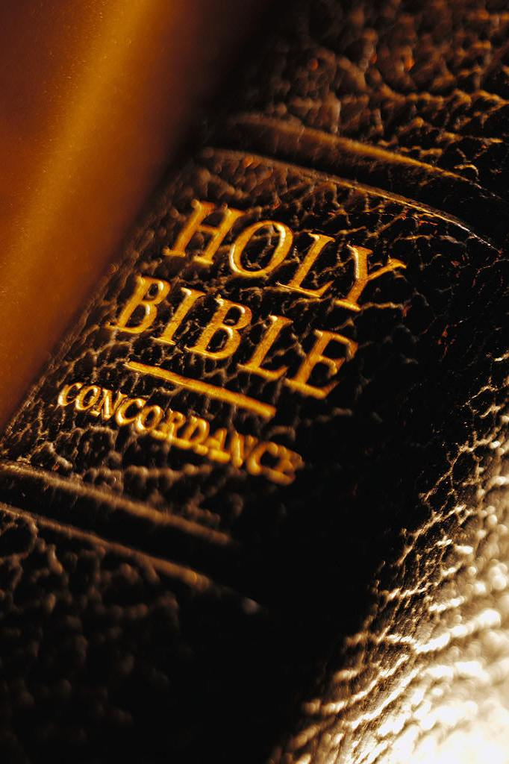
Abortion
What Does the Bible say?
Is it Sinful?

Slide 4
Why Do Abortions Occur?
Less than 1% of ALL abortions occur because of:
Rape
Incest
Birth defects
Mother’s life is in danger

Slide 5
Why Do Abortions Occur?
¾ of the women who have abortions do so because:
A baby would interfere with work, school, or other responsibilities
Cannot afford the child
½ don’t want to be a single parent
89-92% of abortions – before 13th week
8.1% between 14th and 21st week

Slide 6
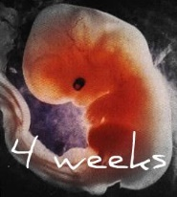
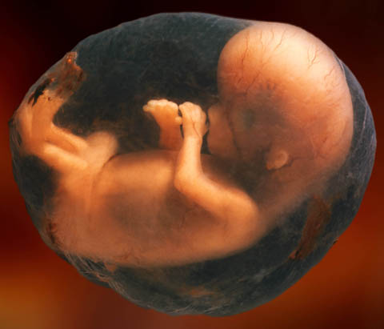
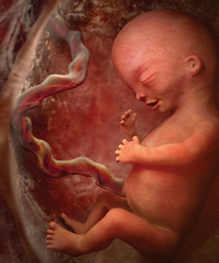
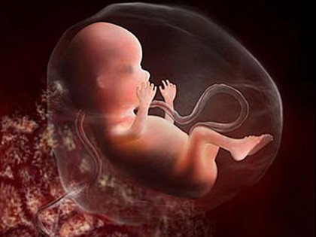
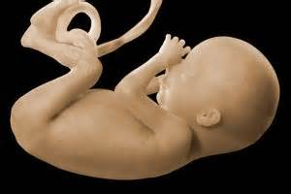
Various Stages of a Fetus
4 Weeks
8 Weeks
12 Weeks
16 Weeks
20 Weeks

Slide 7
Why Abortion is Wrong
Abortion is murder
“Murder” – the unlawful and malicious or premeditated killing of one human by another.”
Exodus 20:13
Genesis 9:6-7
Abortion is a pre-meditated decision to destroy the life of an unborn child, usually for selfish reasons

Slide 8
Why Abortion is Wrong
Abortion shows a disregard for human life
Genesis 1:26-27
Abortionists have a distinctly inferior view of human life
Children are a heritage to the Lord
Psalms 127:3
Psalms 128:3

Slide 9
Why Abortion is Wrong
Abortion usually performed for selfish reasons
Matthew 22:39
Philippians 2:4
Some reasons include:
Will interfere with my lifestyle
Will interfere with my mental health
Will cover up my fornication
Galatians 5:19; 1 Corinthians 6:9,18-20

Slide 10
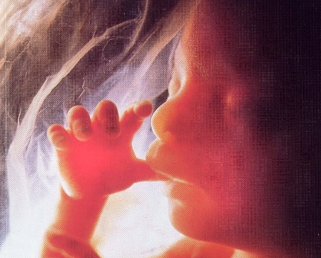
When Does Life Begin?
Pro-Abortionists reason that life does not begin until birth
Anti-Abortionists argue that life begins at the moment of conception
Luke 1:41
Jeremiah 1:5
Psalms 139:13-15
IS
Abortion IS A SIN which separates a person from the fellowship of God

