Slide 1

Richie Thetford www.thetfordcountry.com

Slide 2
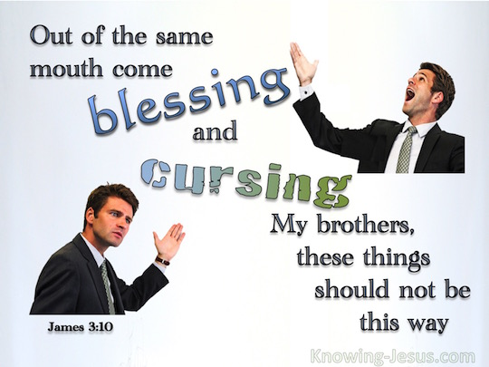
Introduction
The Tongue
  James 3:2, 8
  Matthew 12:37
  Proverbs 18:21
Richie Thetford www.thetfordcountry.com

Slide 3

Controlling the Tongue
Misuse
  James 3:8
Control
  Psalms 39:1
  1 Peter 3:10
  James 1:26; 3:3-4
Richie Thetford www.thetfordcountry.com

Slide 4

Sins Committed
Many Sins
  Slander (Proverbs 10:18)
  Whispering – Gossip (Romans 1:29)
  Foul Language (Ephesians 4:29)
  Lying (Revelation 21:8)
  Cursing (James 3:10)
  Double Tongue (1 Timothy 3:8)
Richie Thetford www.thetfordcountry.com

Slide 5

A Great Blessing
Good of man and glory of God
  Job 27:4
  Psalms 35:28
  Romans 15:6
  2 Corinthians 4:13
Richie Thetford www.thetfordcountry.com

Slide 6
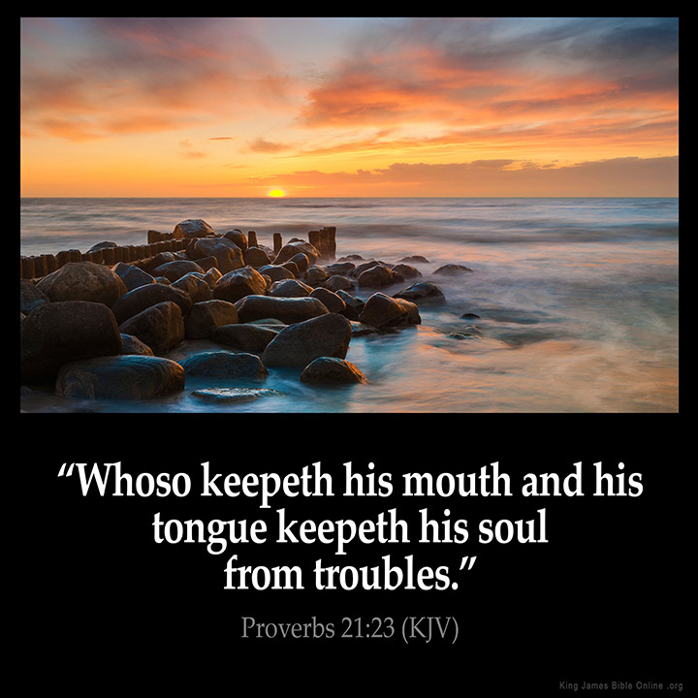
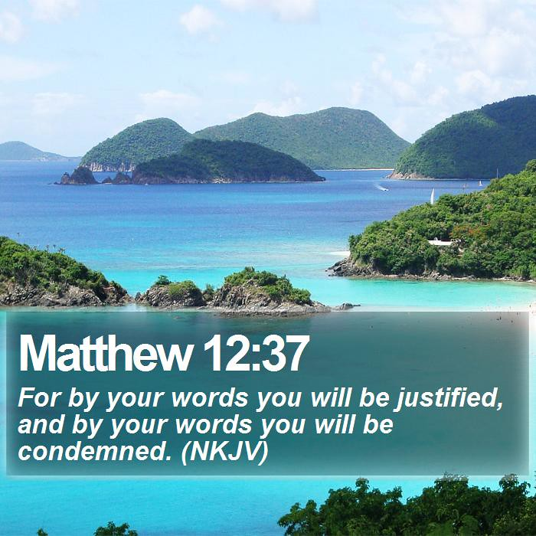
“A word fitly spoken is like apples of gold in pictures of silver”
Richie Thetford www.thetfordcountry.com

