Slide 1
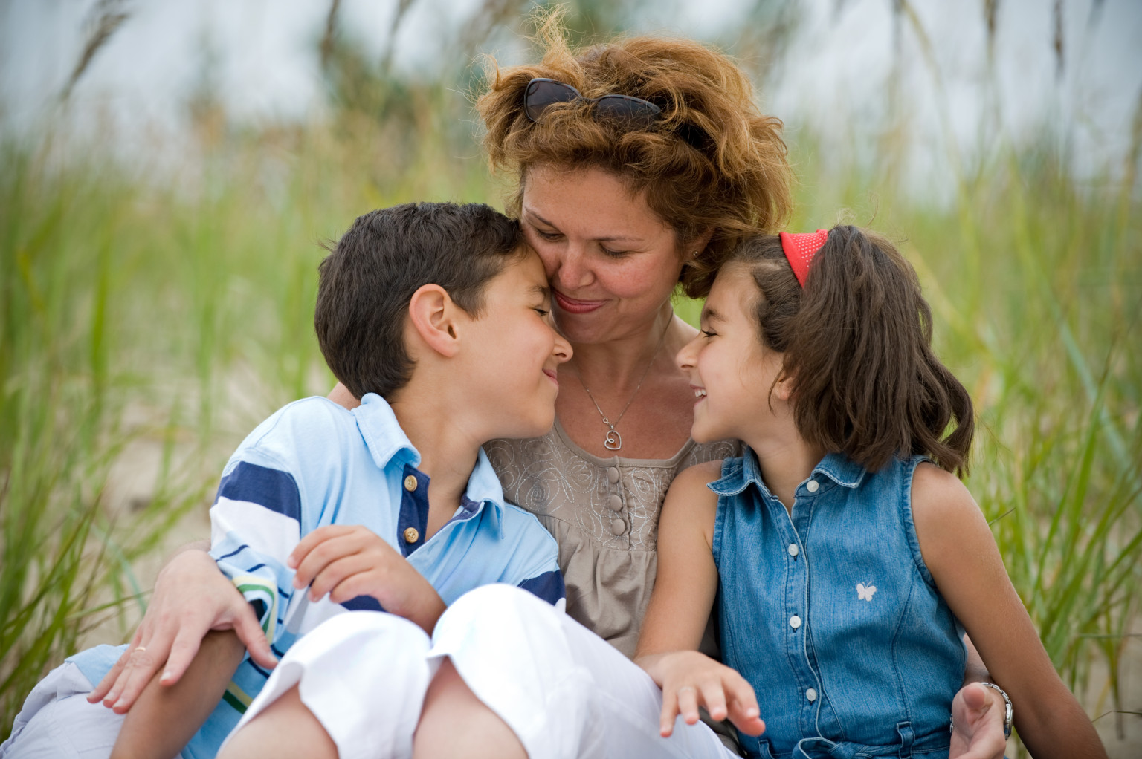

A Special Mother
Proverbs 31:28-29
Richie Thetford www.thetfordcountry.com

Slide 2

Never Leaves Her First Love
Mark 12:30
A great help to her husband
  Genesis 2:18
Submits to her husband’s headship
  Ephesians 5:22
Richie Thetford ww.thetfordcountry.com

Slide 3
Never Leaves Her First Love
Mark 12:30
Stands with her husband
  Proverbs 31:12
Her husband trusts in her
  Proverbs 31:11
Richie Thetford www.thetfordcountry.com

Slide 4
Cherishes Being a Mom
Mark 12:30
Trains her children in the laws of God
  Proverbs 1:8
  Proverbs 29:15
  Deuteronomy 6:4-9
  Ephesians 6:1-3
Richie Thetford www.thetfordcountry.com

Slide 5
Cherishes Being a Mom
Mark 12:30
A godly example for her children
  2 Timothy 1:3-5
Looks to the ways of her household
  Proverbs 31:27
  Proverbs 19:15
A God-fearing, loving mother
wanting the same for her household
Richie Thetford www.thetfordcountry.com

Slide 6
A Special Mother
1 John 4:19
One who exemplifies
the qualities that pleases our heavenly father
Richie Thetford www.thetfordcountry.com

