Slide 1

But the LORD said to Samuel, “Do not look at his appearance or at his physical stature, because I have refused him. For the LORD does not see as man sees; for man looks at the outward appearance, but the LORD looks at the heart.
1 Samuel 16:7
Richie Thetford www.thetfordcountry.com

Slide 2
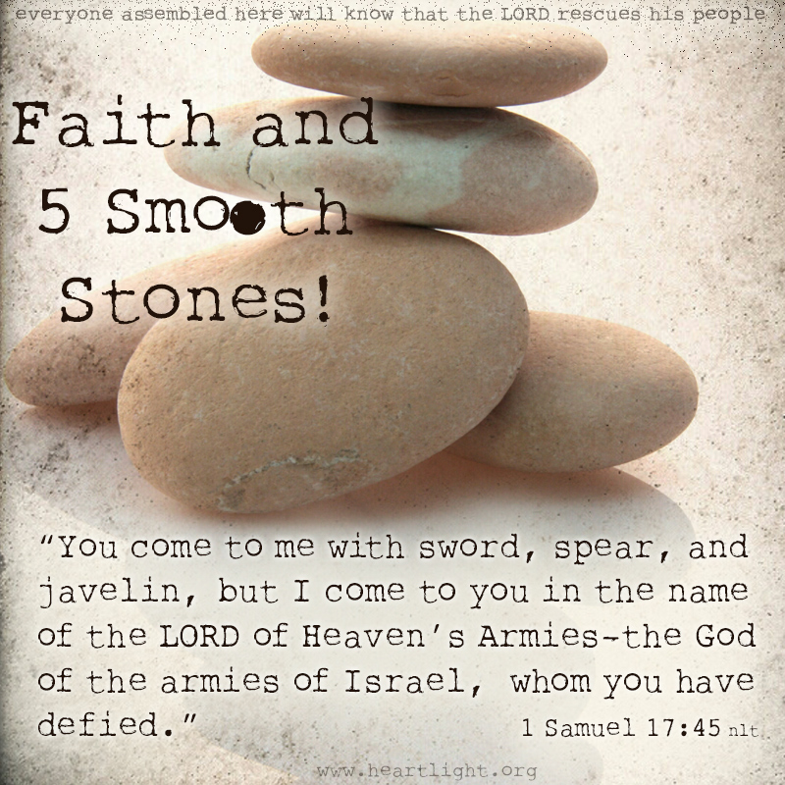
Faith and Trust
David’s trust illustrated
  Goliath
    1 Samuel 17:45-47
  The Flock
    1 Samuel 17:37
  Sin
    2 Samuel 24:14
Richie Thetford www.thetfordcountry.com

Slide 3
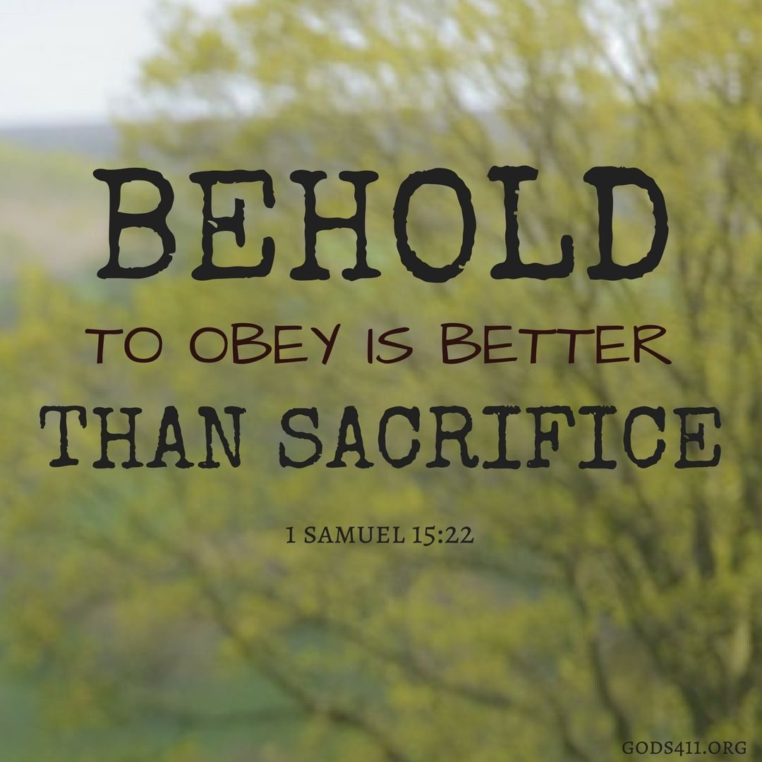
Duty and Humility
David’s devotion to duty
  Saul
    1 Samuel 15:22
  David
    Psalm 131
    Psalm 119
Richie Thetford www.thetfordcountry.com

Slide 4

Respect for Authority
Respect for God
  Psalm 119:137
  Psalm 119:105
  Psalm 119:89
  Psalm 119:104
Obedience to God’s Word
  1 Samuel 24:10
  1 Peter 2:17
Richie Thetford www.thetfordcountry.com

