Slide 1
A GOSPEL MEETING
One of the church’s greatest assets - God’s power to save
Romans 1:16
Gospel is an enduring message
1 Peter 1:24-25
Failure to obey the gospel will result in eternal destruction
2 Thessalonians 1:7-9
Richard Thetford www.thetfordcountry.com

Slide 2
A GOSPEL MEETING
Cornelius
Sends for a preacher that God recommends
Acts 10:24-35
Before Peter’s arrival he got things ready
Acts 10:24, 33
“…we are all present before God”
Richard Thetford www.thetfordcountry.com

Slide 3
A GOSPEL MEETING
What Can We Learn from Cornelius?
He sent for a preacher to hear the good news
Ezra 7:10; Ephesians 4:15
Peter came prepared to preach
Cornelius got things ready to hear
Acts 10:33
Richard Thetford www.thetfordcountry.com

Slide 4
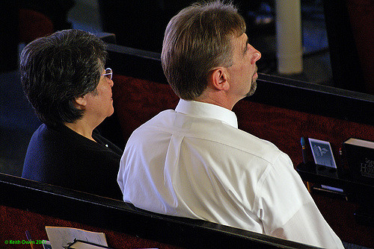
A GOSPEL MEETING
What A Gospel Meeting Can Do
Can create faith
Romans 10:13-17
Can save souls
Mark 16:16; John 8:32; Titus 2:11-12
Can allow us to keep what we’ve got
Acts 20:32; 2 Corinthians 13:5; 2 Peter 1:12-13; Galatians 5:7
Richard Thetford www.thetfordcountry.com

Slide 5
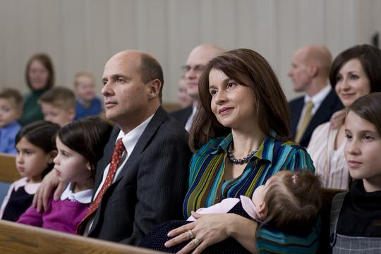
A GOSPEL MEETING
What Can We Do To Make This Gospel Meeting A Success?
Pray
Be present at all the services
Invite others to hear the good news!
Sing with the spirit and understanding
Be very friendly toward those visiting
Be encouraging to all
Come prepared to study and learn
Richard Thetford www.thetfordcountry.com

