Slide 1
A Fountain for Sin
Richie Thetford www.thetfordcountry.com

Slide 2
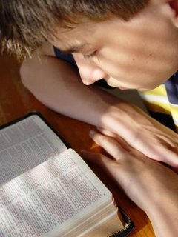
In That Day
They will see the one they pierced
Zechariah 12:10
John 19:31-34
The idols will be cut off
Zechariah 13:2
They will strike the shepherd
Zechariah 13:7
Matthew 26:31
Richie Thetford www.thetfordcountry.com

Slide 3
A Fountain of Blood
Not animal blood
Hebrews 10:1-4
Will flow from Jesus
Hebrews 9:12-14
Only Jesus’ blood can redeem us
1 Peter 1:18-19
Jesus’s blood washes, cleanses, and reconciles us
Revelation 1:5; Acts 22:16; 1 John 1:7; Colossians 1:19-21
Richie Thetford www.thetfordcountry.com

Slide 4
Our Obligations
Be a living sacrifice for Him
Romans 12:1-2
Live for Him
2 Corinthians 5:14-15
Serve Him and Follow Him
Luke 9:23 “take up His cross”
Embrace the challenges
A total commitment
Deny self
Associate with Christ
Have you been washed in the blood?
Have you been baptized to wash away sins?
Why are you waiting?
Richie Thetford www.thetfordcountry.com

