Slide 1
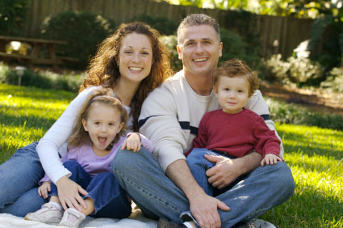
A Faith That Will Not Shrink
Hebrews 6:9-12
Richard Thetford www.thetfordcountry.com

Slide 2
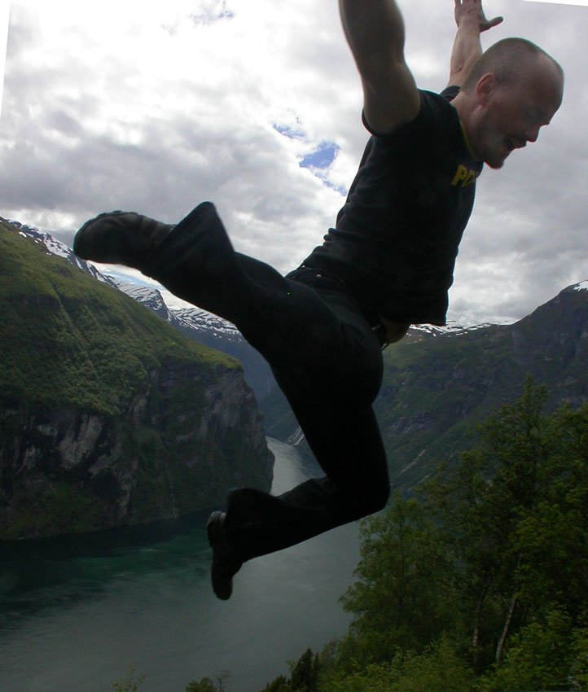
Persecution
The godly will suffer persecution
  2 Timothy 3:12
  Matthew 5:10-12
Some fall away when
faced with persecution
  Matthew 13:20-21
  Hebrews 6:4-6
Richard Thetford www.thetfordcountry.com

Slide 3

Persecution
The righteous remain faithful when persecuted
  Hebrews 10:38-39
  1 Peter 5:8-10
  James 5:10-11
These individuals possessed a faith that would not shrink – even in the face of persecution!
Richard Thetford www.thetfordcountry.com

Slide 4
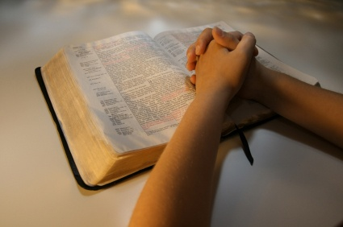
Discipline / Correction
Christians must expect correction
  Proverbs 10:17
  Proverbs 12:1
  2 Timothy 3:16
Those who refuse
correction are foolish
  Proverbs 13:8
  Proverbs 15:5, 32
Richard Thetford www.thetfordcountry.com

Slide 5
Discipline / Correction
Why is accepting correction so difficult for many Christians?
1 Timothy 6:3-5
May we all possess a faith that will not shrink – even in the face of correction
Richard Thetford www.thetfordcountry.com

Slide 6
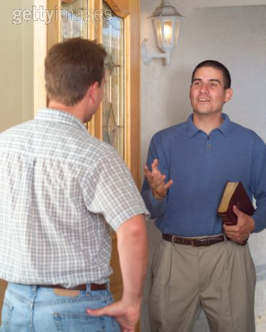
Evangelism
We must be involved in personal evangelism
  Matthew 28:18-20
  Matthew 9:37-38
What is standing in our way?
Ignorance?
Lack of Love?
Fear?
Richard Thetford www.thetfordcountry.com

Slide 7

Evangelism
Don’t be afraid to speak the truth of the gospel of Christ to others
  1 John 4:18
  1 Peter 3:13-15
  Hebrews 13:6
Oh for a faith that will not shrink in the face of
personal evangelism
Richard Thetford www.thetfordcountry.com

