Slide 1
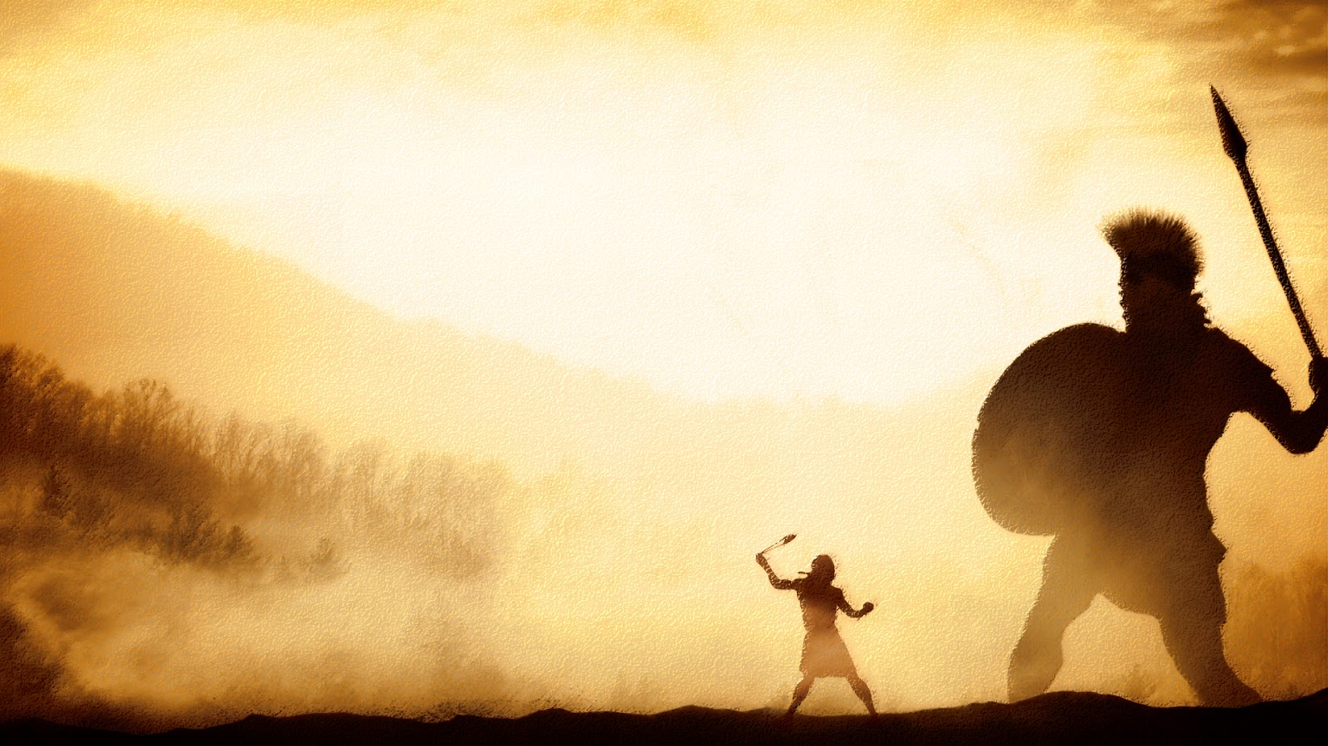
A Courageous Man
1 Samuel 17:40-50
Richard Thetford www.thetfordcountry.com

Slide 2
David Was Zealous
Incensed at the challenge of Goliath
  1 Samuel 17:26, 36
Apostle Paul’s zeal
  Romans 1:15-17
  Acts 20:31-32
Christians encouraged to have zeal
  1 Corinthians 15:58
  Galatians 6:9
  Titus 2:14
  Jude 3
Richard Thetford www.thetfordcountry.com

Slide 3
David Was Courageous
Had reason not to be
  1 Samuel 17:4-7
  1 Samuel 17:32, 45-47
Others had this kind of courage
  Jesus
  Peter
Christians should have courage
  Physical – Matthew 10:27-28
  Mental – Acts 17:18-21, 32
Richard Thetford www.thetfordcountry.com

Slide 4
David Was Equipped
Not as the giant Philistine
  1 Samuel 17:38-40
  1 Samuel 17:37
Others had this kind of faith
  Daniel
  Samson
  Shadrach, Meshack, Abednego
Christians need to be well equipped
  Ephesians 6:10-17
  Romans 10:17
Richard Thetford www.thetfordcountry.com

Slide 5
David Was Victorious
Because God was with him
  1 Samuel 17:46-50
Christians are victorious when
we trust in God
  Romans 8:31-33, 35-37
Let us consider, as David did before he engaged in battle
----- that the battle is God’s!
Richard Thetford www.thetfordcountry.com

