Slide 1

A Blind Man Who Sees
John 9
John 20:30-31
Matthew 13:15
Richie Thetford www.thetfordcountry.com

Slide 2
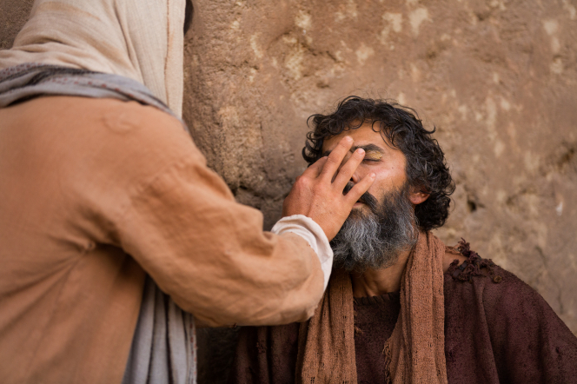
The Blind Man
His condition
  Blind from birth
His situation
  A sinner?
    John 9:2
    John 9:34
    John 9:3
Richie Thetford www.thetfordcountry.com

Slide 3
The Blind Man
The Miracle
  Many unwilling to believe it
    John 9:8-10
There were too many witnesses that
testified to the truth of the matter
Richie Thetford www.thetfordcountry.com

Slide 4
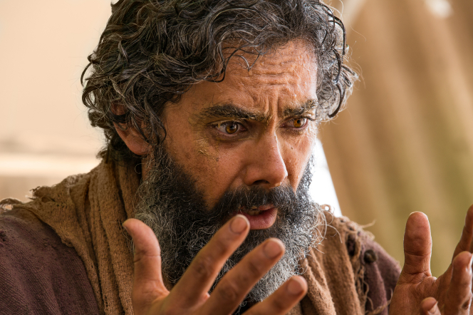
What the Blind Man Saw
No Reason to Deny Jesus
  John 9:11
  Matthew 10:32-33
That it Was a Great Work
  John 9:25
  Psalms 19:1
  Psalms 40:5
Richie Thetford www.thetfordcountry.com

Slide 5
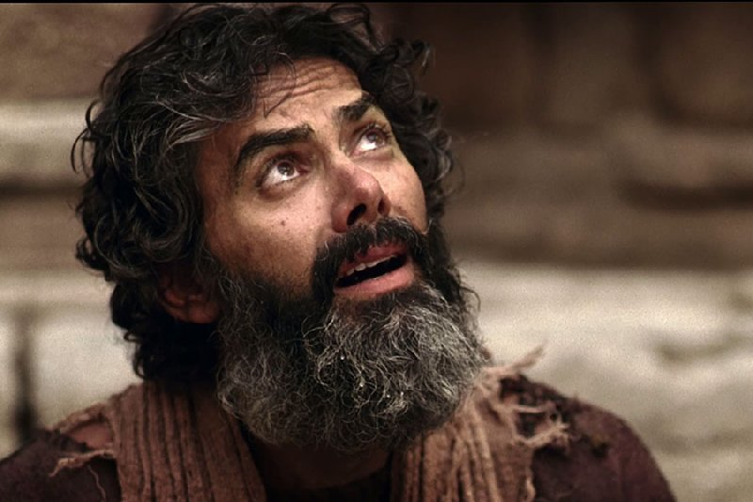
What the Blind Man Saw
Jesus Was a Prophet of God
  John 9:17
  John 9:33
  1 Peter 3:15
  John 20:30-31
Richie Thetford www.thetfordcountry.com

Slide 6
What the Blind Man Saw
Truth Was More
Important Than Man’s Approval
  John 9:27
  2 Timothy 4:2-4
Richie Thetford www.thetfordcountry.com

Slide 7
What the Blind Man Saw
Jesus Was Worthy of Belief and Worship
  John 35-38
  John 8:24
  Revelation 5:12
Richie Thetford www.thetfordcountry.com

Slide 8

Conclusion
Blind Man Saw MORE Than
Those with Sight
  John 9:39-41
They Would NOT SEE
  Matthew 13:13
Richie Thetford www.thetfordcountry.com

Slide 9

A Blind Man Who Sees
Never Deny Jesus
Recognize the value of Truth
Recognize Jesus as being worthy of our belief and worship
Do we really SEE
what the blind man SAW?
Richie Thetford www.thetfordcountry.com

