Slide 2
Christian Characteristics
SELF-CONTROL
2 Peter 1:5-10
“self-restraint in conduct, expression, indulgence of the appetites, etc.”
(Webster)
“the virtue of one who masters his desires and passions, especially his sensual appetites” (Unger’s Bible Dictionary)
Richard Thetford www.thetfordcountry.com

Slide 3
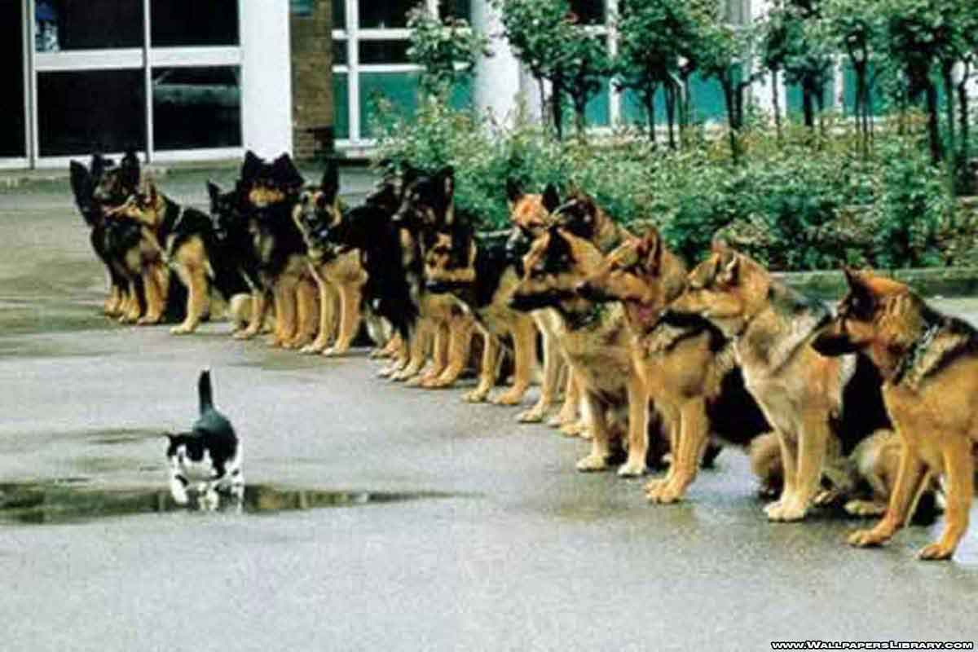
Self-Control Exemplified
“All things are lawful for me, but all things are not helpful. All things are lawful for me, but I will not be brought under the power of any.” 1 Corinthians 6:12
Richard Thetford www.thetfordcountry.com

Slide 4
Self-Control Commanded
Something we must pursue
2 Peter 1:5-10
A qualification to be an elder
Titus 1:8
Aged men to be temperate
Titus 2:2
All are to live “soberly”
Titus 2:12
Soberly:
“not drunk; not extreme or extravagant; characterized by reason”
(Webster’s New World Dictionary)
Richard Thetford www.thetfordcountry.com

Slide 5
Where Self-Control is Needed
With respect to habits or conduct
Daniel - Daniel 1:8
Joseph - Genesis 39:7-12
Jesus - 1 Peter 2:23
With respect to our language
Bridle our tongue
James 3:3-10; Ephesians 4:29; Psalms 39:1
“habits are first cobwebs, then cables”
Richard Thetford www.thetfordcountry.com

Slide 6
Where Self-Control is Needed
With respect to tattling or gossip
Caution is needed
1 Timothy 5:13
2 Thessalonians 3:11
1 Peter 4:15
“Some people will believe anything if it is whispered to them”
Richard Thetford www.thetfordcountry.com

Slide 7
Where Self-Control is Needed
With respect to covetousness
Covetousness strictly forbidden
Romans 13:9
Ephesians 5:3
A desire for wealth often leads to ruin
1 Timothy 6:9-12
Acts 20:33
Richard Thetford www.thetfordcountry.com

Slide 8
Where Self-Control is Needed
With respect to fleshly desires
Passions must be controlled
Romans 13:14
1 Peter 2:11
1 John 2:16
1 Corinthians 9:27
If we do not get involved with fleshly things, then we can not be overcome by them
Richard Thetford www.thetfordcountry.com

Slide 9
Where Self-Control is Needed
With respect to anger
Naaman
2 Kings 4:12
Must be restrained
Proverbs 16:32
Ephesians 4:26
James 1:19-20
Often leads to revenge
Romans 12:17-19; 1 Thessalonians 5:15
“It is he who is in the wrong who first gets angry”
Richard Thetford www.thetfordcountry.com

Slide 10
Self-Control
Galatians 5:23
Must Be Cultivated in Our Life!
Attitude!
Attitude!
Attitude!
Now as he reasoned about righteousness, self-control, and the judgment to come, Felix was afraid and answered, “Go away for now; when I have a convenient time I will call for you.” Acts 24:25
Richard Thetford www.thetfordcountry.com

