Slide 1
LIBERALISM
Church Cooperation
Can churches do every kind of work that is
right for individual Christians to do?
Can individual Christians do certain kinds of work which the church has no scriptural right to do?
Richie Thetford www.thetfordcountry.com

Slide 2
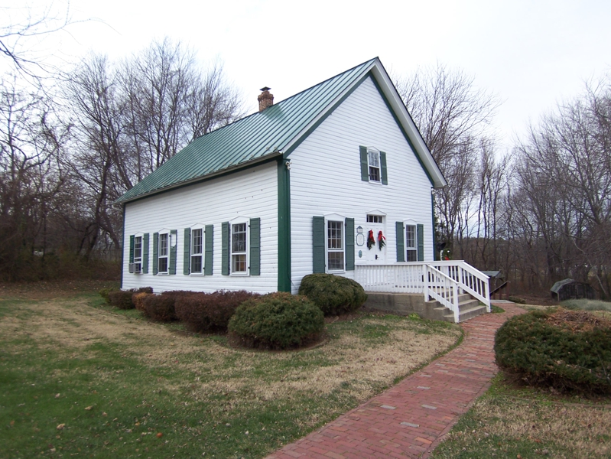
Church Cooperation
Teaching God’s Word is a Work of the Church
Church is to be the ground of truth
1 Timothy 3:15; Ephesians 3:8-11
Philippi sent contributions directly to Paul
Philippians 4:15-17
Churches cooperated in preaching in distant places
2 Corinthians 11:8
Richie Thetford www.thetfordcountry.com

Slide 3
Church Cooperation
Teaching God’s Word is a Work of the Church
The scriptures teach that each individual congregation (local church) sent funds for the purpose of evangelism or benevolence directly to the individual or to the church that had need
Richie Thetford www.thetfordcountry.com

Slide 4
Church Cooperation
Ways in Which New Testament churches DID NOT Cooperate in the Work of Preaching the Gospel
One church appointed itself to be a “sponsoring church” and selected and appointed preachers
Bible Passage?
“Sponsoring church” fixed wages and decided where the preachers would go
Bible Passage?
Richie Thetford www.thetfordcountry.com

Slide 5
Church Cooperation
Ways in Which New Testament churches DID NOT Cooperate in the Work of Preaching the Gospel
Why is this kind of cooperation wrong?
It destroys the autonomy, independence, and self-respect of the cooperating churches
There is NO Bible Authority!
Richie Thetford www.thetfordcountry.com

Slide 6
Church Cooperation
Churches Cooperated in Benevolent Work
By sending contributions to the churches in Judea for the saints
Acts 11:27-30; 12:25; Romans 15:25-26; 1 Corinthians 16:1-4; 2 Corinthians 8:1-4; 9:1-15; Acts 24:17
Richie Thetford www.thetfordcountry.com

Slide 7
Church Cooperation
Churches Cooperated in Benevolent Work
In appointment of messengers to travel among churches
2 Corinthians 8:18-24
In the use of same agents to transport funds to churches
Acts 11:29-30; 12:25; 24:17; 2 Cor 8:20-21
Richie Thetford www.thetfordcountry.com

Slide 8
New Testament Benevolence
Individual | Church To Its Own | Church To Church(es) | Church to Benevolent Org/Sponsoring Church
Matt 5:43-48 | Acts 2:44-45 | Acts 11:27-30 | ?
Matt 25:35-40 | Acts 4:32-35 | Rom 15:25-32 | ?
Luke 10:30-37 | Acts 6:1-6 | 1 Cor 16:1-3 | ?
Acts 9:36-39 | 1 Tim 5:16 | 2 Cor 8 | ?
Acts 20:34-35 |  | 2 Cor 9 | ?
1 Cor 16:15 |  |  | ?
Eph 4:28 |  |  | ?
1 Tim 5:4, 16 |  |  | ?
1 Tim 6:17-18 |  |  | ?
James 1:26-27 |  |  | ?
James 2:15-18 |  |  | ?
1 John 3:17-18 |  |  | ?
God’s Word PROVES That This IS Unquestionably Right!

Slide 9
Church Cooperation
Ways Churches DID NOT Cooperate in Supplying the Needs to the Poor Saint
Didn’t send funds to any church where the saints were in no greater need
When the famine was over -- no longer a need to continue sending the relief
Churches should contribute when a famine strikes a church (2 Corinthians 8:21)
Richie Thetford www.thetfordcountry.com

Slide 10
The UNScriptural Plan
Local
Church
Evangelism
Benevolence
Edification
Sponsoring
Church
over
Local
Church
Local
Church
Richie Thetford www.thetfordcountry.com

Slide 11
The Scriptural Plan
Members
Evangelism
Worship
Benevolence
Discipline
Every
Local
Church
Over its own
1 Timothy 3:5; Acts 20:28; 1 Peter 5:2; Hebrews 13:17; 1 Timothy 5:17
Richie Thetford www.thetfordcountry.com

Slide 12
LIBERALISM
Church Cooperation
Make sure ALL we do in the name of religion is based on Bible authority
Practicing anything without Bible authority is sinful Matthew 15:9; Jeremiah 10:23
Richie Thetford www.thetfordcountry.com

Slide 13
LIBERALISM
Church Cooperation
The true child of God will search the scriptures for truth
2 Timothy 3:1-5; 2 John 9-11
When we fellowship error, we are partakers of that error
Richie Thetford www.thetfordcountry.com

