Slide 1
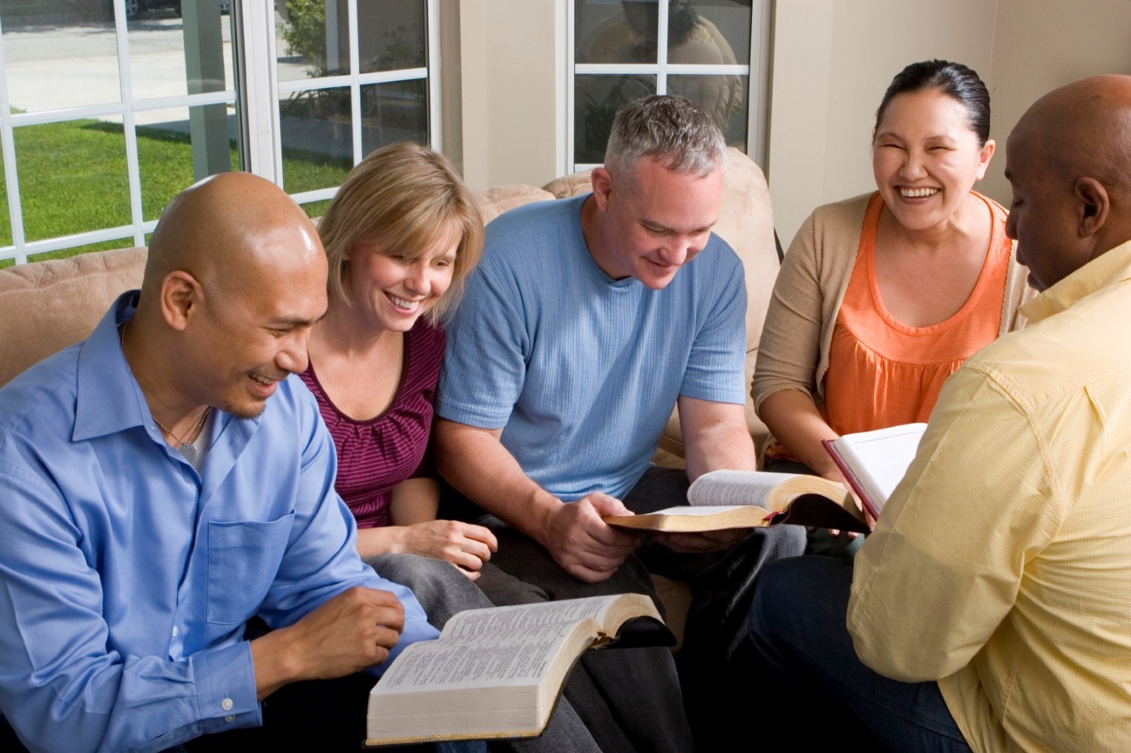
Building Our Faith….

Slide 2
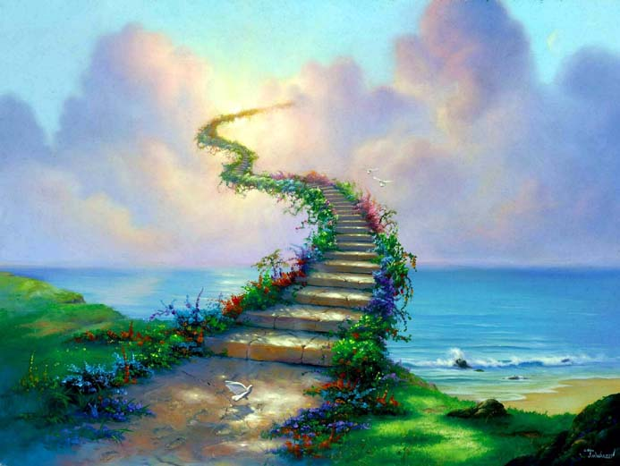
Building Our Faith…. ….Through the Heavenly Hope
Hebrews
11:11-16,
39-40

Slide 3
Heavenly Hope
“for he waited for the city which has foundations, whose builder and maker is God”
These had not received the promises
Having been assured of them
Looking for a heavenly home!
Hebrews 11:10

Slide 4
Heavenly Hope
“for he waited for the city which has foundations, whose builder and maker is God”
Abraham obtained the promise
The promise of God
Promise is still in the future for Christians today
Revelation 21:2
John 14:2-3

Slide 5
Race of Faith
“let us run with endurance the race that is set before us”
Run the race based on “the cloud of witnesses”
Evidenced by those in Hebrews 11
If they could overcome trials of life, based on faith – then we can to!

Slide 6
Race of Faith
“let us run with endurance the race that is set before us”
As a result we are encouraged to:
We must confront that which keeps us from conforming to God’s word
2 Corinthians 13:5
“lay aside every weight, and the sin which so easily ensnares us.”

Slide 7
Race of Faith
“let us run with endurance the race that is set before us”
As we run the race, look toward Jesus
Hebrews 5:9
Jesus endured the cross – let us not become weary
Galatians 6:9

Slide 8
“Yes, and all who desire to live godly in Christ Jesus will suffer persecution.”
2 Timothy 3:12
ABEL – Suffering

Slide 9
“Therefore, my beloved brethren, be steadfast, immovable, always abounding in the work of the Lord, knowing that your labor is not in vain in the Lord.”
1 Corinthians 15:58
ENOCH – Steadfastness

Slide 10
“For we were saved in this hope, but hope that is seen is not hope; for why does one still hope for what he sees? But if we hope for what we do not see, we eagerly wait for it with perseverance.”
Romans 8:24-25
NOAH – Perseverance

Slide 11
“And having been perfected, He became the author of eternal salvation to all who obey Him.”
Hebrews 5:9
ABRAHAM – Obedience

Slide 12
“But seek first the kingdom of God and His righteousness, and all these things shall be added to you.”
Matthew 6:33
MOSES – Dedication

Slide 13
“Therefore we also, since we are surrounded by so great a cloud of witnesses, let us lay aside every weight, and the sin which so easily ensnares us, and let us run with endurance the race that is set before us”
Hebrews 12:1-3
OTHERS – Endurance

