Slide 1
The Growth of the Church
“Faith”
Heaven
“Now faith is the substance of things hoped for, the evidence of things not seen.”
Hebrews 11:1

Slide 2
The Growth of the Church
“Faith”
Need for faith to allow growth
Colossians 1:23
Colossians 2:7
1 Corinthians 3:1-2
Hebrews 5:12-14
John 8:24
Hebrews 11:6

Slide 3
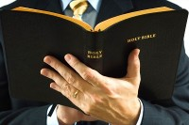
The Growth of the Church
“Faith”
Faith defined:
Now faith is the substance of things hoped for, the evidence of things not seen.
Hebrews 11:1
A whole-hearted acceptance of Christ and His way.

Slide 4
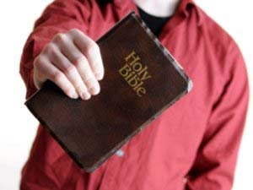
The Growth of the Church
“Faith”
Only one faith
Ephesians 4:4-6
Romans 10:17
2 Timothy 2:15
Hosea 4:6

Slide 5
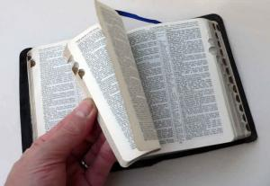
The Growth of the Church
“Faith”
Various degrees of faith
Little faith
Matthew 8:26
Great faith
Matthew 8:10
Strong faith
Romans 4:20

Slide 6
The Growth of the Church
“Faith”
Various degrees of faith
Weak faith
Romans 14:1
Active faith
James 2:14-18
Dead faith
James 2:26
Perfect faith
James 2:21-22

Slide 7
The Growth of the Church
“Faith”
Value of one faith
Saves us
Hebrews 10:39
Purifies the heart
Acts 15:9
Sanctifies
Acts 26:18

Slide 8
The Growth of the Church
“Faith”
Value of one faith
Justifies
Romans 5:8
Brings the crown of life
Revelation 2:10

Slide 9
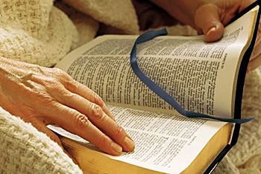
The Growth of the Church
“Faith”
How does the church grow by faith?
Regular attendance
Hebrews 10:25
Praying for others
1 Timothy 2:1-8
Liberal giving
1 Corinthians 16:2

Slide 10
The Growth of the Church
“Faith”
How does the church grow by faith?
Zealous teaching
2 Timothy 4:2
Lights shining
Matthew 5:16
Seeking God first
Matthew 6:33

Slide 11
The Growth of the Church
“Faith”
How does the church grow by faith?
Searching the scriptures
These were more fair-minded than those in Thessalonica, in that they received the word with all readiness, and searched the Scriptures daily to find out whether these things were so.
Acts 17:11

Slide 12
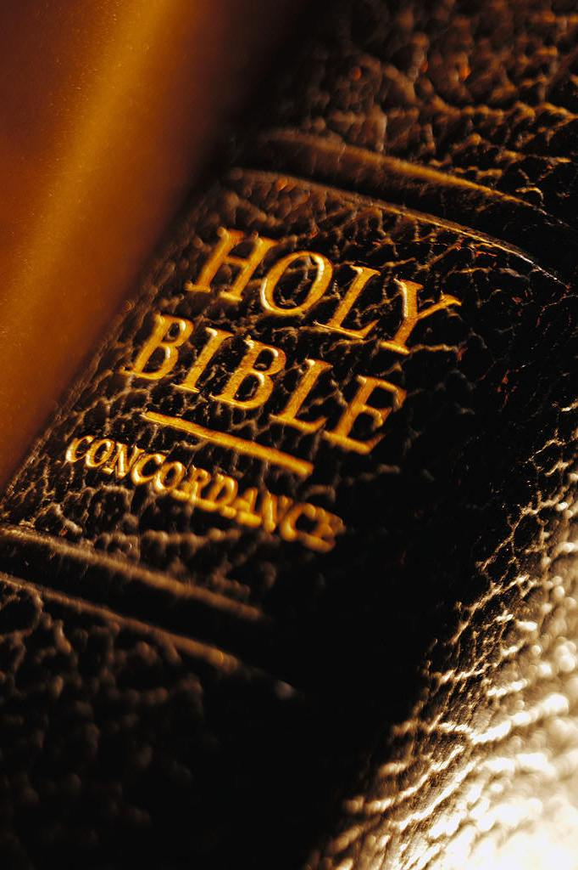
The Growth of the Church
“Faith”
As members grow in faith, the church can grow in members
How’s Your Faith?
Is it helping or hindering the church from growing?

