Slide 1
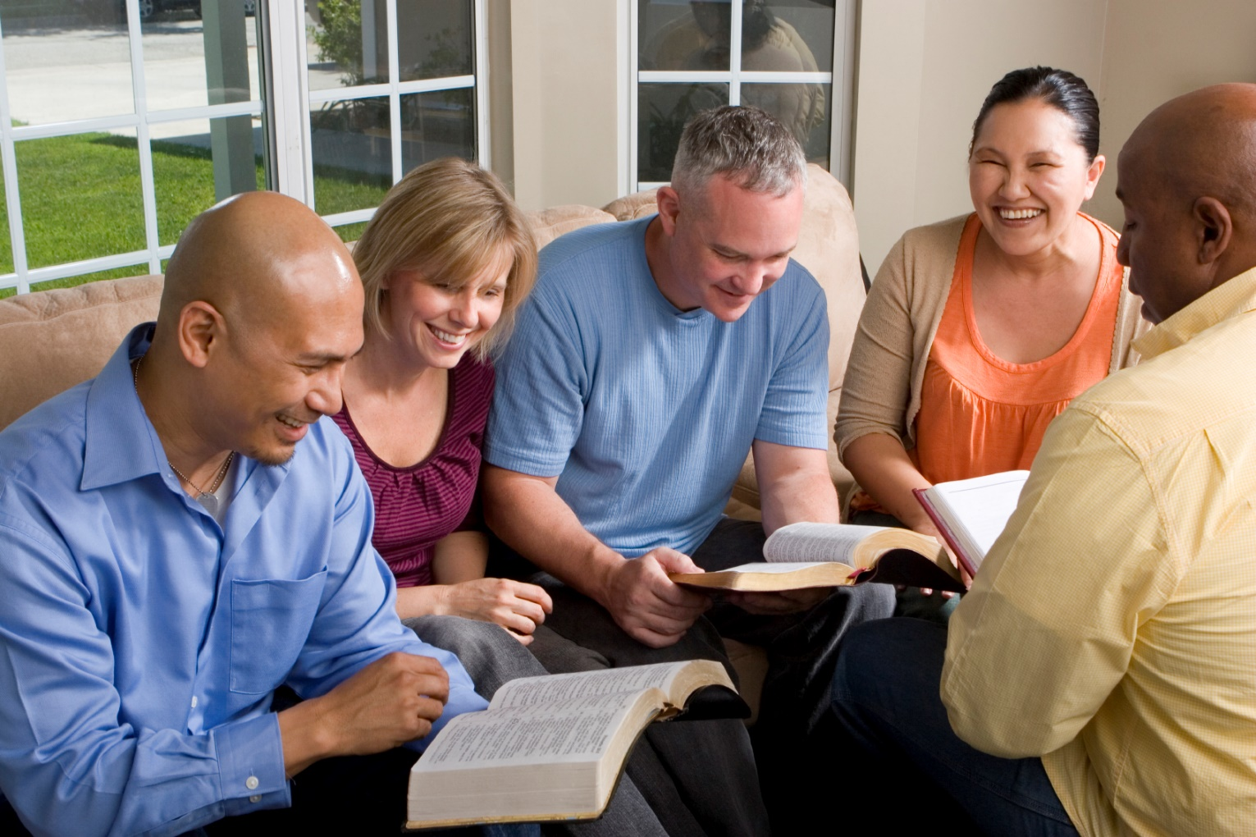
Building Our Faith….

Slide 2
Building Our Faith…. ….By the Examples of Others
Hebrews
11:11, 20-22, 30-34

Slide 3
Sarah
“because she judged Him faithful who had promised”
Sarah’s faith
Genesis 18:11-15
She had trust in God
Faith led her to believe she would have a son
When things go against all odds, our faith must kick in!

Slide 4
Isaac
“blessed Jacob and Esau concerning things to come”
Pronounced a blessing
Genesis 27:26-40
Isaac could not see in the future
Was acting only by faith

Slide 5
Jacob
“blessed each of the sons of Joseph and worshiped….”
Jacob blessed the sons of Joseph
He had confidence in God
He knew that God would provide

Slide 6
Joseph
“….made mention of the departure of the children of Israel”
Had complete faith in God
Genesis 50:24-25
Had faith in God’s spoken word
Made arrangement for the future
He knew it would happen – God said so!

Slide 7
Walls of Jericho
“fell down after they were encircled for seven days”
Historical event
Joshua 6:12-20
No physical force to bring them down
Power of God brought them down!
God keeps His promises

Slide 8
Rahab
“she had received the spies with peace”
A true faith is a faith that saves
Helped the messengers of God
Was rewarded for her faith
God uses people from all walks of life
Faith in God is realized when one decides to do His will

Slide 9
Others
“what more shall I say”
Gideon
Barak
Samson
Jephthah
David
Samuel
Prophets
More that have exhibited faith
“For bodily exercise profits a little, but godliness is profitable for all things, having promise of the life that now is and of that which is to come. This is a faithful saying and worthy of all acceptance. For to this end we both labor and suffer reproach, because we trust in the living God, who is the Savior of all men, especially of those who believe.” 1 Timothy 4:8-10
Key Thought: ENDURANCE – They endured tests of life!

