Slide 1
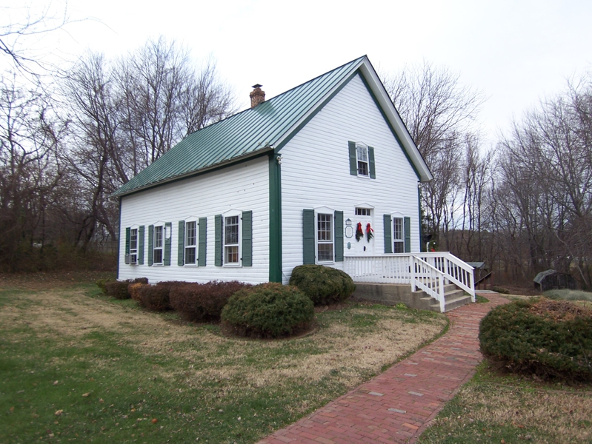
LIBERALISM
Fellowship Halls
and
Entertainment
John 17:21-22
Richie Thetford www.thetfordcountry.com

Slide 2
Definitions
Liberal
  “not restricted; not restricted to the literal meaning: as, a liberal interpretation of the law; broad-minded; favoring reform or progress, as in religion; not conservative”
Conservative
  “tending to preserve established institutions and methods and to resist or oppose any changes in these; prudent, safe”
Richie Thetford www.thetfordcountry.com

Slide 3
Definitions
Institutional
  “having the nature of an institution; in advertising – intended primarily to gain prestige rather than to increase immediate sales”
    Social get-togethers by “the church” seem to take precedence over souls
Anti
  “a person opposed to some policy, proposal, etc.;
  opposed; against”
Richie Thetford www.thetfordcountry.com

Slide 4
Definitions
Fellowship
  (Social) “a mutual sharing, as of activity, etc.” (meals, sports)
  (Spiritual) “Walking in the light of God”
Entertainment
  “interesting, diverting, or amusing thing, as a show or performance”
Richie Thetford www.thetfordcountry.com

Slide 5

Liberal
Not adhering to sound principles, for changes,
not bound by established forms
Trying to justify something or anything
without an appeal to the Bible
End justifies the means
  It gets people here – a “good work”
  Helps keep the young people off the street
  Community will look up to the church
  The denominations are doing it
Richie Thetford www.thetfordcountry.com

Slide 6

Conservative
Bible believing people who understand the scriptures have a different attitude toward divine authority
  Revelation 22:18-19; Galatians 1:6-8;
  2 John 9; 1 Corinthians 4:6;
  2 Timothy 3:16-17; John 8:32
Book, chapter, verse required for all
that is done in the name of religion
Richie Thetford www.thetfordcountry.com

Slide 7
Liberalism
Fellowship Halls and Entertainment
Invitations to come hear the gospel are being replaced today with invitations to “come help eat the world’s largest hot dog.”
When we leave the BIBLE then all things are possible!
Churches of Christ have gone to extremes to accommodate the social needs of the members
Churches of Christ seem to be trying to “keep up with the denominations of the world!”
Richie Thetford www.thetfordcountry.com

Slide 8
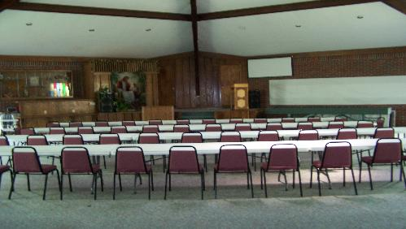
Liberalism
Fellowship Halls and Entertainment
Where is Bible authority to build, and or maintain a “fellowship hall” or to have church sponsored entertainment?
“We often have occasions such as fellowship dinners here in our Fellowship Hall. It's a nice place to get together with members of our congregation and converse with one another,
and just generally have a good time.”
(Lake Mount Church of Christ)
Richie Thetford www.thetfordcountry.com

Slide 9

Liberalism
Fellowship Halls and Entertainment
Many argue that it is a “good work”
  Galatians 6:10
Remember – for something to be expedient
it must first be lawful
“Good works” must be something we do
based on Bible authority
  Must “seek and save the lost” (Luke 19:10; Romans 1:16-17)
Richie Thetford www.thetfordcountry.com

Slide 10
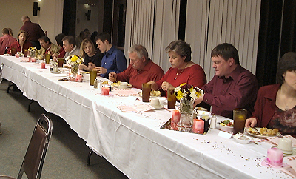
Liberalism
Fellowship Halls and Entertainment
We cannot find anywhere in the Bible for the church to sponsor parties & banquets!
  We cannot exercise an expedient if we don’t have a command or example to begin with
Church sponsored
“sweetheart banquet”
Linary church of Christ, Crossville, TN
Richie Thetford www.thetfordcountry.com

Slide 11
Liberalism
Fellowship Halls and Entertainment
Entertainment focuses upon what is agreeable to the person, while worship channels one’s attention to what is deserving of God.
In entertainment man is absorbed with his “likes.” In true worship, man is absorbed with his “God.”
Key
Points
to
Consider
Richie Thetford www.thetfordcountry.com

Slide 12

Liberalism
Fellowship Halls and Entertainment
True conversion is when man is drawn to Christ by the Father, not drawn by food or games or other things
  John 6:44-45
Key
Points
to
Consider
Richie Thetford www.thetfordcountry.com

Slide 13
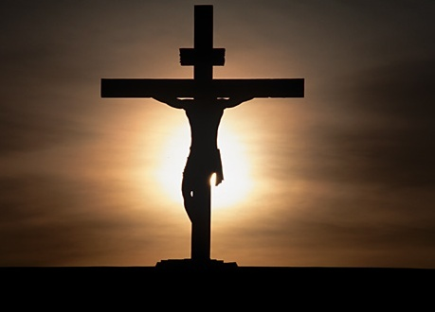
Liberalism
Fellowship Halls and Entertainment
Jesus’ blood was shed to purchase the church, a spiritual house with a spiritual mission
  Ephesians 5:25-27
  1 Peter 2:5
  1 Timothy 3:15
Richie Thetford www.thetfordcountry.com

Slide 14
Liberalism
Fellowship Halls and Entertainment
God made a distinction between the responsibility of the home and the responsibility of the church
“What! Do you not have houses to eat and drink in? Or do you despise the church of God and shame those who have nothing? What shall I say to you? Shall I praise you in this? I do not praise you.” 1 Corinthians 11:22
“for the kingdom of God is not eating and drinking,
but righteousness and peace and joy in the Holy Spirit.”
Romans 14:17
Richie Thetford www.thetfordcountry.com

Slide 15

LIBERALISM
Fellowship Halls
and
Entertainment
“soul center”
rather than a
“social center”
Richie Thetford www.thetfordcountry.com

