Slide 1
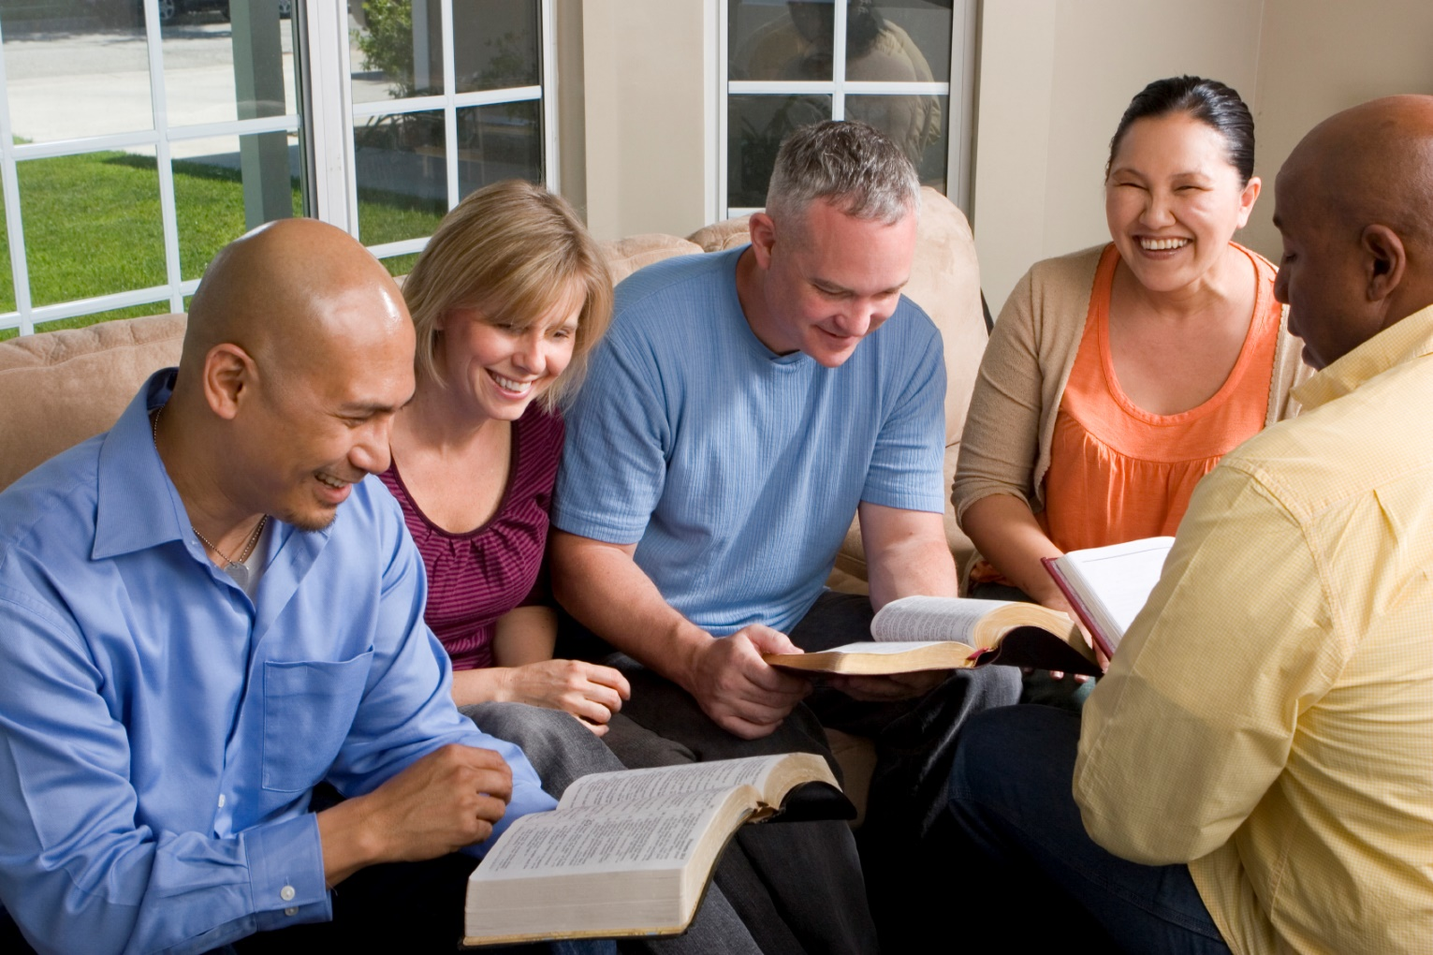
Building Our Faith….

Slide 2

Building Our Faith….
….By the Example of Moses
Hebrews
11:23-29
“choosing rather to suffer affliction”
An example of faith that we can certainly relate to

Slide 3

Moses
The Valleys
Taken from his parents as an infant
Raised in an idolatrous household
Taught as an Egyptian
  Acts 7:22
Rejected by his own people
  Acts 7:23-29

Slide 4
Moses
The Valleys
Not a born leader
  Exodus 3:10-11; 4:10-11
His wife opposed him
  Exodus 4:24-26
His brother made a golden calf
  Exodus 32:1-4

Slide 5
Moses
The Valleys
His sister and brother rebelled
  Numbers 14:10; Exodus 17:4
He rebelled at the waters of Meribah
  Numbers 20:7-12
Lost His opportunity to enter Canaan
  Deuteronomy 3:23-27

Slide 6
Moses
Two Elements in His Decision
The “negative” element
  He “refused”
    Hebrews 11:24
The “positive” element
  A full-fledged YES!
Moses had a longing hope of being with God
--- A faith that was always growing

Slide 7
Moses
His Decision was Costly
He had MUCH to give up
  We must also “count the cost”
    Luke 14:27-28
    Matthew 19:21-22
    Matthew 10:34-37

Slide 8
Moses
His Decision was Costly
In what he chose
  Chose suffering – Hebrews 11:25
  We must also “suffer persecution”
    2 Timothy 3:12
    John 16:33
He had faith that heaven is worth it!
  Psalms 73:2-17

Slide 9
Moses
Why Did He Make His Choice?
Distinguished right and wrong
  Hebrews 11:27
  Matthew 6:22-23
Pleasure of sin was only temporal
  Luke 6:25

Slide 10
Moses
Why Did He Make His Choice?
Knew what real values were
  Hebrews 11:26
  2 Corinthians 4:16-18
Knew his decision would result in an eternity with God!
  Matthew 7:13-14

Slide 11
Moses
Summary
Key verse – Hebrews 11:25
  “choosing rather to suffer affliction”
Key thought
  Dedication
    Dedicated to God in his choices
May we have a continual and abiding faith
in God as did Moses!

Slide 12

Conclusion
Noah – Perseverance
  “moved with godly fear”
Abraham – Obedience
  “obeyed when he was called”
Moses – Dedication
  “choosing to suffer affliction”
Hebrews 11:1
Hebrews 11:6
1 Corinthians 15:58
2 Corinthians 5:7

