Slide 1

Expediency
“suitability for a given purpose; appropriateness to the conditions; useful for effecting a desired result; suited to the circumstances or the occasion; advantageous; convenient”
(Webster’s New World College Dictionary)
Richie Thetford www.thetfordcountry.com

Slide 2
The Common Concept:
The end justifies the means, so anything that
will accomplish what we think to be good,
whether authorized or not, is permissible.
“results accomplished” does not authorize anything
In order for a thing to be a scriptural expedient it must
first facilitate in the accomplishment of God’s will
and must be in harmony with His word
Richie Thetford www.thetfordcountry.com

Slide 3
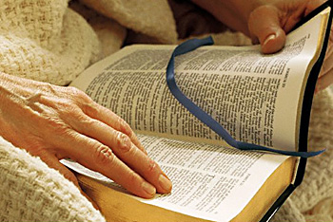
For A Thing To Be Expedient
It Must Be Lawful
All scriptural expedients are lawful
  Come within the realm of things authorized
  2 John 9-11; 2 Corinthians 5:7; Romans 14:23
We have no assurance that a thing
is pleasing unto God unless it is
authorized in the scripture
Richie Thetford www.thetfordcountry.com

Slide 4
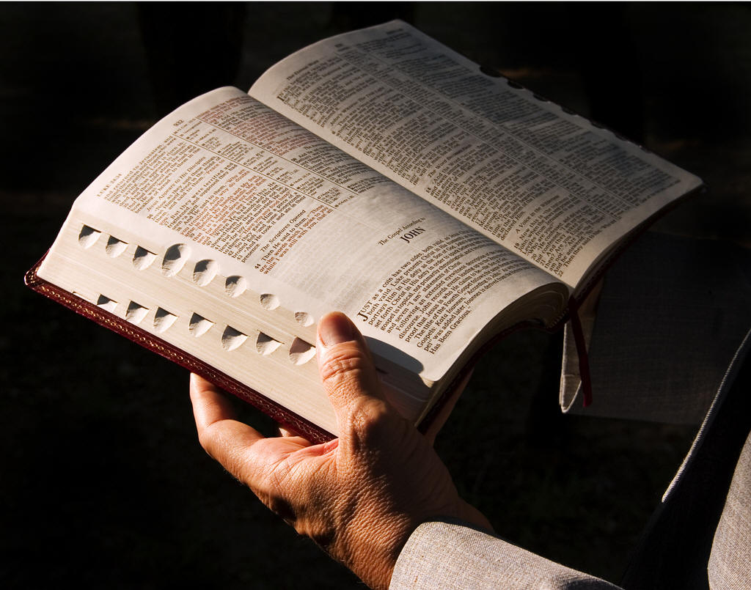
For A Thing To Be Expedient
It Must Be Lawful
Unlawful things cannot be expedients
  Men are not the source of authority
  Women preachers:
    1 Timothy 2:12
  David and the ox cart:
    1 Chronicles 13:7-10; 15:2
Richie Thetford www.thetfordcountry.com

Slide 5
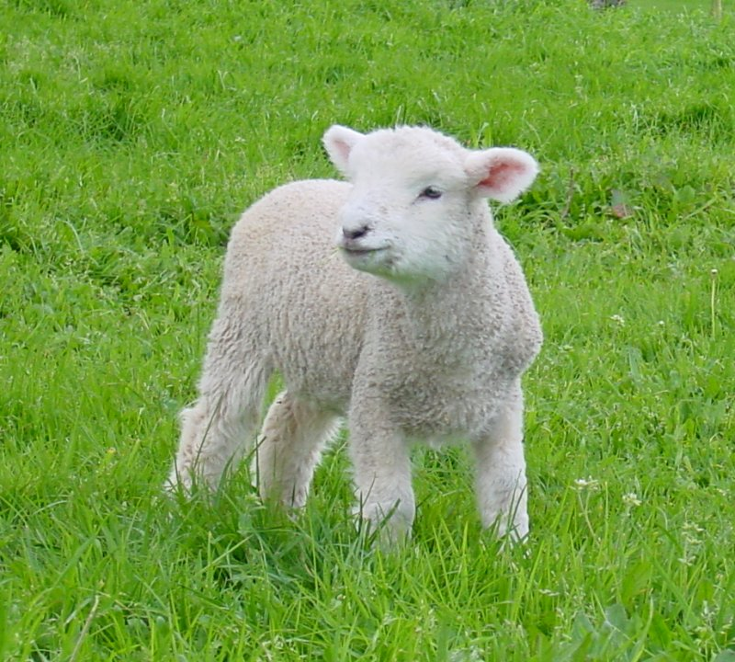
For A Thing To Be Expedient
It Cannot Be Specified
When God specifies – man must obey
  God specified “gopher wood”
    Genesis 6:14, 22; Hebrews 11:7
  God specified “male lamb of the
  first year without blemish”
    Exodus 12:5
Richie Thetford www.thetfordcountry.com

Slide 6
For A Thing To Be Expedient
It Cannot Be Specified
  Expediency involves the right of choice within the realm of those things included in what God has authorized
    Noah could choose which gopher wood to use – but he must use gopher wood
    Israelites could choose which male lamb of the first year without blemish to be offered – but they must offer this type of animal to obey God
Richie Thetford www.thetfordcountry.com

Slide 7
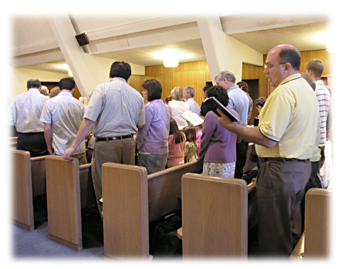
For A Thing To Be Expedient
It Cannot Be Specified
To go beyond that which is specified – is to add to God’s Word
  God commands “singing”
    Ephesians 5:19; Colossians 3:16
    Instrumental music is not an aid in
    “singing” but is an addition to God’s command
    Song books are an aid to “singing” (expedient)
Richie Thetford www.thetfordcountry.com

Slide 8
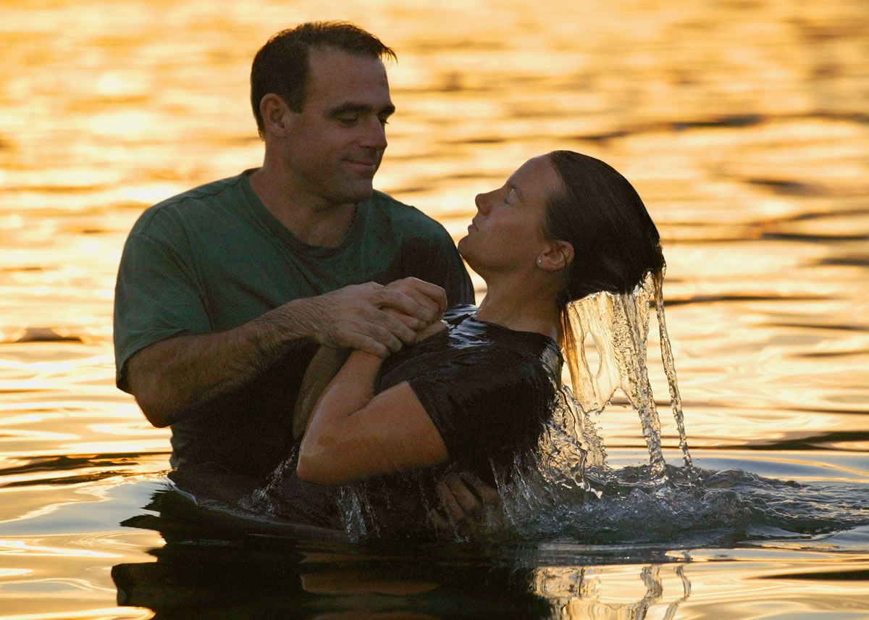
For A Thing To Be Expedient
It Cannot Be Specified
To go beyond that which is specified – is to add to God’s Word
  God commands “immersion”
    Romans 6:3-4
    Baptistery is an aid to
    “immersion” (expedient)
    Sprinkling is a substitution to God’s
    command and therefore is unlawful
Richie Thetford www.thetfordcountry.com

Slide 9
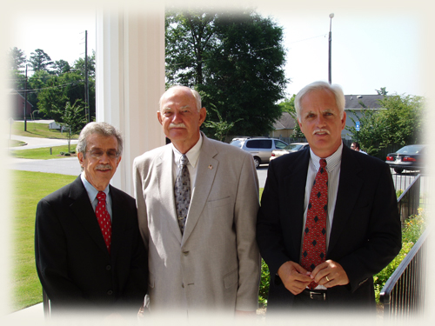
For A Thing To Be Expedient
It Cannot Be Specified
To go beyond that which is specified – is to add to God’s Word
  God specified that the oversight of elders
  be restricted to the local church
    Acts 14:23; 20:28; 1 Peter 5:1-3
    Elders overseeing the members and money
    of another church is not lawful
Richie Thetford www.thetfordcountry.com

Slide 10
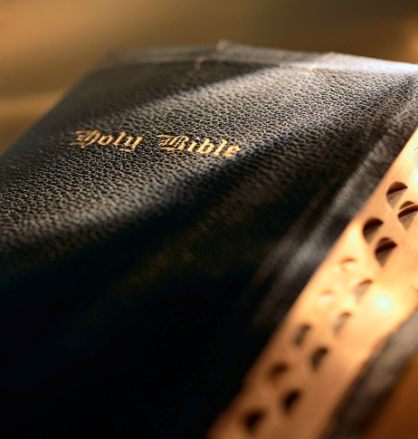
For A Thing To Be Expedient
It Cannot Be Specified
To go beyond that which is specified – is to add to God’s Word
  God authorized the church as the organization
  for preaching the gospel
    1 Timothy 3:15; Ephesians 4:11-13
    A Missionary Society is an addition to the
    organization which God established
Richie Thetford www.thetfordcountry.com

Slide 11
For A Thing To Be Expedient
It Must Edify
1 Corinthians 10:23-24, 31
All things must be done to edify
  1 Corinthians 10:23-24, 31; 14:26
  IF a thing is a matter of choice, falling in the realm of human judgment, and its practice causes division in the body
  – then it is sinful
Richie Thetford www.thetfordcountry.com

Slide 12
For A Thing To Be Expedient
It Must Edify
When God commands something, then it MUST be done in spite of consequences – even if it divides people
  Example: Preaching the Word
    Acts 4:18-20; 5:29
But if it is non-essential – meaning that God has left the choice up to human wisdom, and then we demand to enforce that practice on others that will destroy the unity and peace of God’s children, then we sin!
Richie Thetford www.thetfordcountry.com

Slide 13
For A Thing To Be Expedient
It Must Not Offend the
Conscience of A Brother
1 Corinthians 10:31-33
This rule governs only matters of expediency
Where the liberty of a choice by human wisdom has been permitted – we must not force our way to the offending brother by causing him to violate his conscience in partaking in that which he believes to be wrong
Richie Thetford www.thetfordcountry.com

Slide 14
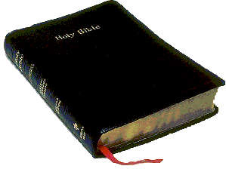
For A Thing To Be Expedient
It Must Be Lawful
Richie Thetford www.thetfordcountry.com

Slide 15
LAWFUL
UNLAWFUL
Specified
Expedient
No Authority
Place – rent, own, build,
sit or stand; time of day;
heat or cool
Assemble Heb 10:25;
Jam 2:2; Acts 20:7
Not assembling
Where? Baptistery or river? Cold or warm water?
Fresh or salt water?
Sprinkling, pouring, babies, unbelievers, “because of” remission
Baptize Matt 28:19;
Mark 16:16; Acts 2:38
Books or memory?
Number of Songs?
Sit or stand?
Sing Eph 5:19; Col 3:16 Psalms, hymns, and spiritual songs
Mechanical Instruments
Lay By In Store
1 Cor 16:1-2; 2 Cor 9:6-7;
When? 1st Day of Week
Cash or check?
In basket or hat?
Before or after sermon?
Raffles, chicken dinners, business enterprises, investments
Preaching
Mark 16:15; 2 Tim 4:1;
1 Tim 3:15 – Gospel
When? How? Where?
Pulpit, radio, TV, printed page, private, public
Another doctrine,
missionary society

Slide 16
LAWFUL
UNLAWFUL
Specified
Expedient
No Authority
Relieve the needy
Acts 2:44; 4:32-35; 11:29 Who? Needy Saints
Money, food, clothing,
provide facilities
Benevolent society,
orphan home, elderly home
Drink this cup
Matt 26:26-30; Luke 22:18
Cup, 1st day of the week
Morning or evening?
How served?
One container or many?
Coffee, tea, coke,
Thursday night, once a year, outside kingdom
Arrangements – time, place, size of group, PC, projector, black board
Teach Matt 28:20; 2 Tim 2:2; 4:1
The taught, the Word
Another gospel,
another organization
Supporting the Preacher
1 Cor 9:14; 2 Cor 11:8
Support, the Laborer
How it is given:
Money, house, food, utilities, frequency
To refuse to support,
Beg to get public donations
Jurisdiction of Elders
Acts 20:28; 14:23
The local church
How they oversee, the number, frequency of meetings,
teachers used
One elder, oversight of members, money,
work of another church

Slide 17
Expediency
Involves the right of choice
within the realm of that
which is authorized in the
New Testament, and is not
a course of authority within itself
Richie Thetford www.thetfordcountry.com

