Slide 1
The Growth of the Church
“Keeping the Church Pure”
2 Timothy 4:1-8
“teaching them to observe all things that I have commanded you”
Matthew 28:20

Slide 2
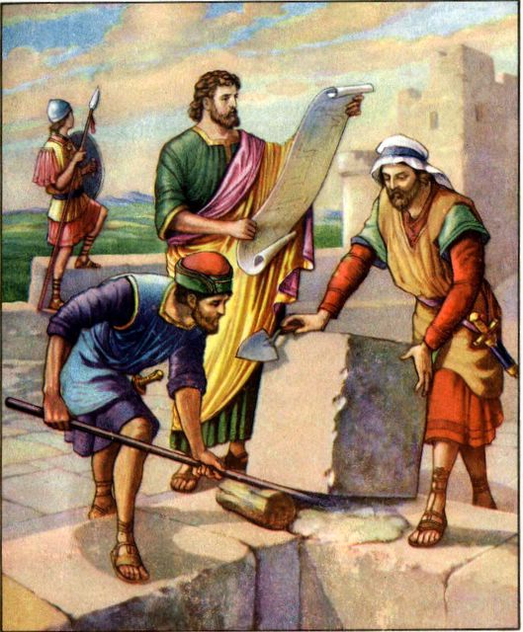
The Growth of the Church
“Keeping the Church Pure”
Rebuilding of Jerusalem
Enemy ridiculed God’s people
Nehemiah 4:3-8
Conspired to make war
Nehemiah 4:7-8
Wanted to kill Nehemiah
Nehemiah 6:2-3

Slide 3
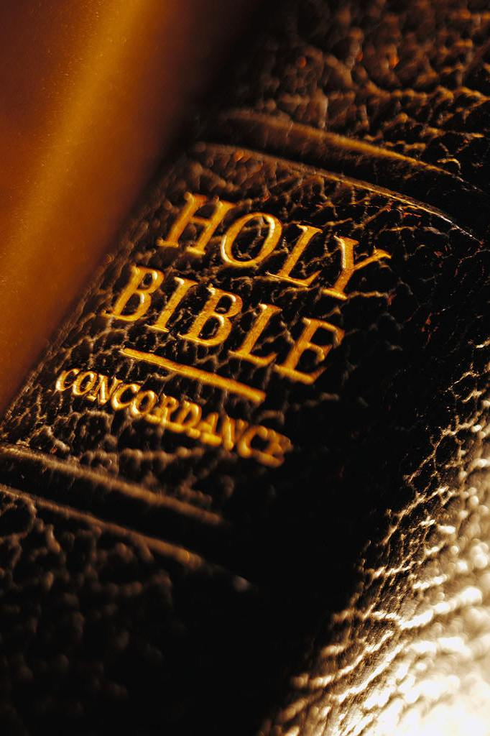
The Growth of the Church
“Keeping the Church Pure”
Rebuilding of Jerusalem
By prayer and work Israel succeeded
Nehemiah 4:9, 16-18, 6
Parallel that we can learn from:
Be engaged in working – 1 Corinthians 9:16-22
Put on God’s armor – Ephesians 6:10-18

Slide 4
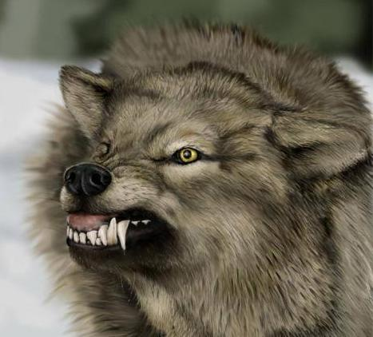
The Growth of the Church
“Keeping the Church Pure”
Greatest dangers come from within
False doctrines
Acts 20:30
Individual persuasions
3 John 9-10
Worldliness
1 John 2:15; James 4:4

Slide 5
The Growth of the Church
“Keeping the Church Pure”
Must preach the word to maintain purity
Word like a hammer – Jeremiah 23:29
Food to strengthen – Matthew 4:4
A light to guide – Psalms 119:105
Sanctifies – John 17:17
Preach the word! Be ready in season and out of season. Convince, rebuke, exhort, with all longsuffering and teaching. 2 Timothy 4:2

Slide 6
The Growth of the Church
“Keeping the Church Pure”
Must preach the word to maintain purity
Releases us from sin – John 8:32
Sharper than any other – Hebrews 4:12
Preach the word! Be ready in season and out of season. Convince, rebuke, exhort, with all longsuffering and teaching. 2 Timothy 4:2
2 Corinthians 10:3-5

Slide 7
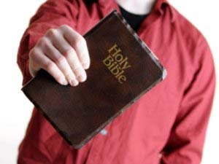
The Growth of the Church
“Keeping the Church Pure”
When the preaching of the word fails, discipline is needed
2 Thessalonians 3:6
Titus 3:10-11
1 Corinthians 5:11-13
Put God first – ALL others second
“A friend worth having is a friend worth saving”

Slide 8
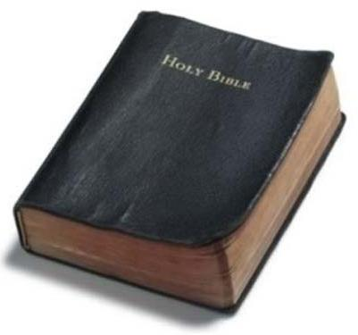
The Growth of the Church
“Keeping the Church Pure”
NEVER lower the standard, but rather RAISE ourselves and the church to meet it!

