Slide 1
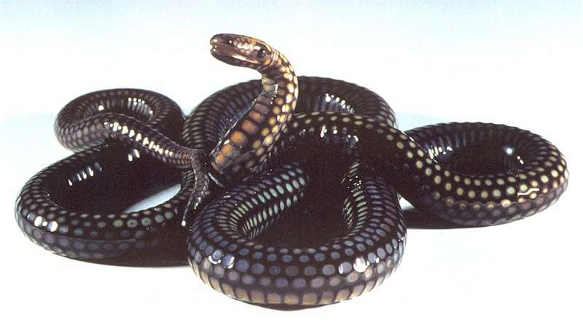
The Growth of the Church
“The Problem of SIN in the Church”
SOUND
Doctrinally
CLEAN
Morally
DILIGENT
In Service

Slide 2

The Growth of the Church
Sin in the church
  Romans 6:17-23
Church has an obligation
to the world
  1 Corinthians 5:9-13
The obligation of the church is to save the world by preaching the gospel to it

Slide 3

The Growth of the Church
Sin is not in harmony in the church
  Founder and head is sinless
    Hebrews 4:15
  Church has an obligation to purge sin
    Titus 2:11-14
  Sin is unbefitting in the church
    Acts 2:42-47

Slide 4
The Growth of the Church
Sin is not in harmony in the church
  Christians are said to be:
    Dead to sin – Rom 6:1-4
    New creatures – 2 Cor 5:17
    Washed, sanctified, justified – 1 Cor 6:9-11
    Freed from sin – Rom 6:17
    Summed up – Col 3:17
    The conclusion – Rom 8:12; Gal 5:19-21

Slide 5
The Growth of the Church
God’s displeasure of sin
  Achan
    Joshua 7
  Ananias and Sapphira
    Acts 5:1-11
God wants purity among His people, therefore – we should want purity!

Slide 6
The Growth of the Church
Sin among members
– worse than without
For if, after they have escaped the pollutions of the world through the knowledge of the Lord and Savior Jesus Christ, they are again entangled in them and overcome, the latter end is worse for them than the beginning. For it would have been better for them not to have known the way of righteousness, than having known it, to turn from the holy commandment delivered to them. But it has happened to them according to the true proverb: “A dog returns to his own vomit,” and, “a sow, having washed, to her wallowing in the mire.”
2 Peter 2:20-22

Slide 7

The Growth of the Church
What is the ultimate danger?
  Die in sin and be lost
  Apostasy
  Sin condoned by the local church
Your glorying is not good. Do you not know
that a little leaven leavens the whole lump?
1 Corinthians 5:6
Sometimes we glory simply by tolerating the evil

Slide 8
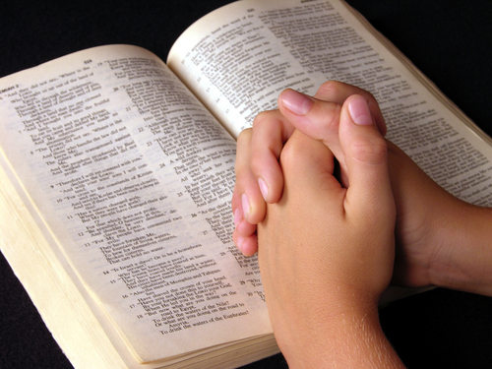
The Growth of the Church
What is the solution?
  Restore
    James 5:19-20
    Galatians 6:1
  Withdraw
    1 Corinthians 5:13
Sin in the church is dangerous
We need to keep ourselves pure!
Keep sin out of the Lord’s church

