Slide 1

Bible Authority and Truth
Most problems in religion are the result of
a lack of Bible authority and truth
Richie Thetford www.thetfordcountry.com

Slide 2
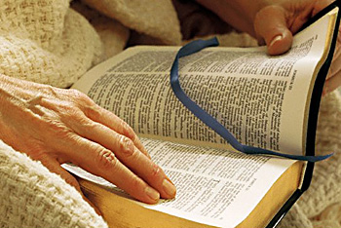
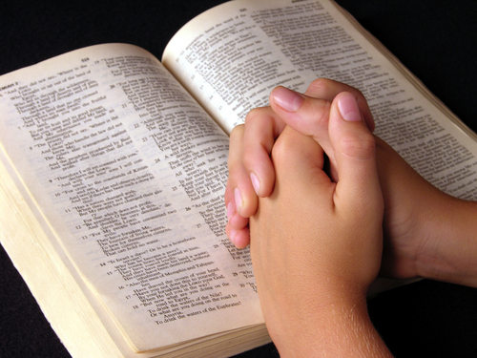
Authority and Truth
“And Jesus came and spoke to them, saying, “All authority has been given to Me in heaven and on earth. Go therefore and make disciples of all the nations, baptizing them in the name of the Father and of the Son and of the Holy Spirit, teaching them to observe all things that I have commanded you; and lo, I am with you always, even to the end of the age. Amen.”
Matthew 28:18-20
Richie Thetford www.thetfordcountry.com

Slide 3

Authority and Truth
“And you shall know the truth,
and the truth
shall make
you free.”
John 8:32
“and with all unrighteous deception among those who perish, because they did not receive the love of the truth, that they might be saved.”
2 Thessalonians 2:10
Richie Thetford www.thetfordcountry.com

Slide 4

Authority and Truth
God is the author of the Bible
“All Scripture is given by inspiration of God, and is profitable for doctrine, for reproof, for correction, for instruction in righteousness, that the man of God may be complete, thoroughly equipped for every good work.”
2 Timothy 3:16-17
Richie Thetford www.thetfordcountry.com

Slide 5

Respect for Bible Authority
Every writer of the Bible was guided by the Holy Spirit
“knowing this first, that no prophecy of Scripture is of any private interpretation, for prophecy never came by the will of man, but holy men of God spoke as they were moved by the Holy Spirit.”
2 Peter 1:20-21
Richie Thetford www.thetfordcountry.com

Slide 6
Respect for Bible Authority
Our attitude toward God:
Respect God - then we respect His Word, the Bible
Disrespect the Bible - then we disrespect God who gave it
The same attitude that will allow us to break one law
of God, will allow us to break EVERY law of God
Richie Thetford www.thetfordcountry.com

Slide 7

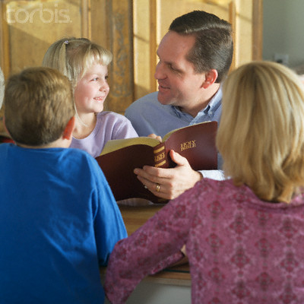
Walk By Faith
The Bible’s instruction to us
  2 Corinthians 5:7
  Romans 14:23
The Bible MUST be our authority!
  Colossians 3:17; Matthew 28:18
“So then faith comes by hearing, and hearing by the word of God.”
Romans 10:17
Richie Thetford www.thetfordcountry.com

Slide 8
Walk By Faith
We must learn to respect God’s Word
  Immoral people disrespect His Word
    Galatians 5:19-21
  Unfaithful people disrespect His Word
    1 Corinthians 15:58; Hebrews 10:25
  Those who do things without Bible authority
    Colossians 3:17
Richie Thetford www.thetfordcountry.com

Slide 9
Walk By Faith
Faithful Christians have learned to respect
God’s Holy Word
“….that you may learn in us not to think beyond
what is written, that none of you may be puffed up
on behalf of one against the other.”
1 Corinthians 4:6
Richie Thetford www.thetfordcountry.com

Slide 10
Walk By Faith
Faithful Christians have learned to respect
God’s Holy Word
“For I testify to everyone who hears the words of the prophecy of this book:
If anyone adds to these things, God will add to him the plagues that are written in this book; and if anyone takes away from the words of the book of this prophecy, God shall take away his part from the Book of Life, from the holy city, and from the things which are written in this book.”
Revelation 22:18-19
Richie Thetford www.thetfordcountry.com

Slide 11
Walk By Faith
Faithful Christians have learned to respect
God’s Holy Word
“Whoever transgresses and does not abide in the doctrine
of Christ does not have God. He who abides in the doctrine
of Christ has both the Father and the Son.”
2 John 9
We MUST have Bible authority for ALL that we do
Richie Thetford www.thetfordcountry.com

Slide 12


Divine Authority Established
Divine authority is established in the scriptures
Command
  Direct statement or a positive command
    All Must Repent: Acts 17:30
    Disciples are to contribute: 1 Corinthians 16:1-2
    Saints are to assemble: Hebrews 10:25
    It is wrong to lie: Colossians 3:9
Richie Thetford www.thetfordcountry.com

Slide 13
Divine Authority Established
Divine authority is established in the scriptures
Approved Apostolic Example
  Action of an individual or a collectivity of individuals (local church) under the guidance of inspired apostles in the first century
    Breaking of bread - first day of week: Acts 20:7
    Churches sending relief: Acts 11:29-30
Richie Thetford www.thetfordcountry.com

Slide 14
Divine Authority Established
Divine authority is established in the scriptures
Necessary Inference
  That which is necessarily implied by the clear import and meaning of the language used
    Before being baptized, Jesus went down into the water: Matthew 3:16
Richie Thetford www.thetfordcountry.com

Slide 15

All Activity in Serving God
Must Be God Authorized
Old Testament example:
  Moses divinely authorized to “speak” to the rock
    Numbers 20:8
  In this example – look what Moses did:
    Numbers 20:11-12
This simple act of disobedience caused Moses and Aaron
not to be allowed to enter the promised land
Richie Thetford www.thetfordcountry.com

Slide 16

All Activity in Serving God
Must Be God Authorized
New Testament teaches us the necessity of authority
  Matthew 7:21-23
    Jesus did not deny that they were religious
    Jesus did not contradict having done good works
    Jesus did say “depart from Me, you who practice lawlessness!”
Lawlessness is a condition of one without law (ignorance or violation)
Richie Thetford www.thetfordcountry.com

Slide 17

Conclusion
We must ensure that all we do is in the name of the Lord – based solely upon His written inspired Word
“He who rejects Me, and does not receive My words,
has that which judges him — the word that I have spoken will judge him in the last day.”
John 12:48
Richie Thetford www.thetfordcountry.com

