Slide 1
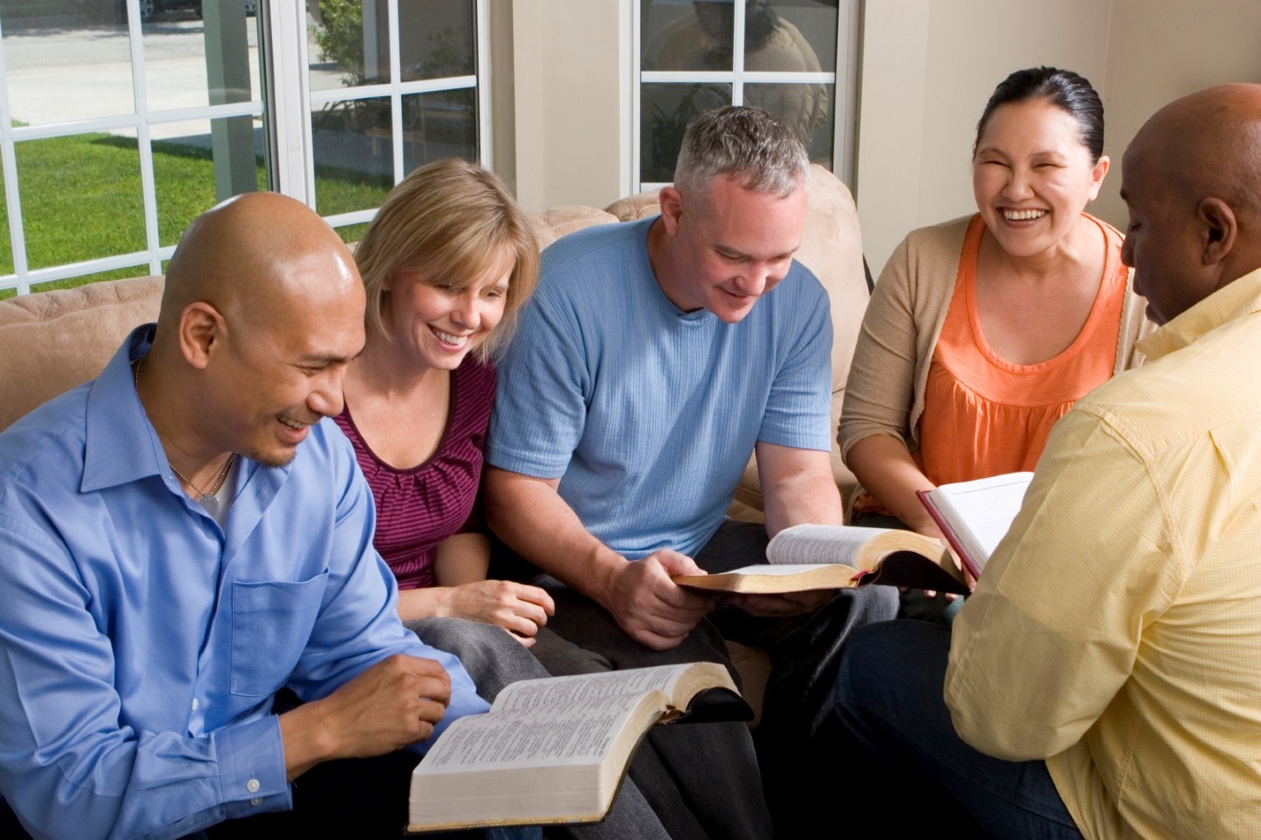
Building Our Faith….

Slide 2
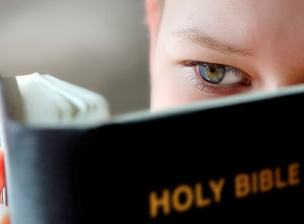
Building Our Faith…. ….By the Example of Noah
Hebrews 11:1
Hebrews 11:6
Noah persevered because he was “moved with godly fear”

Slide 3
Noah
“moved with godly fear”
Noah means “to comfort”
Genesis 5:29
Described as:
“heir of righteousness which is by faith”

Slide 4
Noah
The Times of Noah
Days of Noah were terrible!
Wickedness of man (V5)
Thoughts of heart evil continually (V5)
Corrupt (V11)
Filled with violence (V11,13)
Distracted from Spiritual service
Matthew 24:36-39
2 Peter 2:5; 3:9

Slide 5
Noah
Noah’s Faith
Constant pressures of a corrupt society requires great faith!
Standards are in place for Christians today
Philippians 2:15-16
Philippians 1:27-28
We must have true faith in God!

Slide 6
Noah
Basis of Noah’s Faith
“Noah, being divinely warned of things not yet seen”
His faith was tested
No deluge of rain before
Would God destroy humans?
Could have had other concerns
Had only God’s word
His faith rested on that – All that he needed

Slide 7
Noah
Expression of Noah’s Faith
“Noah, moved with godly fear, prepared an ark for the saving of his household”
His faith manifested by obedience
Genesis 6:14-16
His work performed – based on faith
525 feet long, 87 feet wide, 52 feet high
His work prosecuted by many

Slide 8
Noah
Result of Noah’s Faith
“By which he condemned the world and became heir of the righteousness which is according to faith”
Condemnation of unbelievers
Holy fear of God condemned their confidence in themselves
Faith condemned their unbelief
Good examples will either convert sinners or condemn them

Slide 9
Noah
Result of Noah’s Faith
“By which he condemned the world and became heir of the righteousness which is according to faith”
Became the heir of the righteous people of God
He was righteous before he was commanded to build the ark
Building the ark exemplified his faith
DID GOD’S WILL

Slide 10
Noah
Summary
Key verse – Hebrews 11:7
Genuine fear of God
Motivated him to live a righteous life
Key thought – perseverance (patience)
1 Peter 3:20
Patience in building the ark
Preparing for God’s plan in His time

Slide 11
Noah
Application
Foolish to refuse to obey God
The judgment is going to come
Must accept it by faith – Hebrews 11:1
Salvation will ONLY be realized by…..
Those who understand and DO God’s will
“But without faith it is impossible to please Him, for he who comes to God must believe that He is, and that He is a rewarder of those who diligently seek Him.” Hebrews 11:6

