Slide 1


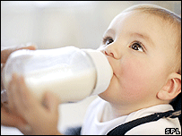
The Growth of the Church
“Growing into Maturity”
“For everyone who partakes only of milk is unskilled in the word of righteousness, for he is a babe”
Hebrews 5:13
“But solid food belongs to those who are of full age, that is, those who by reason of use have their senses exercised to discern both good and evil”
Hebrews 5:14

Slide 2
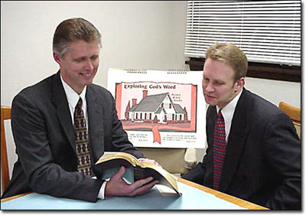
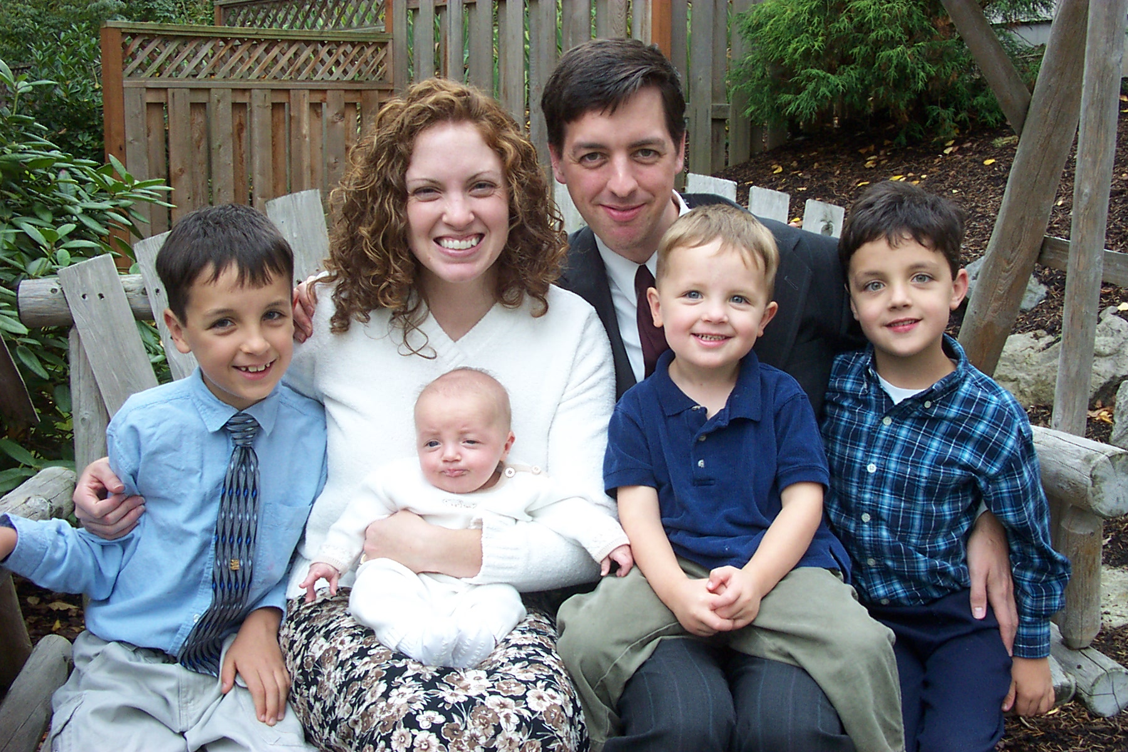

The Growth of the Church
Begins with one on one study
Which converts families
Leading to saved Christians!

Slide 3
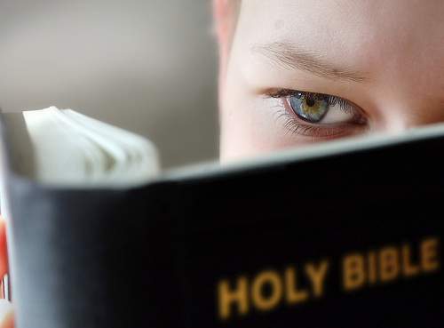
The Growth of the Church
Grew in the first century
  Acts 4:4; 5:14; 6:1,7; 8:4-5,12;
  2 Peter 3:18; 1 Peter 2:2
Requires a united effort
  John 17:20-21; 1 Corinthians 1:10;
  Philippians 1:27; 3:16; Romans 14:19
Be Steadfast
  Acts 2:42; 1 Corinthians 15:58

Slide 4

The Growth of the Church
Have faith in what we teach
  2 Timothy 1:12; Colossians 1:21-23;
  Galatians 1:10
Must Sacrifice
  2 Corinthians 8:5; Romans 12:1-2;
  2 Corinthians 8:11-12
Must uphold the light
  Philippians 2:14-16; Matthew 5:16

Slide 5

The Growth of the Church
What are we willing to do?
Have unity?
Be steadfast in the faith?
Believe what we teach?
Make sacrifices along the way?
Let our lights shine everyday?
Work at making this church strong?
Before the church can grow – we must grow

