Slide 1
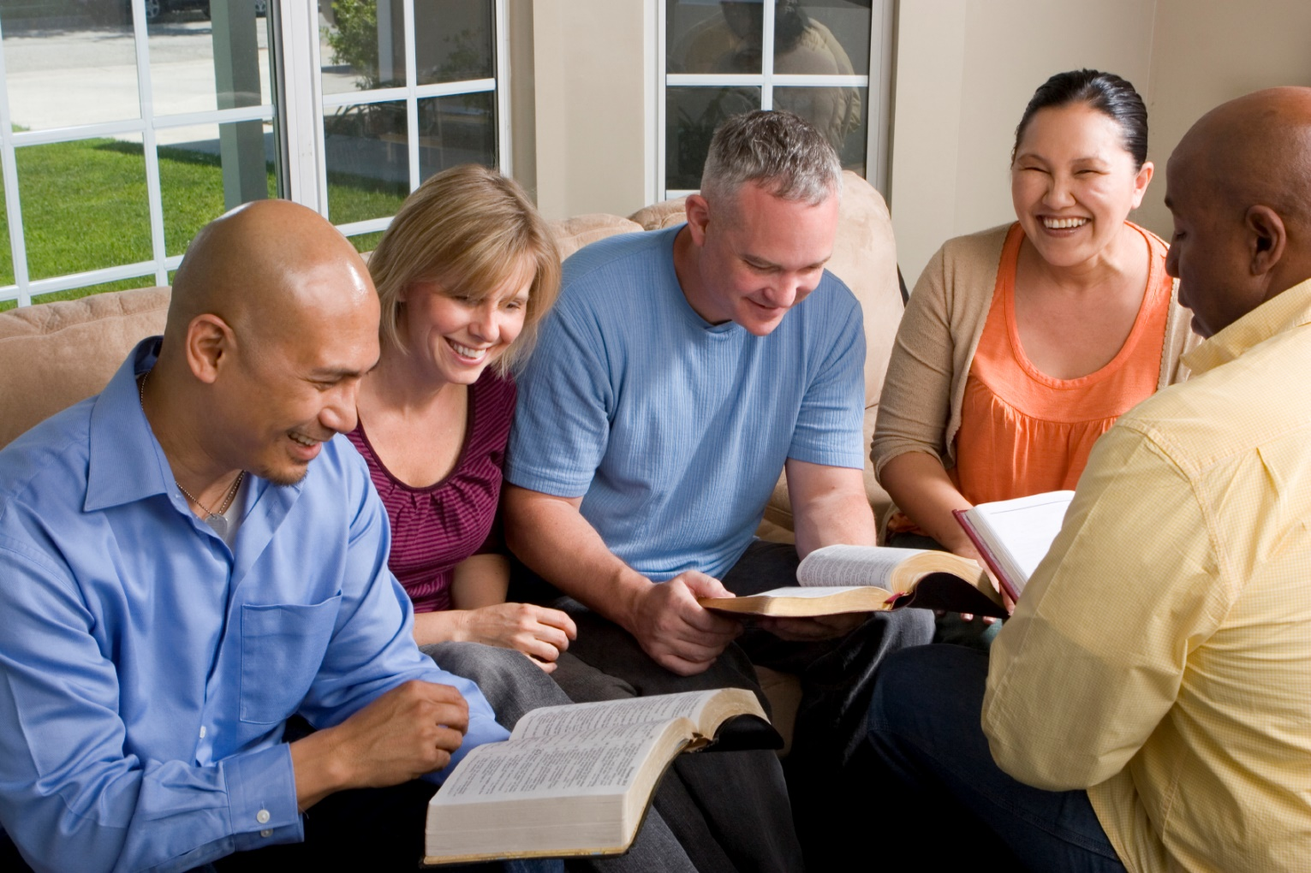
Building Our Faith….

Slide 2

Building Our Faith….
The stronger our faith – the better our service to God
“the just shall live by faith”
  Hebrews 10:34-39
Object of the lessons:
  Show that faith is the means of perseverance in religion
  Know that our true faith will allow us to conquer trials

Slide 3
Building Our Faith….
What is faith?
  Hebrews 11:1
  Hebrews 11:6
Substance
  “confidence”
  To feel and act as if it was as if we had actually seen
Evidence
  “something that tends to prove”

Slide 4
Building Our Faith….
….By the Examples of Abel and Enoch
ABEL
“though he being dead still speaks”
“Jesus the Mediator of the new covenant, and to the blood of sprinkling that speaks better things than that of Abel.”
Hebrews 12:24

Slide 5
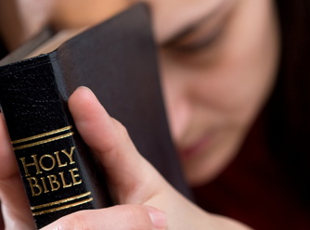
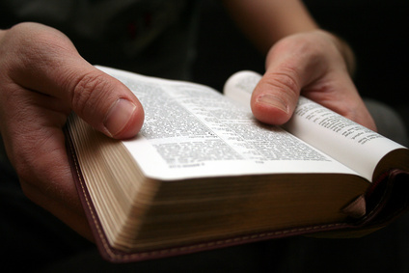
Abel
“though he being dead still speaks”
Faith in worship
  Genesis 4:3-4
  Romans 10:17
  John 4:23-24
  Psalms 51:15-17
Faith in obedience
  Luke 4:26; John 14:15
  Hebrews 5:9

Slide 6
Abel
“though he being dead still speaks”
Faith in endurance
  Genesis 4:8
  1 Corinthians 15:33
Was righteous because of his faith
  1 John 3:10-12
Suffered because of his faith in God
  Hebrews 9:14-15

Slide 7
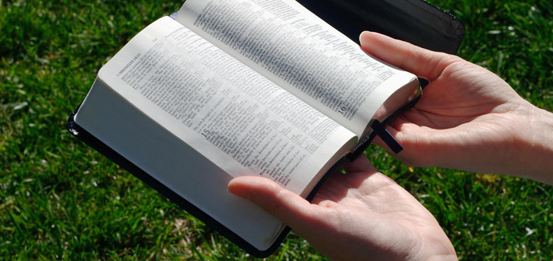
Abel
SUMMARY
Key Verse
  Hebrews 11:4
Key Thought
  Suffering
  Was not willing to compromise his faith!
“Yes, and all who desire to live godly in Christ Jesus will suffer persecution” (2 Timothy 3:12)

Slide 8
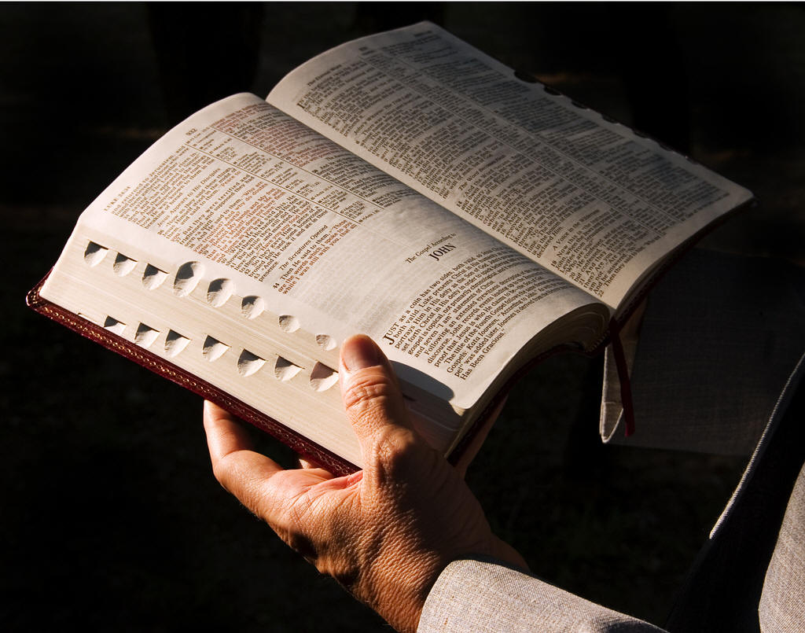
Enoch
“walked with God”
Genesis 5:23-24; Hebrews 11:5
Enoch mentioned 10 times in the Bible
Methuselah was his son
“walked with God”
Believed wholly in God
  Hebrews 11:6

Slide 9
Enoch
SUMMARY
Key Verse
  Hebrews 11:5 “he pleased God”
Key Thought
  Steadfastness
  Was not willing to compromise his faith!
“Therefore, my beloved brethren, be steadfast, immovable, always abounding in the work of the Lord, knowing that your labor is not in vain in the Lord” (1 Corinthians 15:58)

