Slide 1
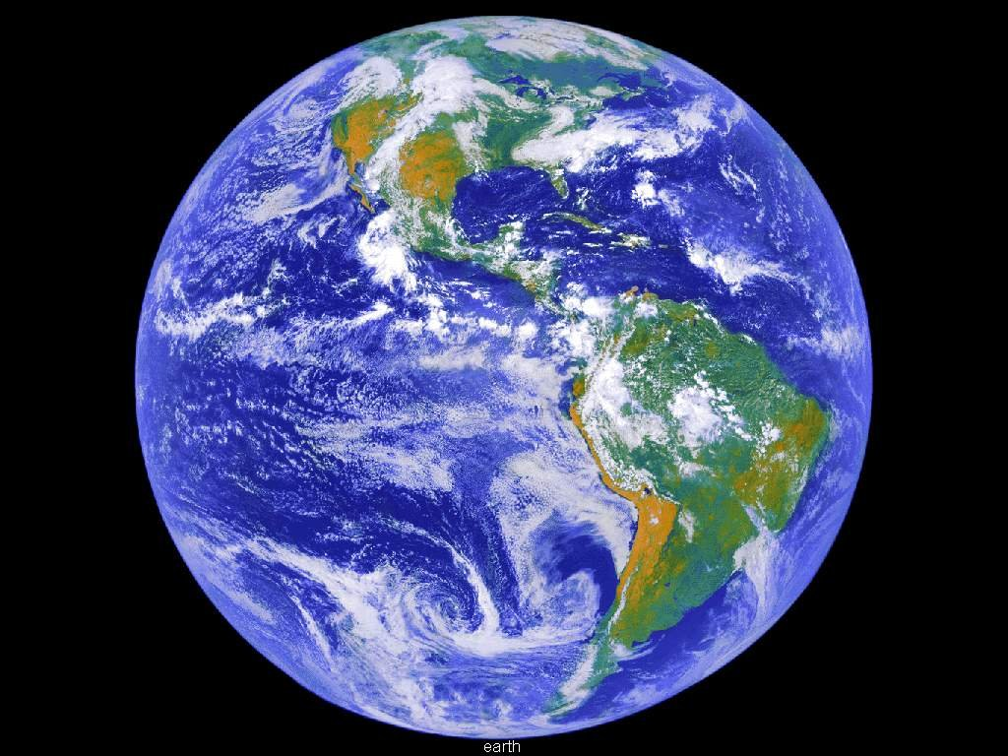
Worldliness
2 Timothy 3:1-5

Slide 2
Introduction
“And everyone who has this hope in Him purifies himself, just as He is pure. Whoever commits sin also commits lawlessness, and sin is lawlessness.”
1 John 3:3-4
Focus on Christ – not the world
Dancing, Drinking, Gambling, Materialism, Immodesty, Fornication, Pornography, Drugs, Tobacco, Inappropriate
TV shows, Movies, and Music – Other works of the flesh

Slide 3
Introduction
Two problems associated with this subject:
  Worldliness among God’s people
  Worldliness not dealt with
    Not preached on
    Preached on – but nothing done about it

Slide 4

What Is Worldliness?
“of or limited to this world; temporal or secular; devoted to or concerned with the affairs, pleasures, etc. of this world”
--- Webster
1 John 2:15-17

Slide 5
What Is Worldliness?
Worldliness is:
  A participation in sin
  Given to a life of following one’s passions
  Living like the world
  Living a life for the temporal – not spiritual
A person who “drinks and curses” IS worldly
A person can be worldly and not “drink and curse.”

Slide 6

The Spirit That Worldliness
Has and Generates
Becomes “soft” toward the Word of God
  Should never be a problem for the “Christian”
    Romans 13:14
A “softness” on moral issues
  Isaiah 30:9-11
  Jeremiah 5:30-31
  Jeremiah 6:13-17

Slide 7

Seriousness of Worldliness
Separates us from God
  James 1:15
  Romans 5:12
  Isaiah 59:1-2
One loses their good reputation
  Proverbs 22:1
  Proverbs 6:33

Slide 8

Seriousness of Worldliness
One loses their influence for good
  1 Timothy 4:12
It hinders our worship
  John 9:31
It desensitizes us to sin
  Psalms 1:1-3
Our heart becomes hardened
  Hebrews 3:12-13

Slide 9

Seriousness of Worldliness
It breeds other sins
  2 Samuel 11
It leads to disfellowship
  1 Corinthians 5:1-13; 2 Thessalonians 3:6-15
It hinders our race and growth
  Hebrews 12:1-2
It leads to eternal damnation
  Romans 6:23

Slide 10

Christian Life in
Contrast to Worldliness
Life of holiness
  1 Peter 1:15-16; 4:1-3
Life of Purity
  1 John 3:3
Law by which we live
  1 John 3:4
Will not continue in sin
  Romans 6:1-6

Slide 11

Christian Life in
Contrast to Worldliness
A genuine respect for the Word of God
  Psalms 119:11
Desires to be separate from the world
  2 Corinthians 6:14-17

Slide 12

Conclusion
Worldliness among God’s people
  Must have a submissive heart
  Repent of wrong – turn to God
  Rid ourselves of all worldliness

Slide 13
Worldliness
Strive to live the Christian life apart from worldliness!

