Slide 1

Where God Has Placed
Richard Thetford www.thetfordcountry.com

Slide 2

Where Did God Place Salvation AT THE FLOOD?
Genesis 6:5-18
Genesis 7:7, 19, 21
Richard Thetford www.thetfordcountry.com

Slide 3
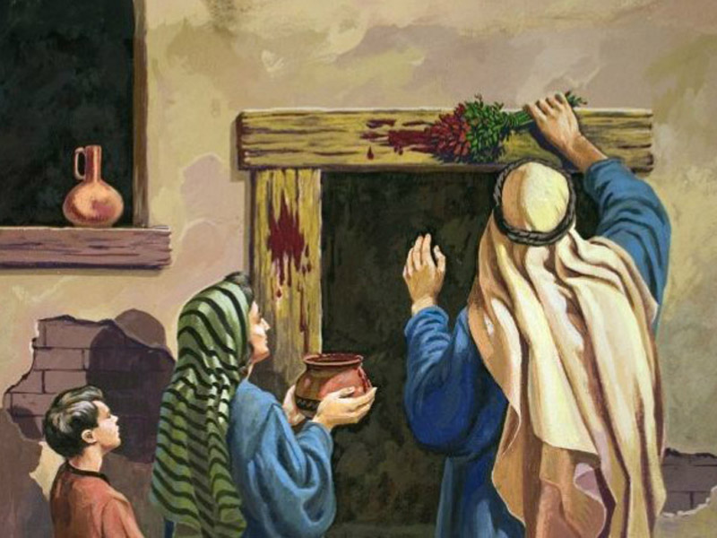
Where Did God Place Salvation AT THE PASSOVER?
Exodus 11:1, 4-6
Exodus 12:3-7, 29
Richard Thetford www.thetfordcountry.com

Slide 4
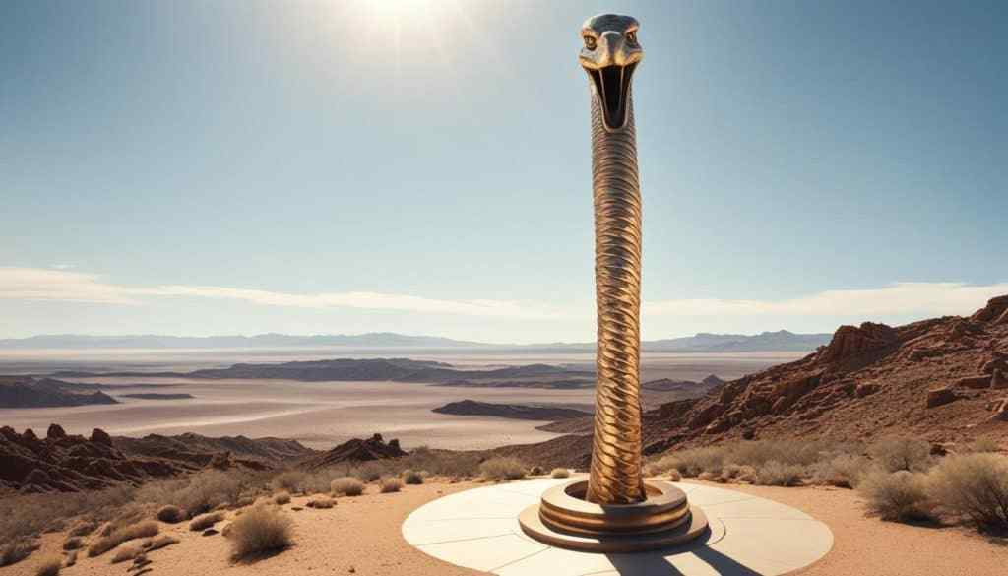
Where Did God Place Salvation IN THE WILDERNESS?
Numbers 21:5-9
Richard Thetford www.thetfordcountry.com

Slide 5
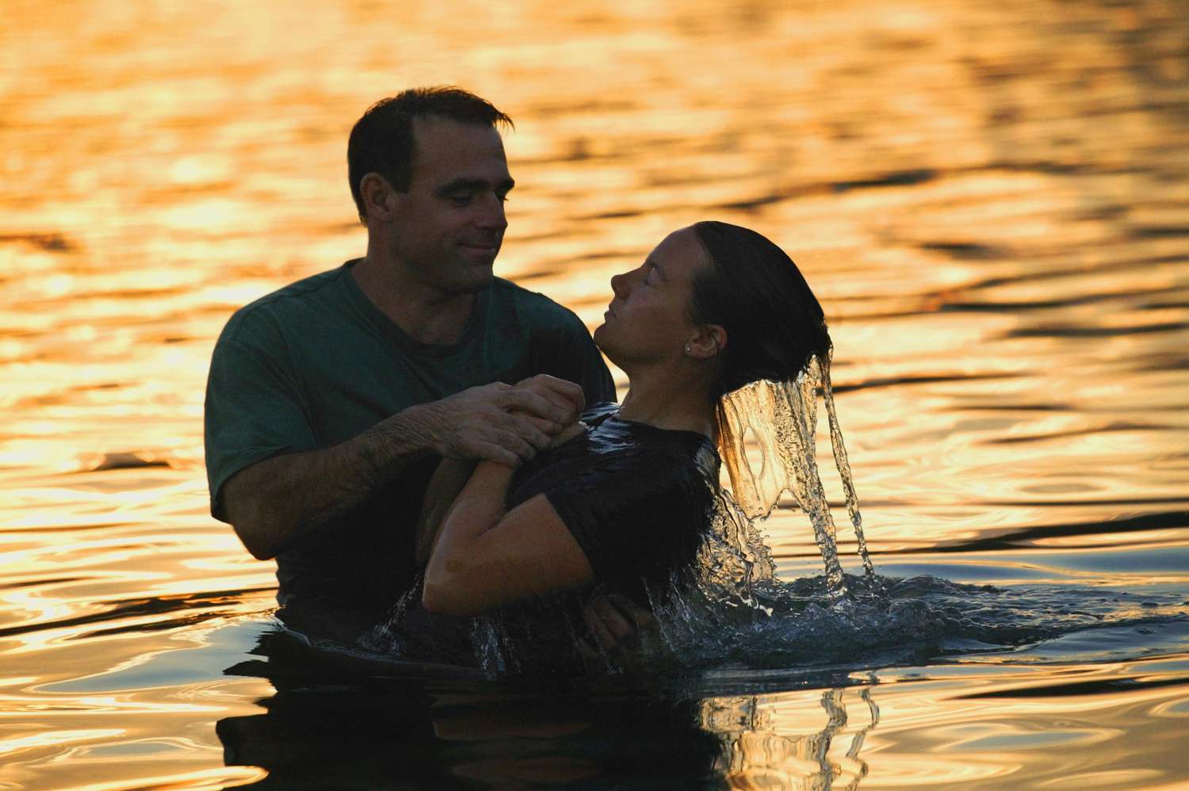
Where Has God Placed Salvation FOR MAN TODAY?
Obedience (Hebrews 5:8-9)
Believe (Romans 10:10; John 8:24; Hebrews 11:6)
Repent (Acts 2:38; 17:30; Luke 13:3)
Confess (Acts 8:37; Rom 10:10)
Baptism (Acts 22:16; 2:38; 1 Peter 3:21)
Richard Thetford www.thetfordcountry.com

Slide 6
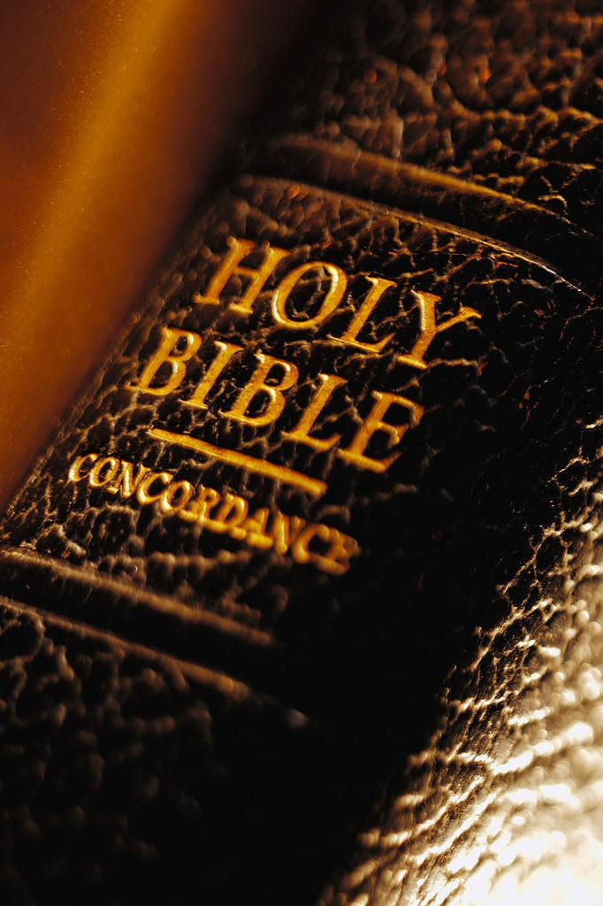
The Saved Are Added to the Church
The church that Christ built
Acts 2:47
Only those in Christ’s church will be saved
Ephesians 5:23
Richard Thetford www.thetfordcountry.com

Slide 7
Man Is Lost In Sin
God has provided a way of salvation
Romans 1:16-17
Refuse to obey – eternal condemnation
2 Thessalonians 1:7-9
God has always offered man the way of salvation – to escape sin
Richard Thetford www.thetfordcountry.com

