Slide 1

What Does Water
Have to Do with It?
Acts 8:26-39
Richard Thetford www.thetfordcountry.com

Slide 2
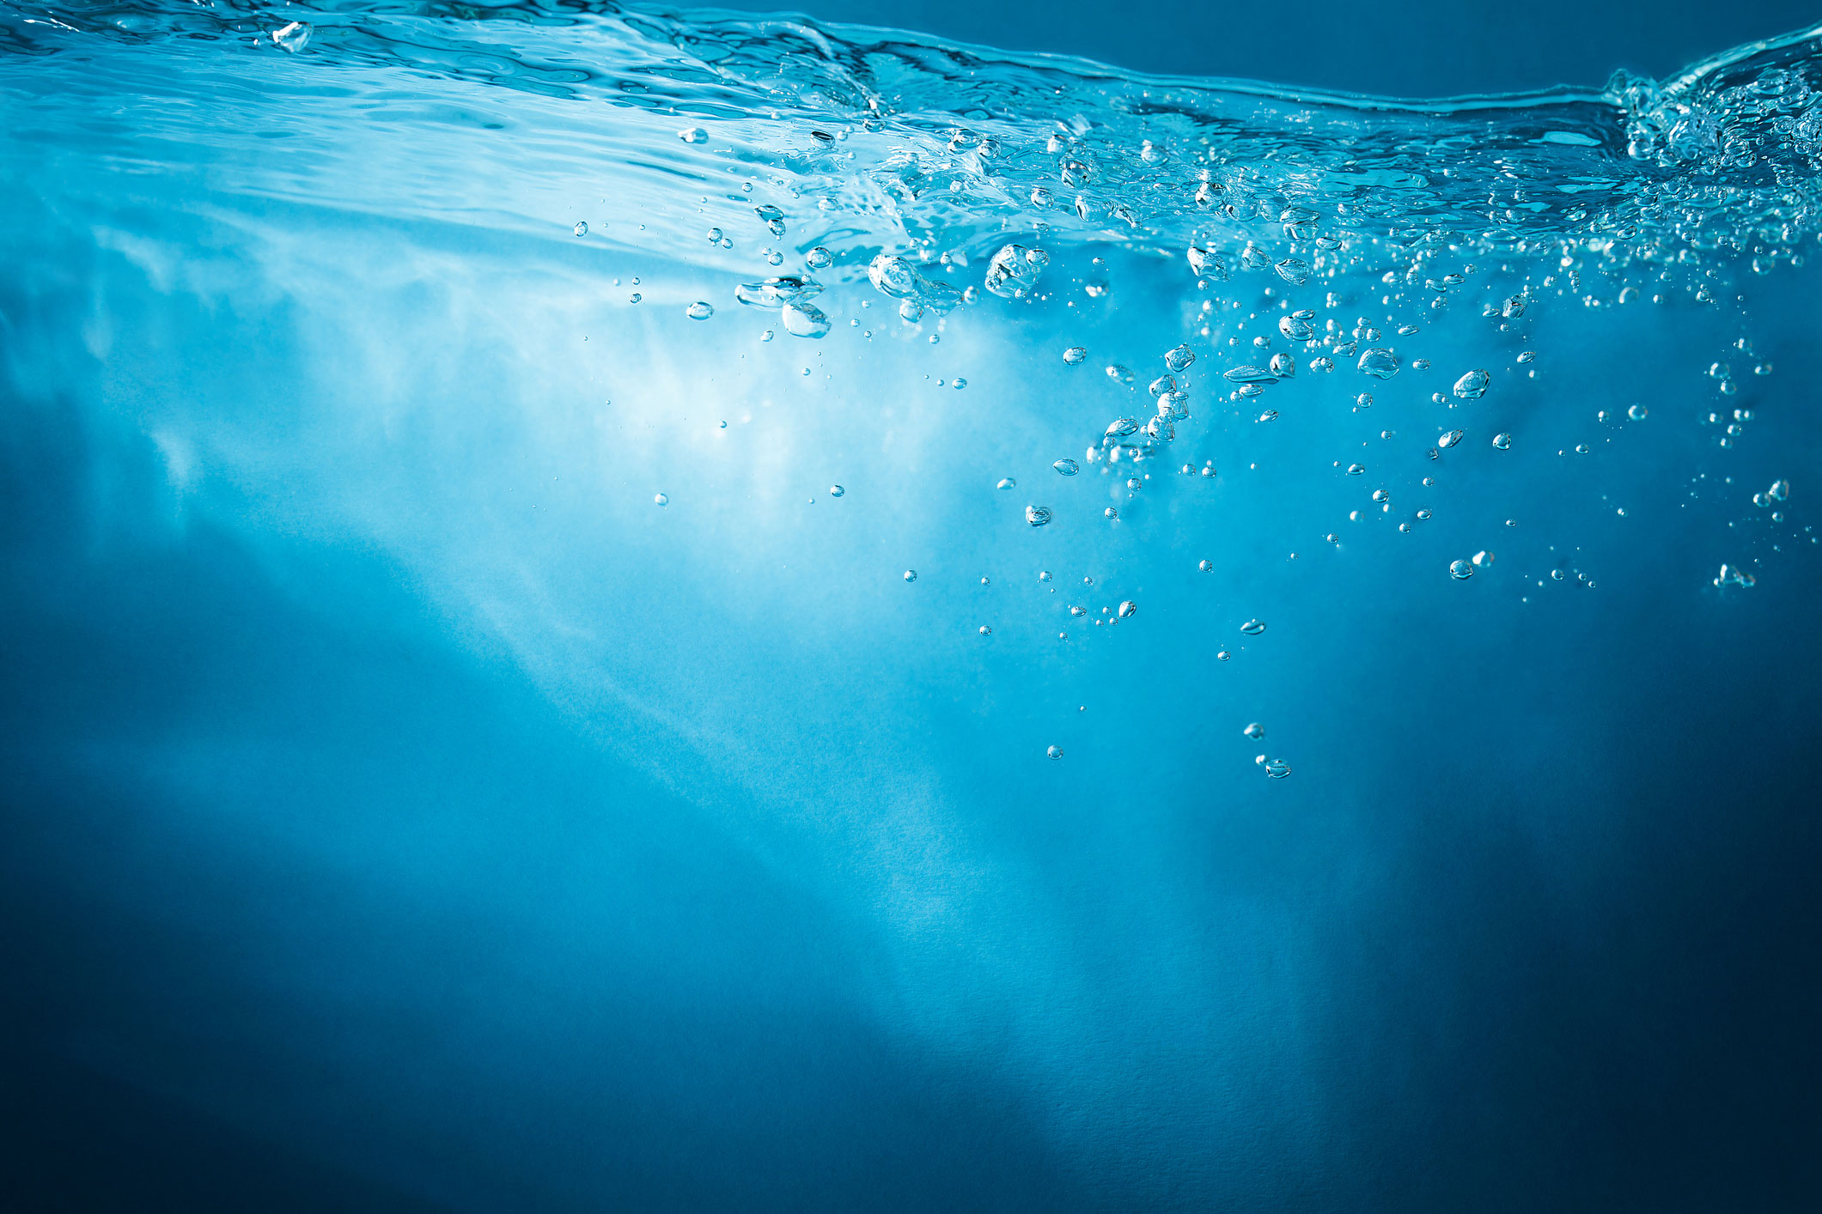
The Flood
“For after seven more days I will cause it to rain on the earth forty days and forty nights, and I will destroy from the face of the earth all living things that I have made. And Noah did according to all that the LORD commanded him. Noah was six hundred years old when the floodwaters were on the earth.”
Genesis 7:4-6
“who formerly were disobedient, when once the Divine longsuffering
waited in the days of Noah, while the ark was being prepared,
in which a few, that is, eight souls, were saved through water.”
1 Peter 3:20
Richard Thetford www.thetfordcountry.com

Slide 3
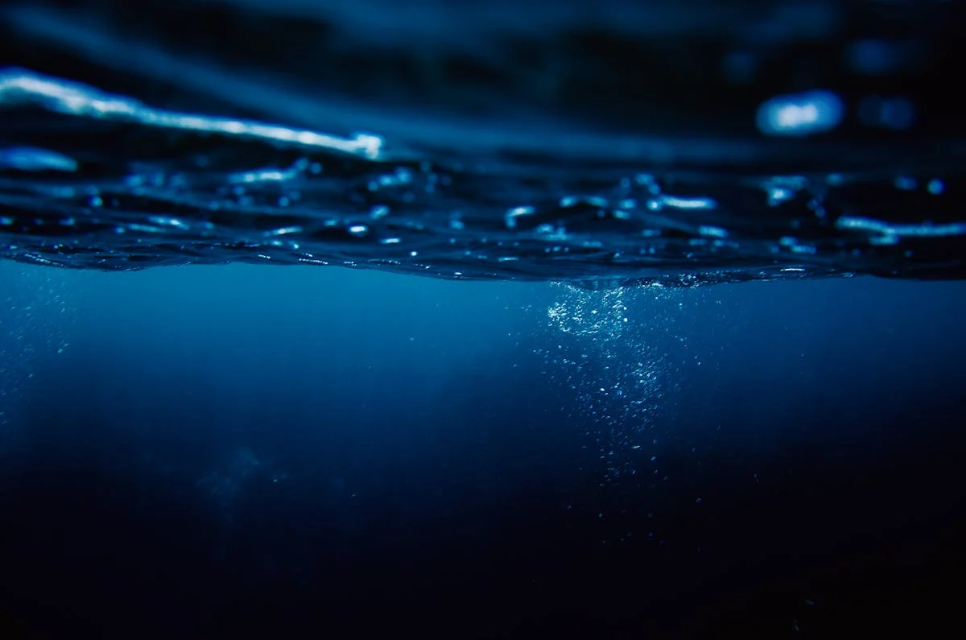
The Red Sea
“Then Moses stretched out his hand over the sea; and the LORD caused
the sea to go back by a strong east wind all that night, and made the sea
into dry land, and the waters were divided. So the children of Israel went
into the midst of the sea on the dry ground, and the waters were a wall
to them on their right hand and on their left.”
Exodus 14:21-22
“Moreover, brethren, I do not want you to be unaware that all our
fathers were under the cloud, all passed through the sea,
all were baptized into Moses in the cloud and in the sea”
1 Corinthians 10:1-2
Richard Thetford www.thetfordcountry.com

Slide 4
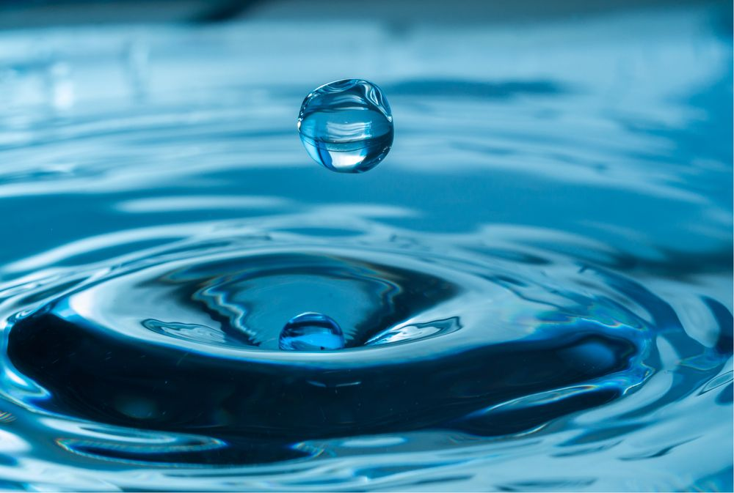
Gideon and His Three Hundred
“But the LORD said to Gideon, The people are still too many;
bring them down to the water, and I will test them for you there.
Then it will be, that of whom I say to you, ‘This one shall go with you,’
the same shall go with you; and of whomever I say to you,
‘This one shall not go with you,’ the same shall not go.”
Judges 7:4
Richard Thetford www.thetfordcountry.com

Slide 5

Naaman the Leper
“So, he went down and dipped seven times in the Jordan,
according to the saying of the man of God; and his flesh was
restored like the flesh of a little child, and he was clean.”
2 Kings 5:14
Richard Thetford www.thetfordcountry.com

Slide 6

The Baptism of John
“But the Pharisees and lawyers rejected the will of God for themselves,
not having been baptized by him.”
Luke 7:30
John 14:15
Luke 6:46
Richard Thetford www.thetfordcountry.com

Slide 7
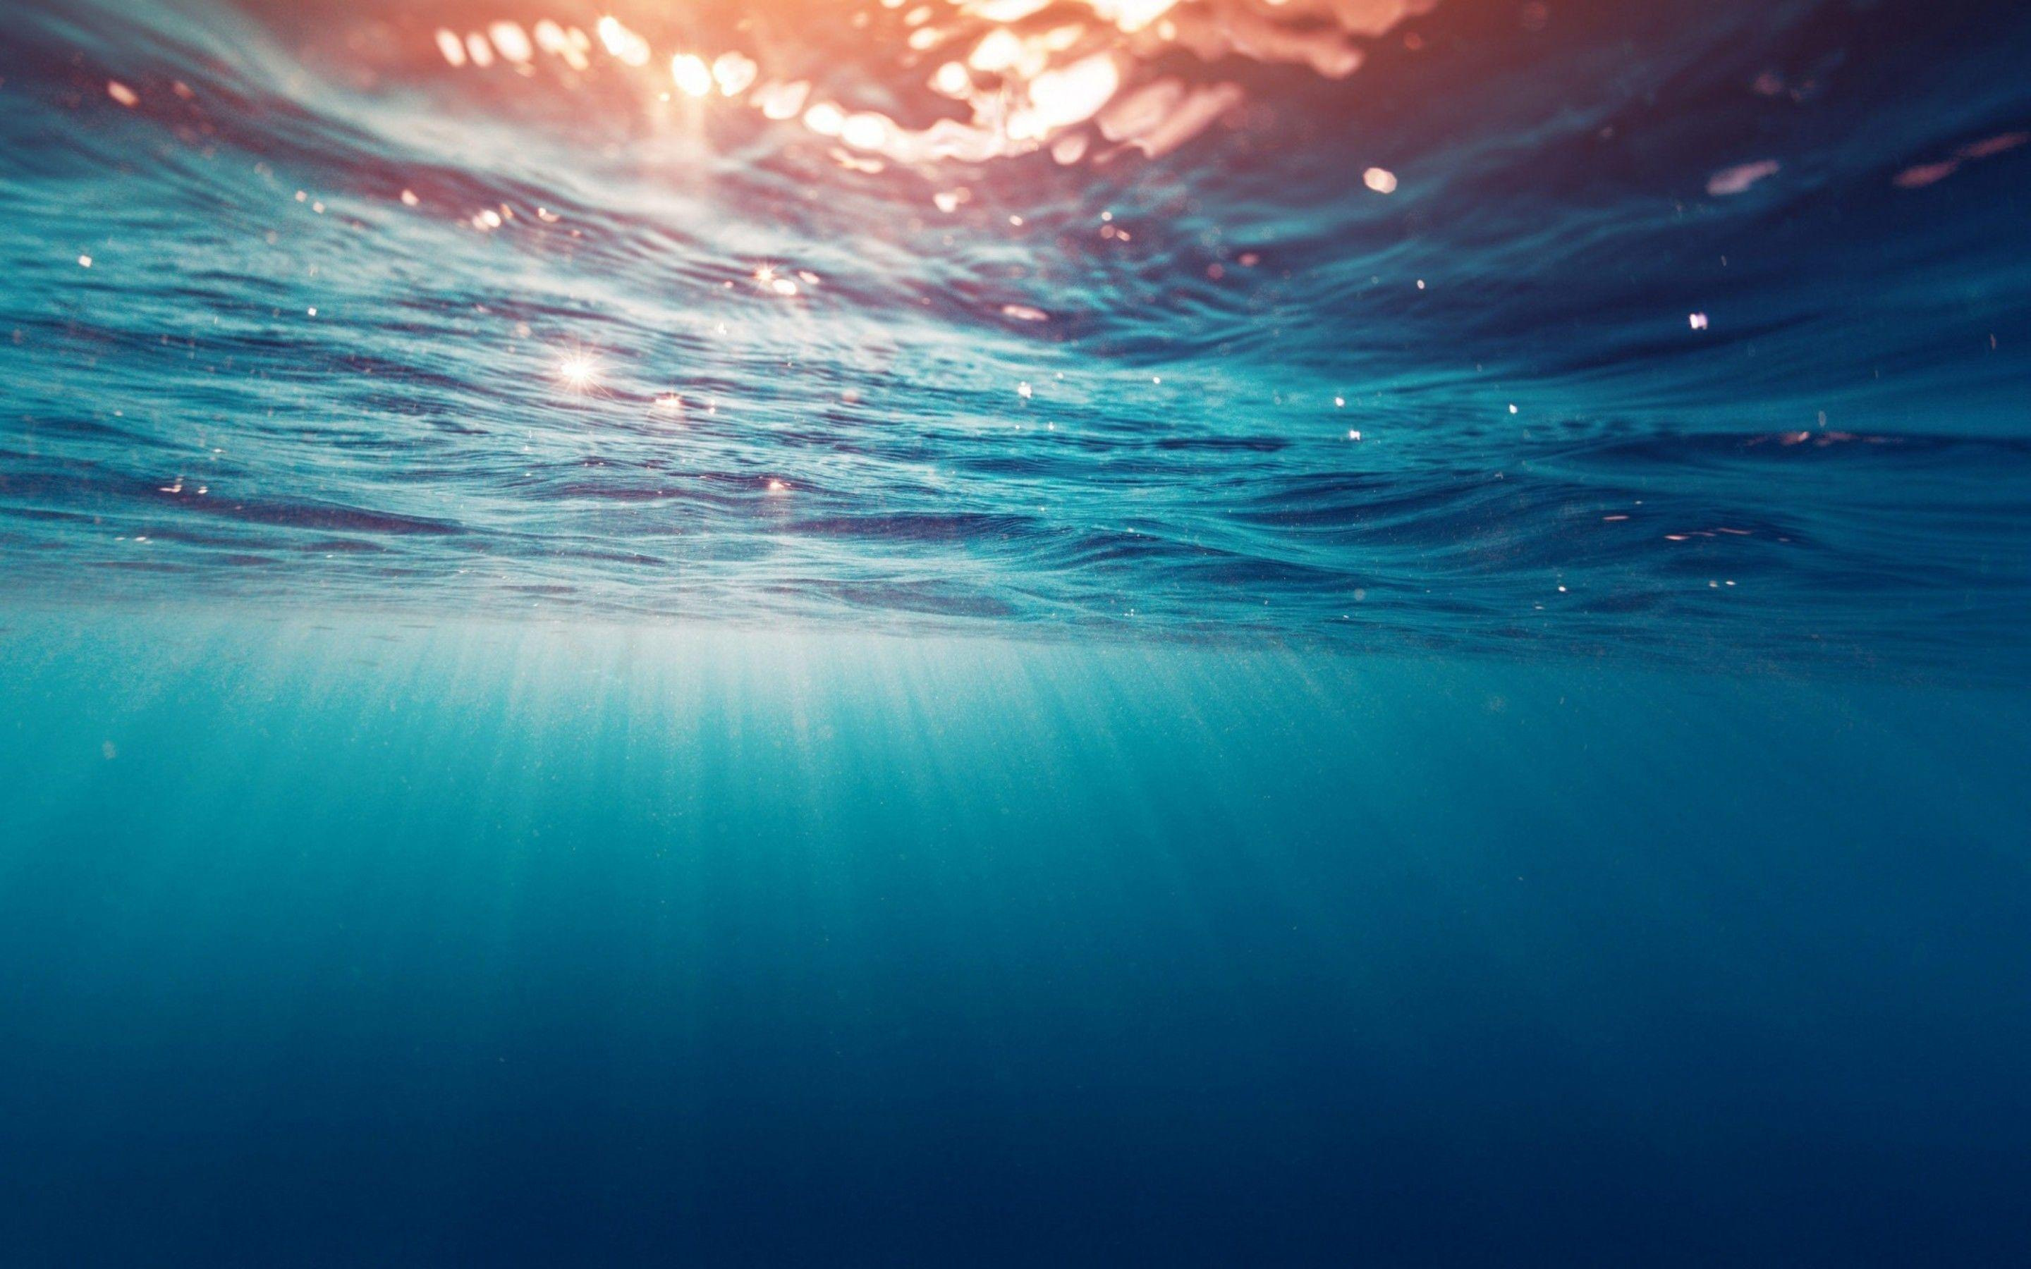
The New Birth
John 3:1-5
1 Peter 1:22-25
“Of His own will He brought us forth by the word of truth,
that we might be a kind of firstfruits of His creatures.”
James 1:18
Acts 22:16
Romans 6:3-4
Revelation 1:5
Richard Thetford www.thetfordcountry.com

Slide 8
What Does Water
Have to Do with It?
Take away water baptism and you remove
God’s plan for bringing us into contact with
the saving power of the blood, preventing
the washing away of sins, cleansing,
and aborting the new birth.
Richard Thetford www.thetfordcountry.com

