Slide 1
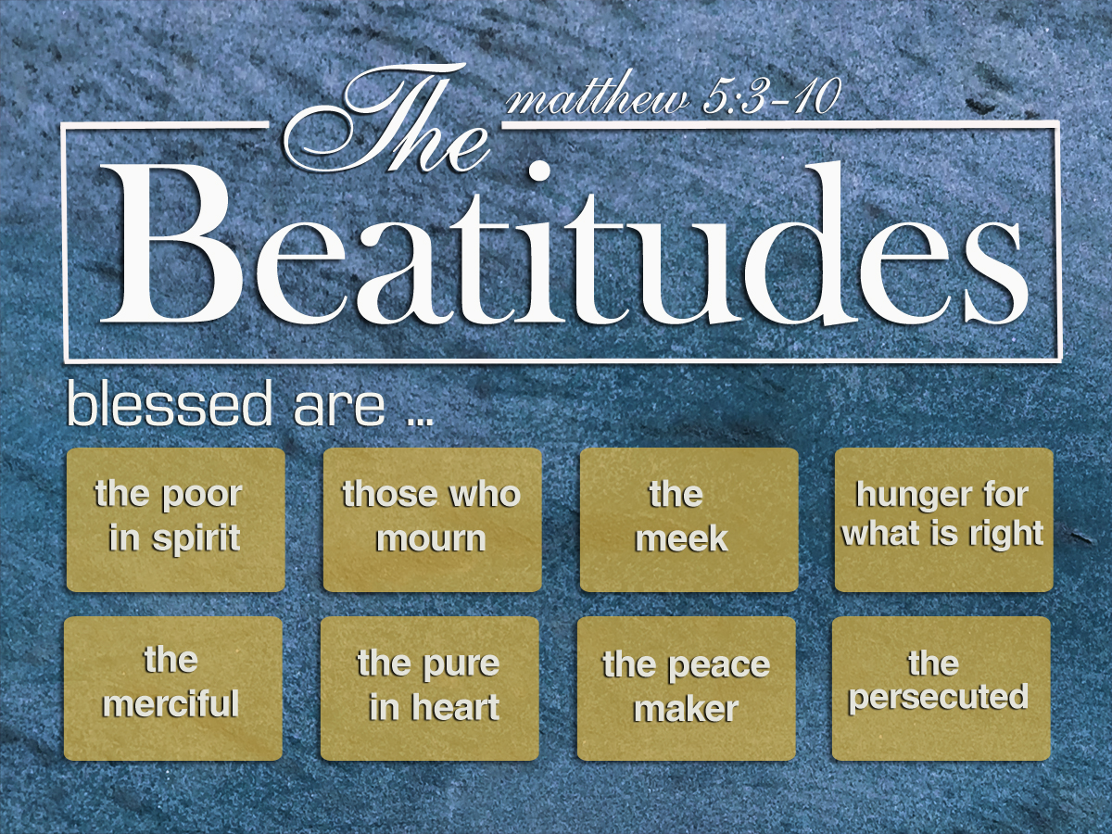
The Meaning of
The Meaning of
Richard Thetford www.thetfordcountry.com

Slide 2
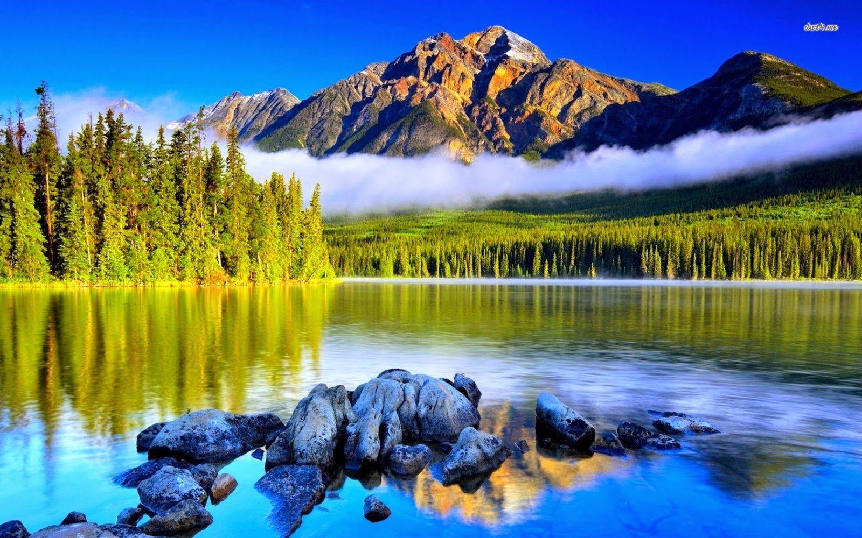
“Blessed are the poor in spirit, For theirs is the kingdom of heaven”
Matthew 5:3
Richard Thetford www.thetfordcountry.com

Slide 3
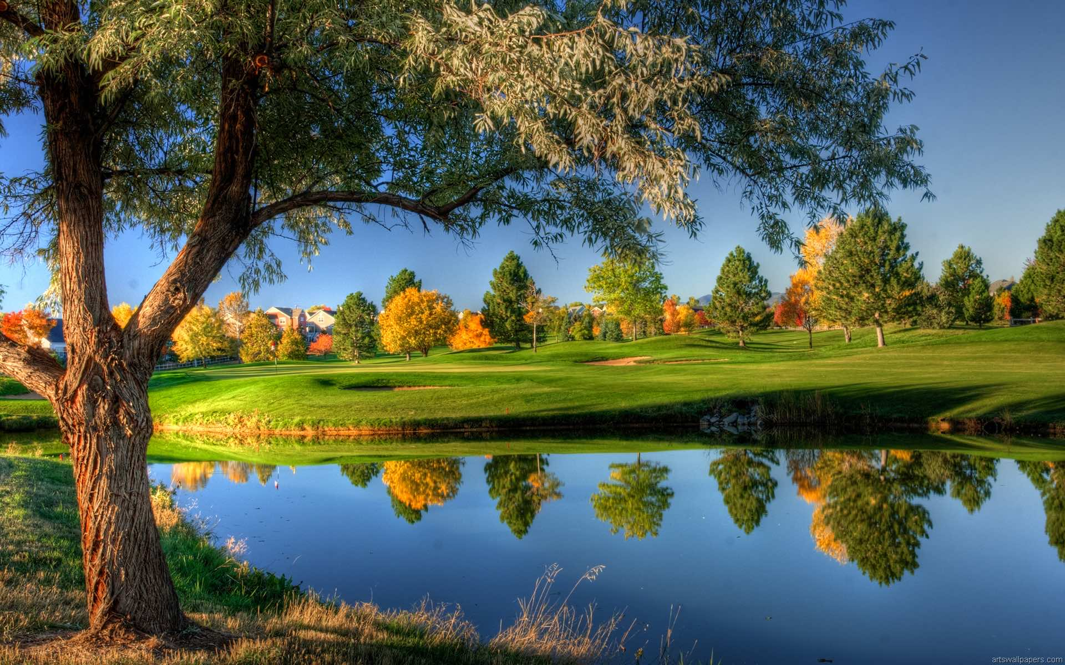
“Blessed are those who mourn, For they shall be comforted”
Matthew 5:4
Richard Thetford www.thetfordcountry.com

Slide 4
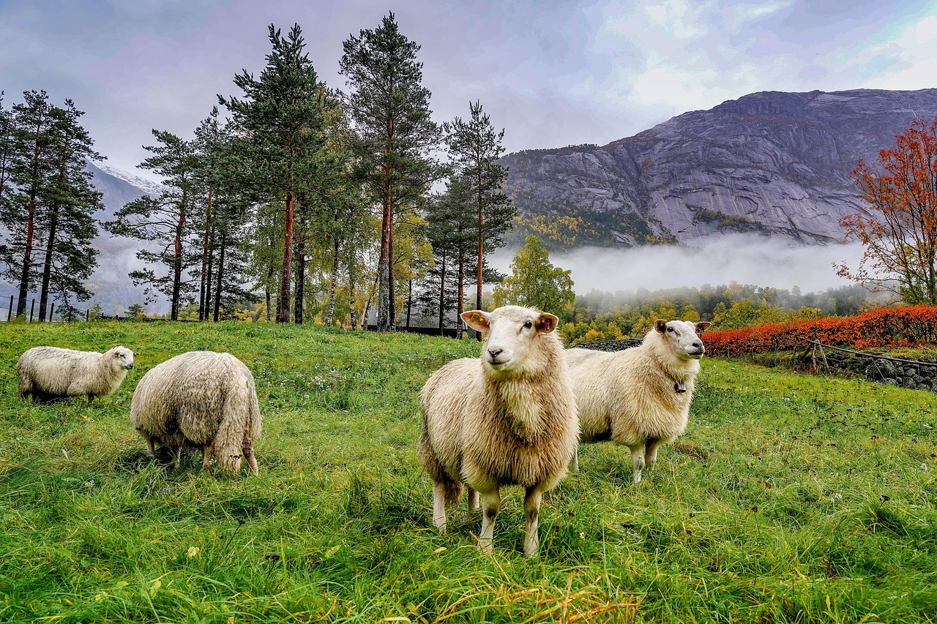
“Blessed are the meek, For they shall inherit the earth”
Matthew 5:5
Richard Thetford www.thetfordcountry.com

Slide 5
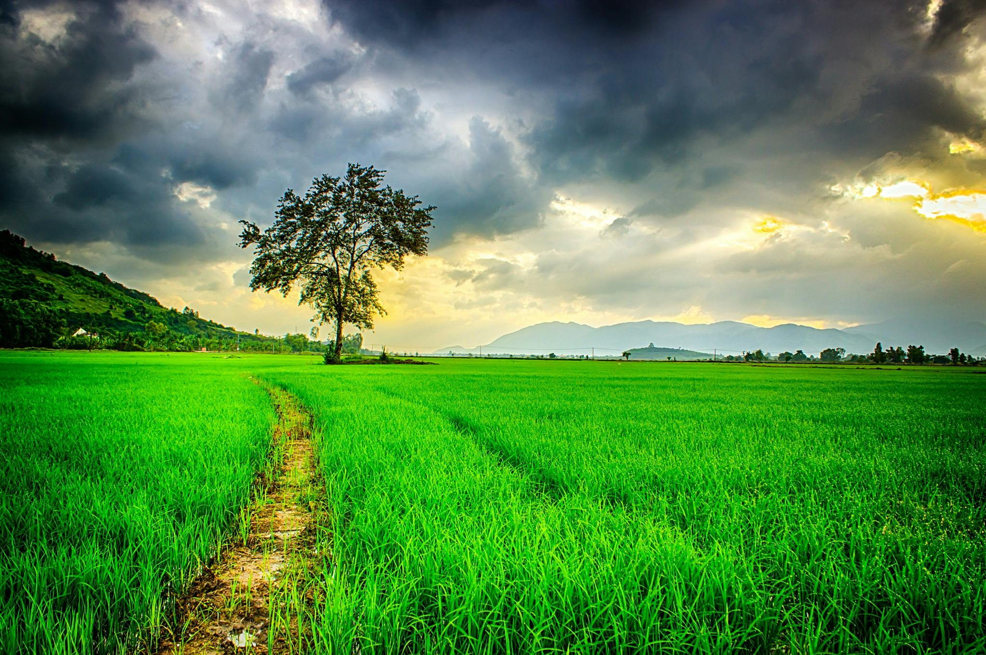
“Blessed are those who hunger and thirst for righteousness, For they shall be filled”
Matthew 5:6
Richard Thetford www.thetfordcountry.com

Slide 6
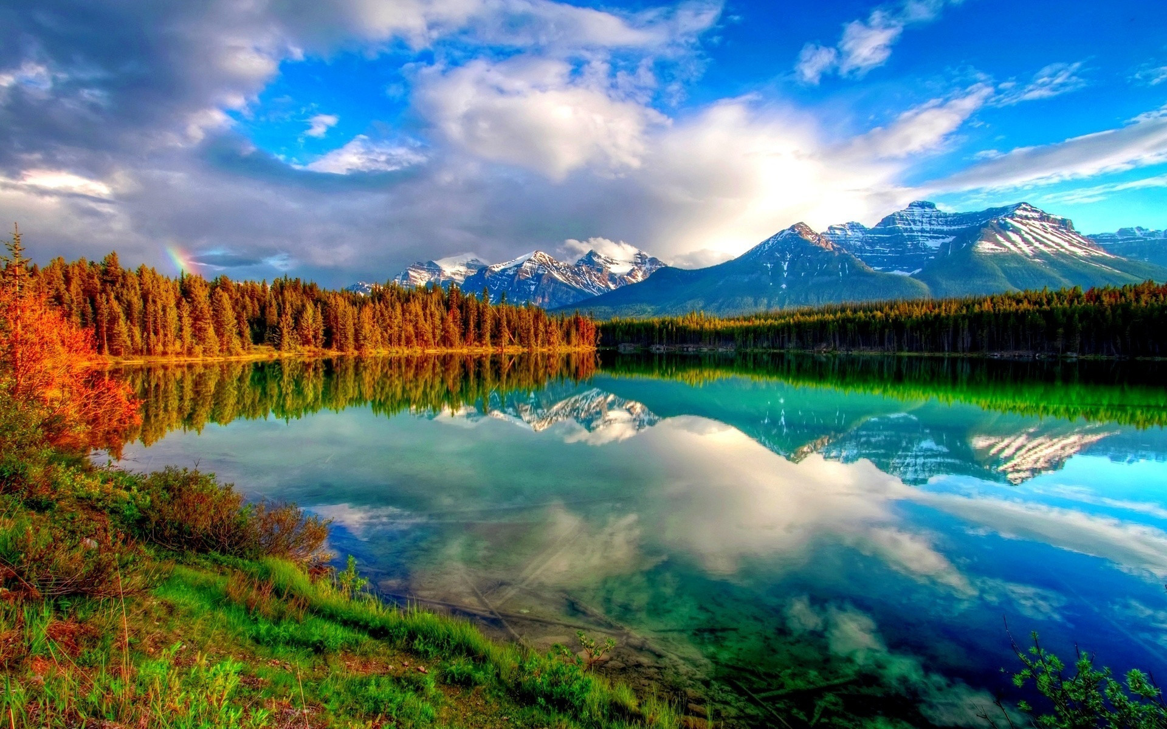
“Blessed are the merciful, For they shall obtain mercy”
Matthew 5:7
Matthew 5:7
Richard Thetford www.thetfordcountry.com

Slide 7

“Blessed are the pure in heart, For they shall see God”
Matthew 5:8
Richard Thetford www.thetfordcountry.com

Slide 8
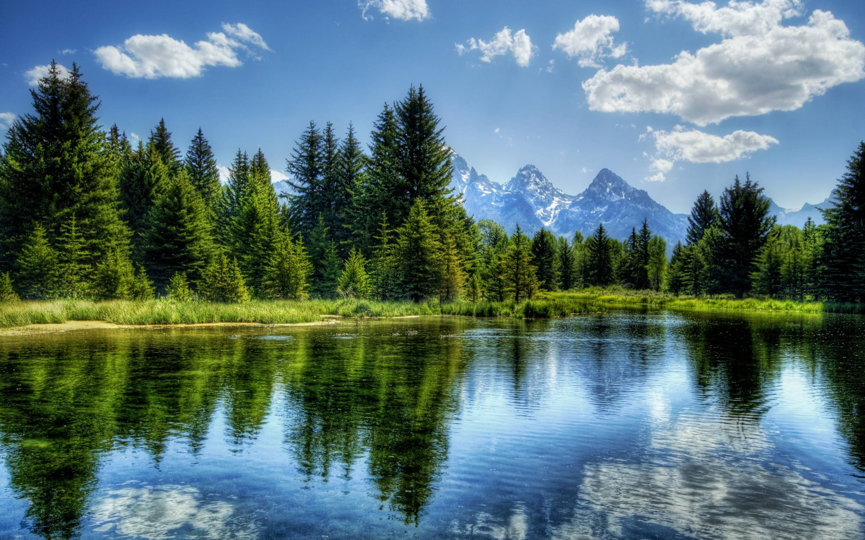
“Blessed are the peacemakers, For they shall be called sons of God”
Matthew 5:9
Richard Thetford www.thetfordcountry.com

Slide 9

“Blessed are those who are persecuted for righteousness’ sake, For theirs is the kingdom of heaven”
Matthew 5:10
Richard Thetford www.thetfordcountry.com

Slide 10

Jesus desires that we become the very best that we can be!
1 John 3:1-3
Richard Thetford www.thetfordcountry.com

