Slide 1
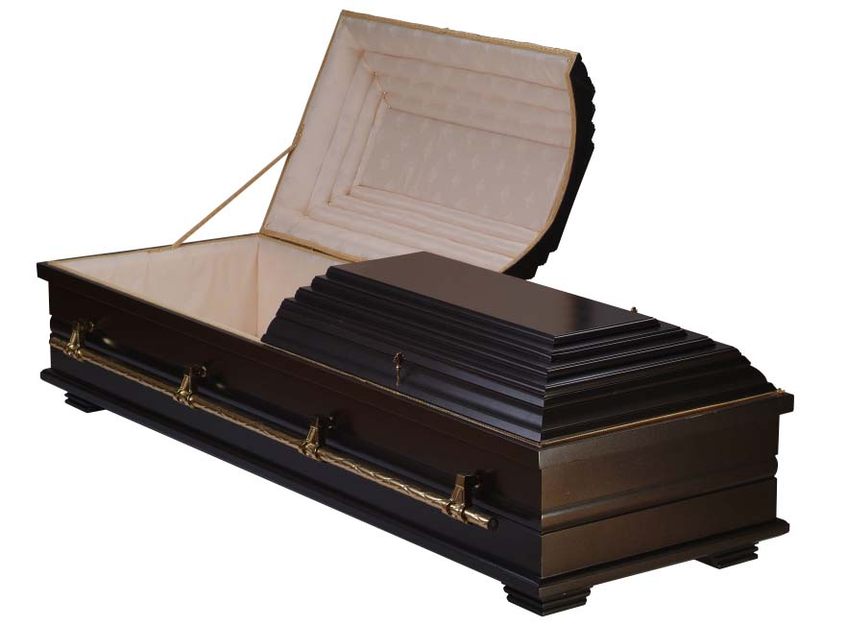
The Resurrection
of Man
Richard Thetford www.thetfordcountry.com

Slide 2
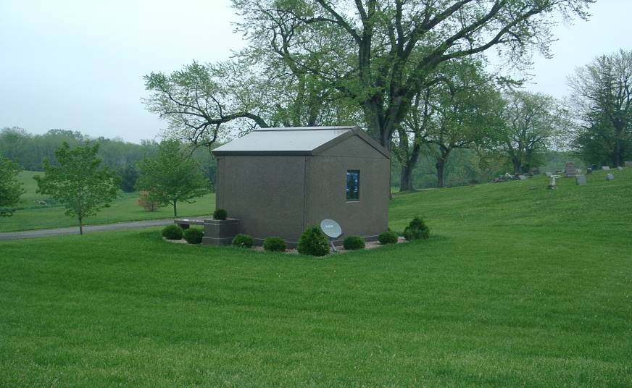
Some Don’t Prepare Properly!
Richard Thetford www.thetfordcountry.com

Slide 3
What Happens to Man at Death?
Question answered by scripture
“Then the dust will return to the earth as it was,
and the spirit will return to God who gave it.” (Ecclessiastes 12:7)
Jesus revealed the habitation of the immortal spirits of the dead
  Luke 16:19-31
  Two places – Torment and Paradise
  Righteous cannot “fall from grace” after death, nor can the wicked be saved
Richard Thetford www.thetfordcountry.com

Slide 4
Richard Thetford www.thetfordcountry.com

Slide 5
What Happens to Man at Death?
Question answered by scripture
“Then the dust will return to the earth as it was,
and the spirit will return to God who gave it.” (Ecclessiastes 12:7)
Jesus revealed the habitation of the immortal spirits
of the dead
  Luke 16:19-31
Paul expressed his desire to go home to be with God
  Philippians 1:21-24; 2 Corinthians 4:16-5:10
Leaving a world of suffering – going to Abraham’s bosom!
Richard Thetford www.thetfordcountry.com

Slide 6


What Shall be Raised from the Dead?
Not the spirit
  Spirit does not die
The question was asked
long ago
  1 Corinthians 15:35-37
Before a seed can
produce a living plant,
it must die
The plant which grows
does not resemble the seed
Richard Thetford www.thetfordcountry.com

Slide 7
What Kind of Body Will Man Have at the Resurrection?
Paul provides the answer
  1 Corinthians 15:38-42
  A body fit for eternal habitation (Philippians 3:20-21)
  Nature of the resurrected body (1 Corinthians 15:42-44)
Our physical body can’t inherit heaven
  1 Corinthians 15:50
  If alive when Jesus returns, we experience a change in our body
    1 Corinthians 15:51-53
Richard Thetford www.thetfordcountry.com

Slide 8
Who Shall be Raised?
Not just the righteous
  John 5:29; Acts 24:15
Richard Thetford www.thetfordcountry.com

Slide 9
Who Shall be Raised?
Not just the righteous
  John 5:29; Acts 24:15
The Guarantee of the Resurrection
Jesus guarantees man will be raised
  Acts 17:30-31
  Resurrection of Christ is our proof that we too shall be raised
    1 Corinthians 15:21-22, 26
Richard Thetford www.thetfordcountry.com

Slide 10
Consequences of the Resurrection
If we believe in the resurrection
– then that should affect how we live!
  If no resurrection – then we might as well live as we please
    1 Corinthians 15:32
  In contrast to the wicked – the righteous believe in the resurrection!
    1 Corinthians 15:58
    2 Peter 3:11-14
Richard Thetford www.thetfordcountry.com

Slide 11
Consequences of the Resurrection
If we believe in the resurrection
– then that should affect how we live!
  Belief in the resurrection provides comfort
    1 Thessalonians 4:13-18
  Resurrection removes the sting of death!
    1 Corinthians 15:54-57
Richard Thetford www.thetfordcountry.com

Slide 12
The Resurrection
Everyone will live forever in a resurrected body
Where will your resurrected body live eternally?
of Man
Richard Thetford www.thetfordcountry.com

