Slide 1

Materialism
Richard Thetford www.thetfordcountry.com

Slide 2

Introduction
Materialism Defined:
The tendency to give undue importance to material interests (Webster)
“Anything you cannot relinquish when it has outlived its usefulness possesses you, and in this materialistic age a great many of us are possessed by our possessions.” —Peace Pilgrim
“No one can serve two masters; for either he will hate the one and love the other, or else he will be loyal to the one and despise the other. You cannot serve God and mammon.”
Matthew 6:24
Richard Thetford www.thetfordcountry.com

Slide 3

Introduction
The Church at Laodicea
Revelation 3:14-19
Ananias and Sapphira
Acts 5:1-11
The days of Lot
Luke 17:28
Ezekiel 16:49
Richard Thetford www.thetfordcountry.com

Slide 4
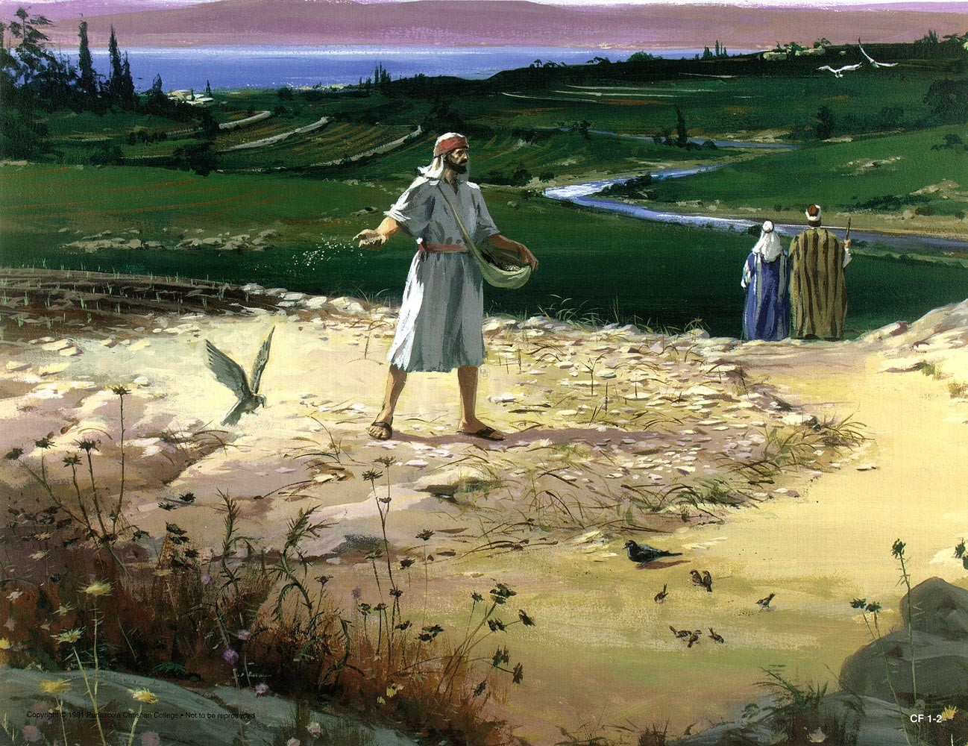
Introduction
The Parable of the Sower
Matthew 13:22
Paul gave warnings
Colossae – Colossians 3:1-2
Philippi – Philippians 3:18-19
Timothy – 1 Timothy 6:6-11, 17-19
Richard Thetford www.thetfordcountry.com

Slide 5

Jesus Stressed the Spiritual
The “Spiritual” Emphasis
Matthew 6:33
Matthew 16:26
John 18:36
Romans 14:17
Matthew 6:1-6, 16-21
Mark 10:17-27
Luke 16:19-31
Richard Thetford www.thetfordcountry.com

Slide 6

Become Rich Toward God
Love God the most
Mark 12:30
Seek His Kingdom first
Matthew 6:33
Trust in God
Psalms 31:1
Rejoice in the Lord
Philippians 4:4
Richard Thetford www.thetfordcountry.com

Slide 7
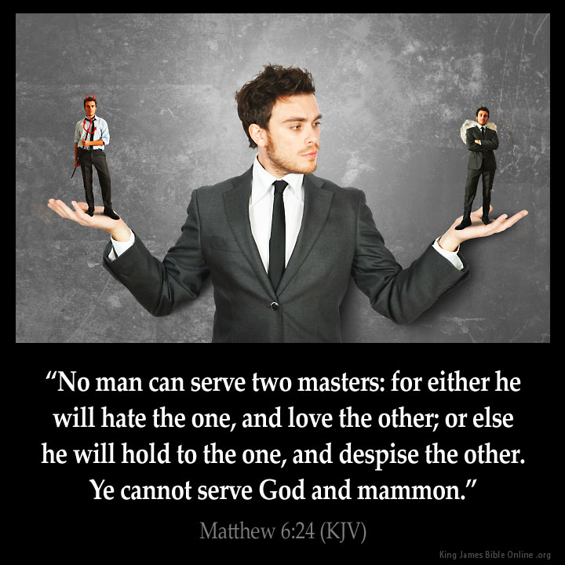
Become Rich Toward God
Labor in the work of the Lord
1 Corinthians 15:58
Be devoted to God
Matthew 6:24
Don’t commit idolatry
Colossians 3:5
Richard Thetford www.thetfordcountry.com

Slide 8

Service to Mammon Has Weakened the Church
Children for “things”
Salvation for “things”
Work of the church for “things”
Association with brethren for “things”
Acts 2:46-47
Richard Thetford www.thetfordcountry.com

Slide 9

Conclusion
Learn what Jesus said:
Luke 12:15
Learn to be rich toward God
Matthew 6:20
Learn to trust in God
Hebrews 13:5
Seek the Kingdom first
Matthew 6:33
Richard Thetford www.thetfordcountry.com

