Slide 1
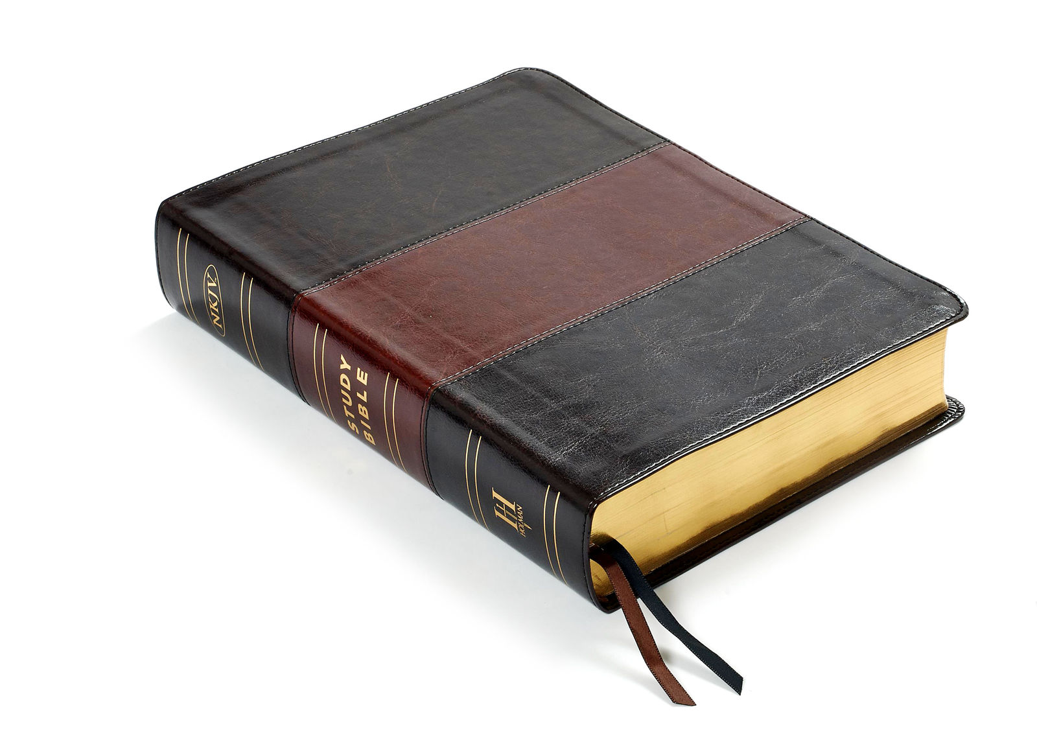
ENOCH
Hebrews 11:5
Jude 14-15
Richard Thetford www.thetfordcountry.com

Slide 2

Enoch Walked with God
“Walked with God”
  Genesis 5:22, 24
  Genesis 6:9
Keeping oneself in agreement with God
  Amos 3:3; Isaiah 59:1-2
  2 Corinthians 6:14-18
Indicates the “whole of life”
  Genesis 17:1
  1 John 1:6-7
Richard Thetford www.thetfordcountry.com

Slide 3
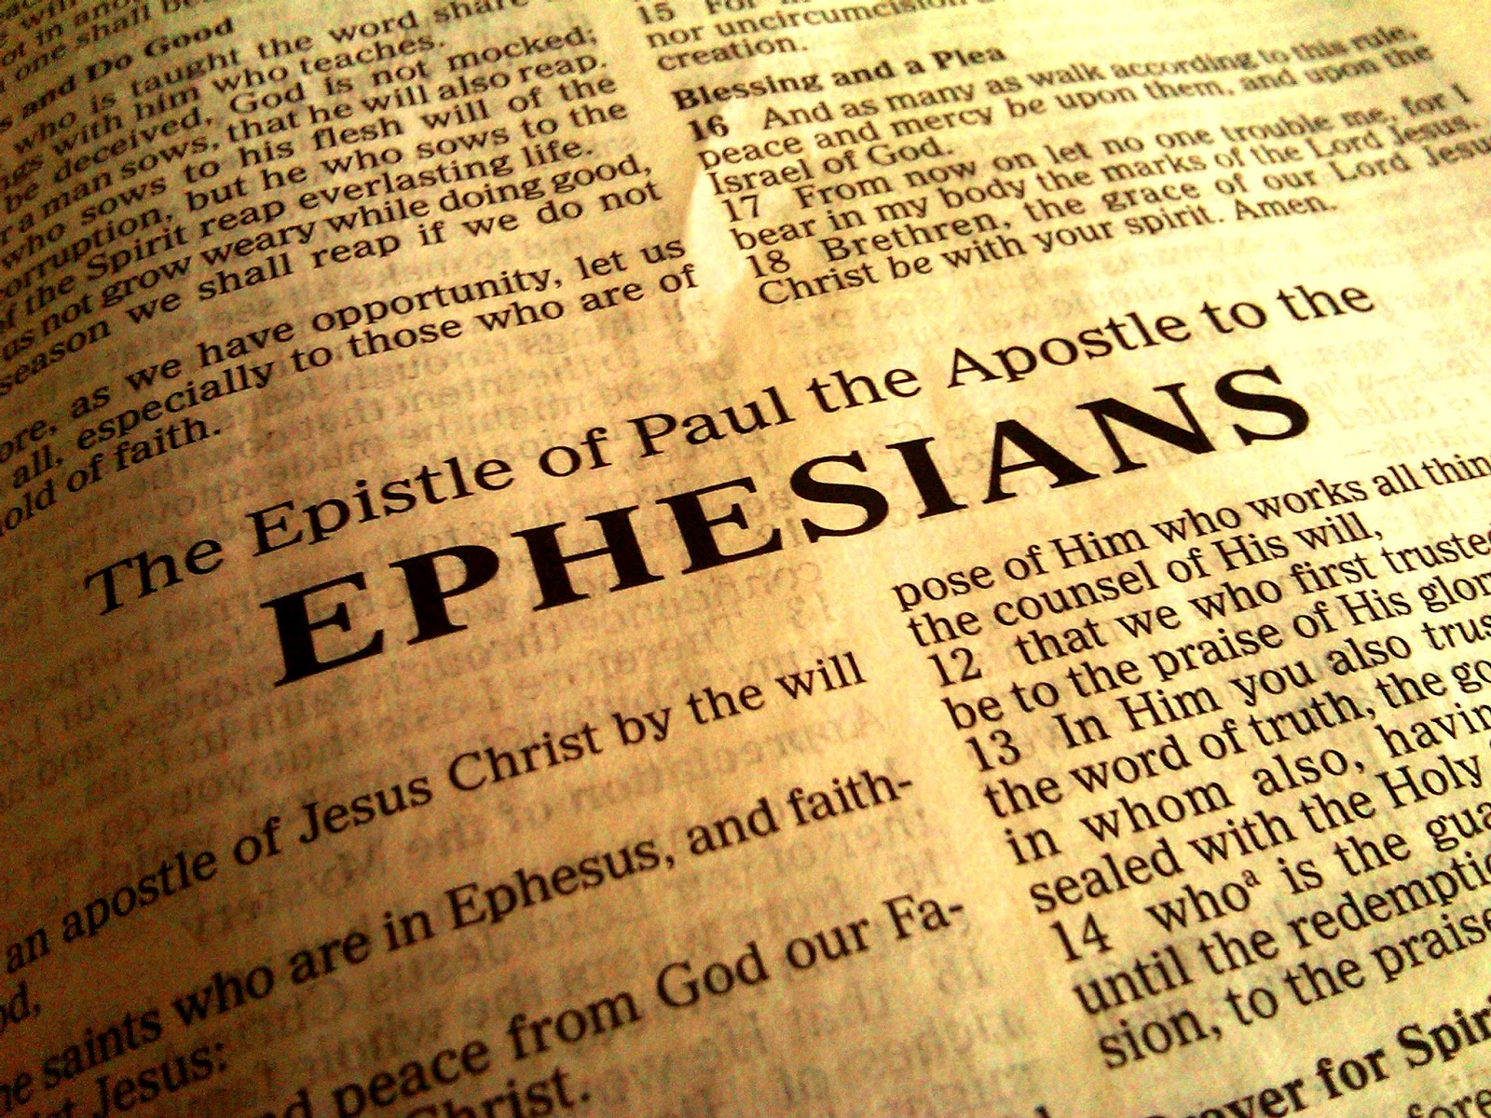
Enoch Walked with God
Seven “walks” of the Ephesians
  According to His word – Ephesians 2:2
  In good works – Ephesians 2:10
  Worthy of the calling – Ephesians 4:1
  Not as other Gentiles – Ephesians 4:17
  In love – Ephesians 5:2
  As children of light – Ephesians 5:8
  Wisely – Ephesians 5:15
“Walking” is making progress – 2 Pet 3:18
Richard Thetford www.thetfordcountry.com

Slide 4

Enoch Left His Good Example to His Children
Youth need good examples to follow
  Genesis 5:22
  Genesis 18:19
Richard Thetford www.thetfordcountry.com

Slide 5

In Life Enoch Was Well Pleasing to God
He “pleased God”
  Hebrews 11:5
How can we please God?
  By gaining faith and doing His will
    Hebrews 11:6
    Romans 10:17
    Acts 16:31
    Luke 13:3
    Acts 22:16
May we all be “well pleasing to God”
Richard Thetford www.thetfordcountry.com

Slide 6
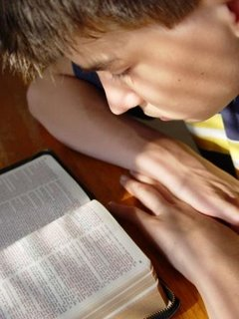
Enoch Was a Prophet of God
Stated in Jude 14-15
He wanted others to be pleasing to God
  Acts 8:4
A message of God’s judgment
  Others did also
    Acts 24:25
    Matthew 25:31-34
    Ephesians 5:14-17
Richard Thetford www.thetfordcountry.com

Slide 7

Conclusion
Was taken up to be with God
God rewards the faithful
  Romans 2:6-7
  1 Corinthians 3:8
Faith is rewarded
  James 2:17-18
Let’s live in a way that we KNOW that when our life is over,
that we will “walk with God” through eternity with Him!
Richard Thetford www.thetfordcountry.com

