Slide 1

A “stiff-necked” People
Acts 7:47-53
Richie Thetford www.thetfordcountry.com

Slide 2

Old Testament Examples
Israel
  2 Kings 17:14
  Deuteronomy 31:27
  Nehemiah 9:16-17
  Jeremiah 17:23
Zedekiah
  2 Chronicles 36:11-13
Richie Thetford www.thetfordcountry.com

Slide 3
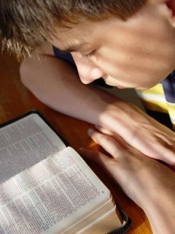
“stiff-necked” Examples Today
Baptism
  Mark 16:16
  Acts 2:38
Remarriage
  Matthew 19:9
Richie Thetford www.thetfordcountry.com

Slide 4
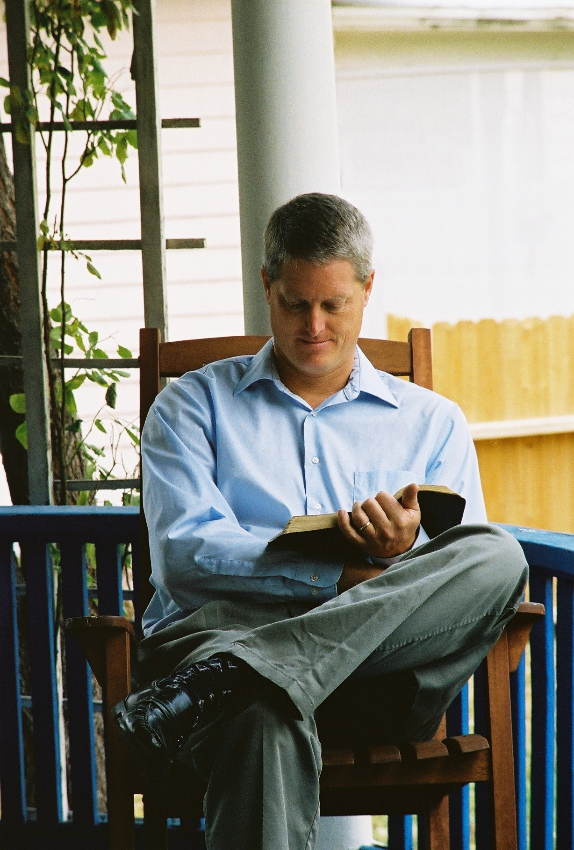
“stiff-necked” Examples Today
Reverence God
  Hebrews 10:25
  John 4:24
  Acts 20:7
Friends of the World
  James 4:4-7
Refusing to Obey God
  Jeremiah 17:23; Romans 10:21
Richie Thetford www.thetfordcountry.com

Slide 5
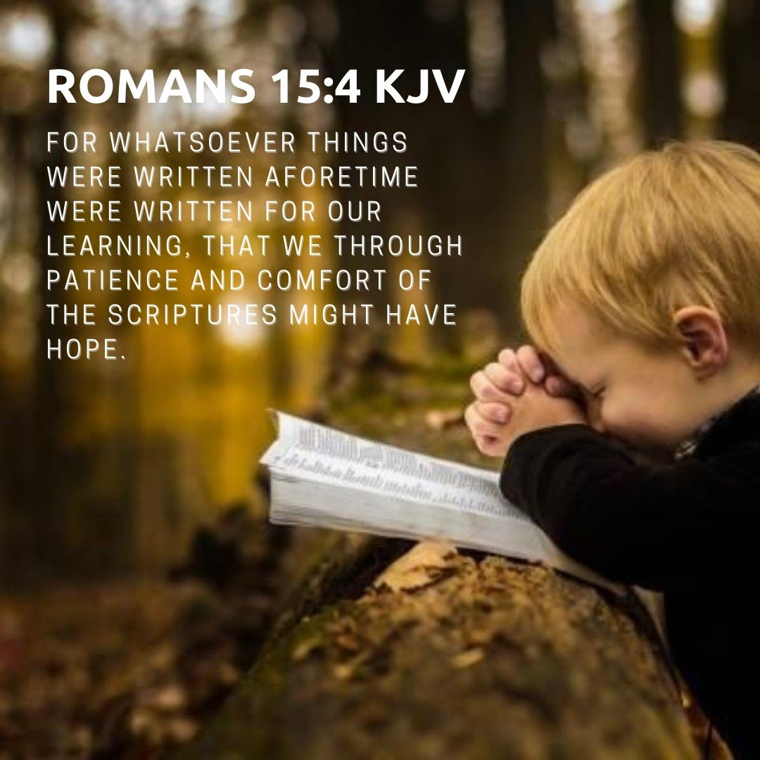
Consequences of Being “stiff-necked”
Resisting the Holy Spirit
Destruction
  2 Kings 23:5-14
Death
  Jeremiah 52:8-11
Eternal Separation
  Hebrews 10:28-31
Richie Thetford www.thetfordcountry.com

