Slide 1
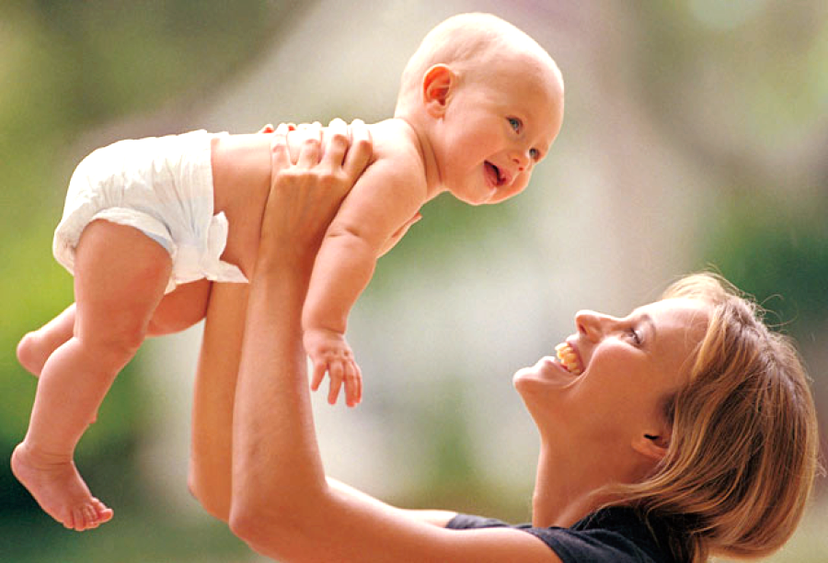
A Mother’s
Sacrificial Love
“By this we know love, because He laid down His life for us. And we also ought to lay down our lives for the brethren”
1 John 3:16
Richard Thetford www.thetfordcountry.com

Slide 2


Jochebed
Exodus 1:22-2:10
Don’t you think she was troubled and concerned about the decree?
Was willing to trust in God
Must always trust in God’s goodness
  Jeremiah 29:11-13; 2 Corinthians 3:5
Are we willing, like Jochebed, to take a back seat?
  Luke 9:23
Richard Thetford www.thetfordcountry.com

Slide 3
Hannah
1 Samuel 1:10-28
Unable to conceive, she wept to have her own child
  Psalms 127:3
The one thing she wanted the most, she gave back to God!
Are we dedicating our children to the Lord?
  Ephesians 6:4
Mothers deserve our praise because they watch over our souls
Richard Thetford www.thetfordcountry.com

Slide 4
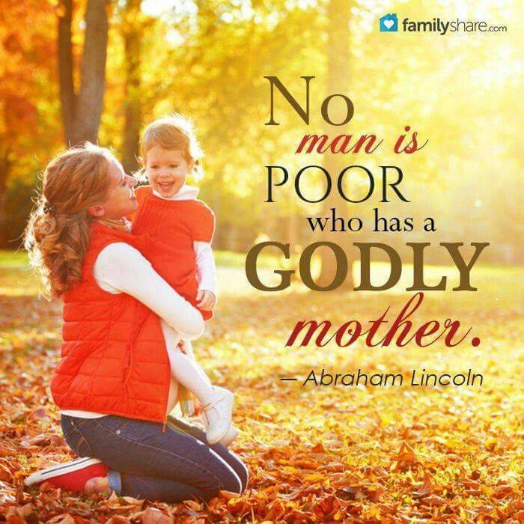

Godly
Mothers
Diligently train their children
  Proverbs 1:8
Teach their young
  Proverbs 29:15
Provide a godly example to the children
  2 Timothy 1:3-5
Children should be thankful
for the sacrificial love
of their mother
Richard Thetford www.thetfordcountry.com

Slide 5
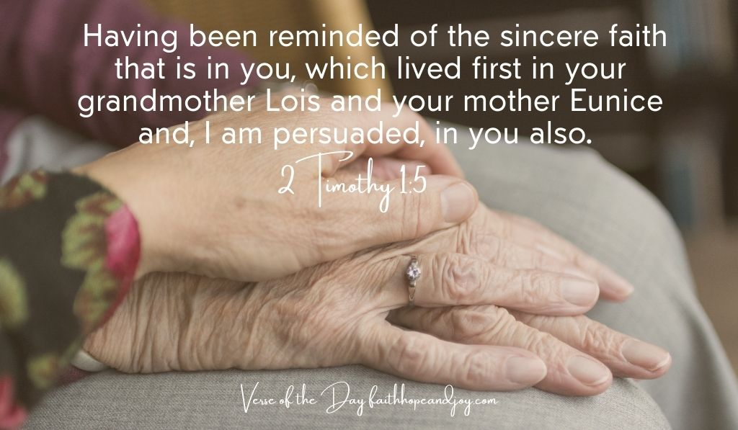
“This is My commandment, that you love one another as I have loved you. Greater love has no
one than this, than to lay down one's life for his friends”
John 15:12-13
“For God so loved the world that He gave His only
begotten Son, that whoever believes in Him
should not perish but have everlasting life” John 3:16
Let the story of Jesus move you today to obey His will
Richard Thetford www.thetfordcountry.com

