Slide 1

A FEW
Jeremiah 31:31-34
Richard Thetford www.thetfordcountry.com

Slide 2

A New Covenant
Hundreds of years before the New Testament
Jeremiah 31:31
Hebrews 8:8
Why a new covenant?
Hebrews 8:7
Hebrews 10:1
Richard Thetford www.thetfordcountry.com

Slide 3
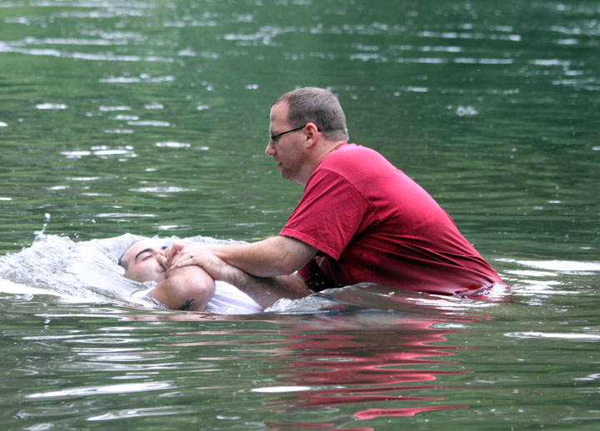
A New Creature
Enter the new covenant by a new birth
A spiritual birth
John 3:3-5
A begetting and then a bringing forth
1 Peter 1:23
James 1:18
1 Corinthians 4:15
When “born again” – now a new creature
2 Corinthians 5:17
Romans 8:1
Richard Thetford www.thetfordcountry.com

Slide 4
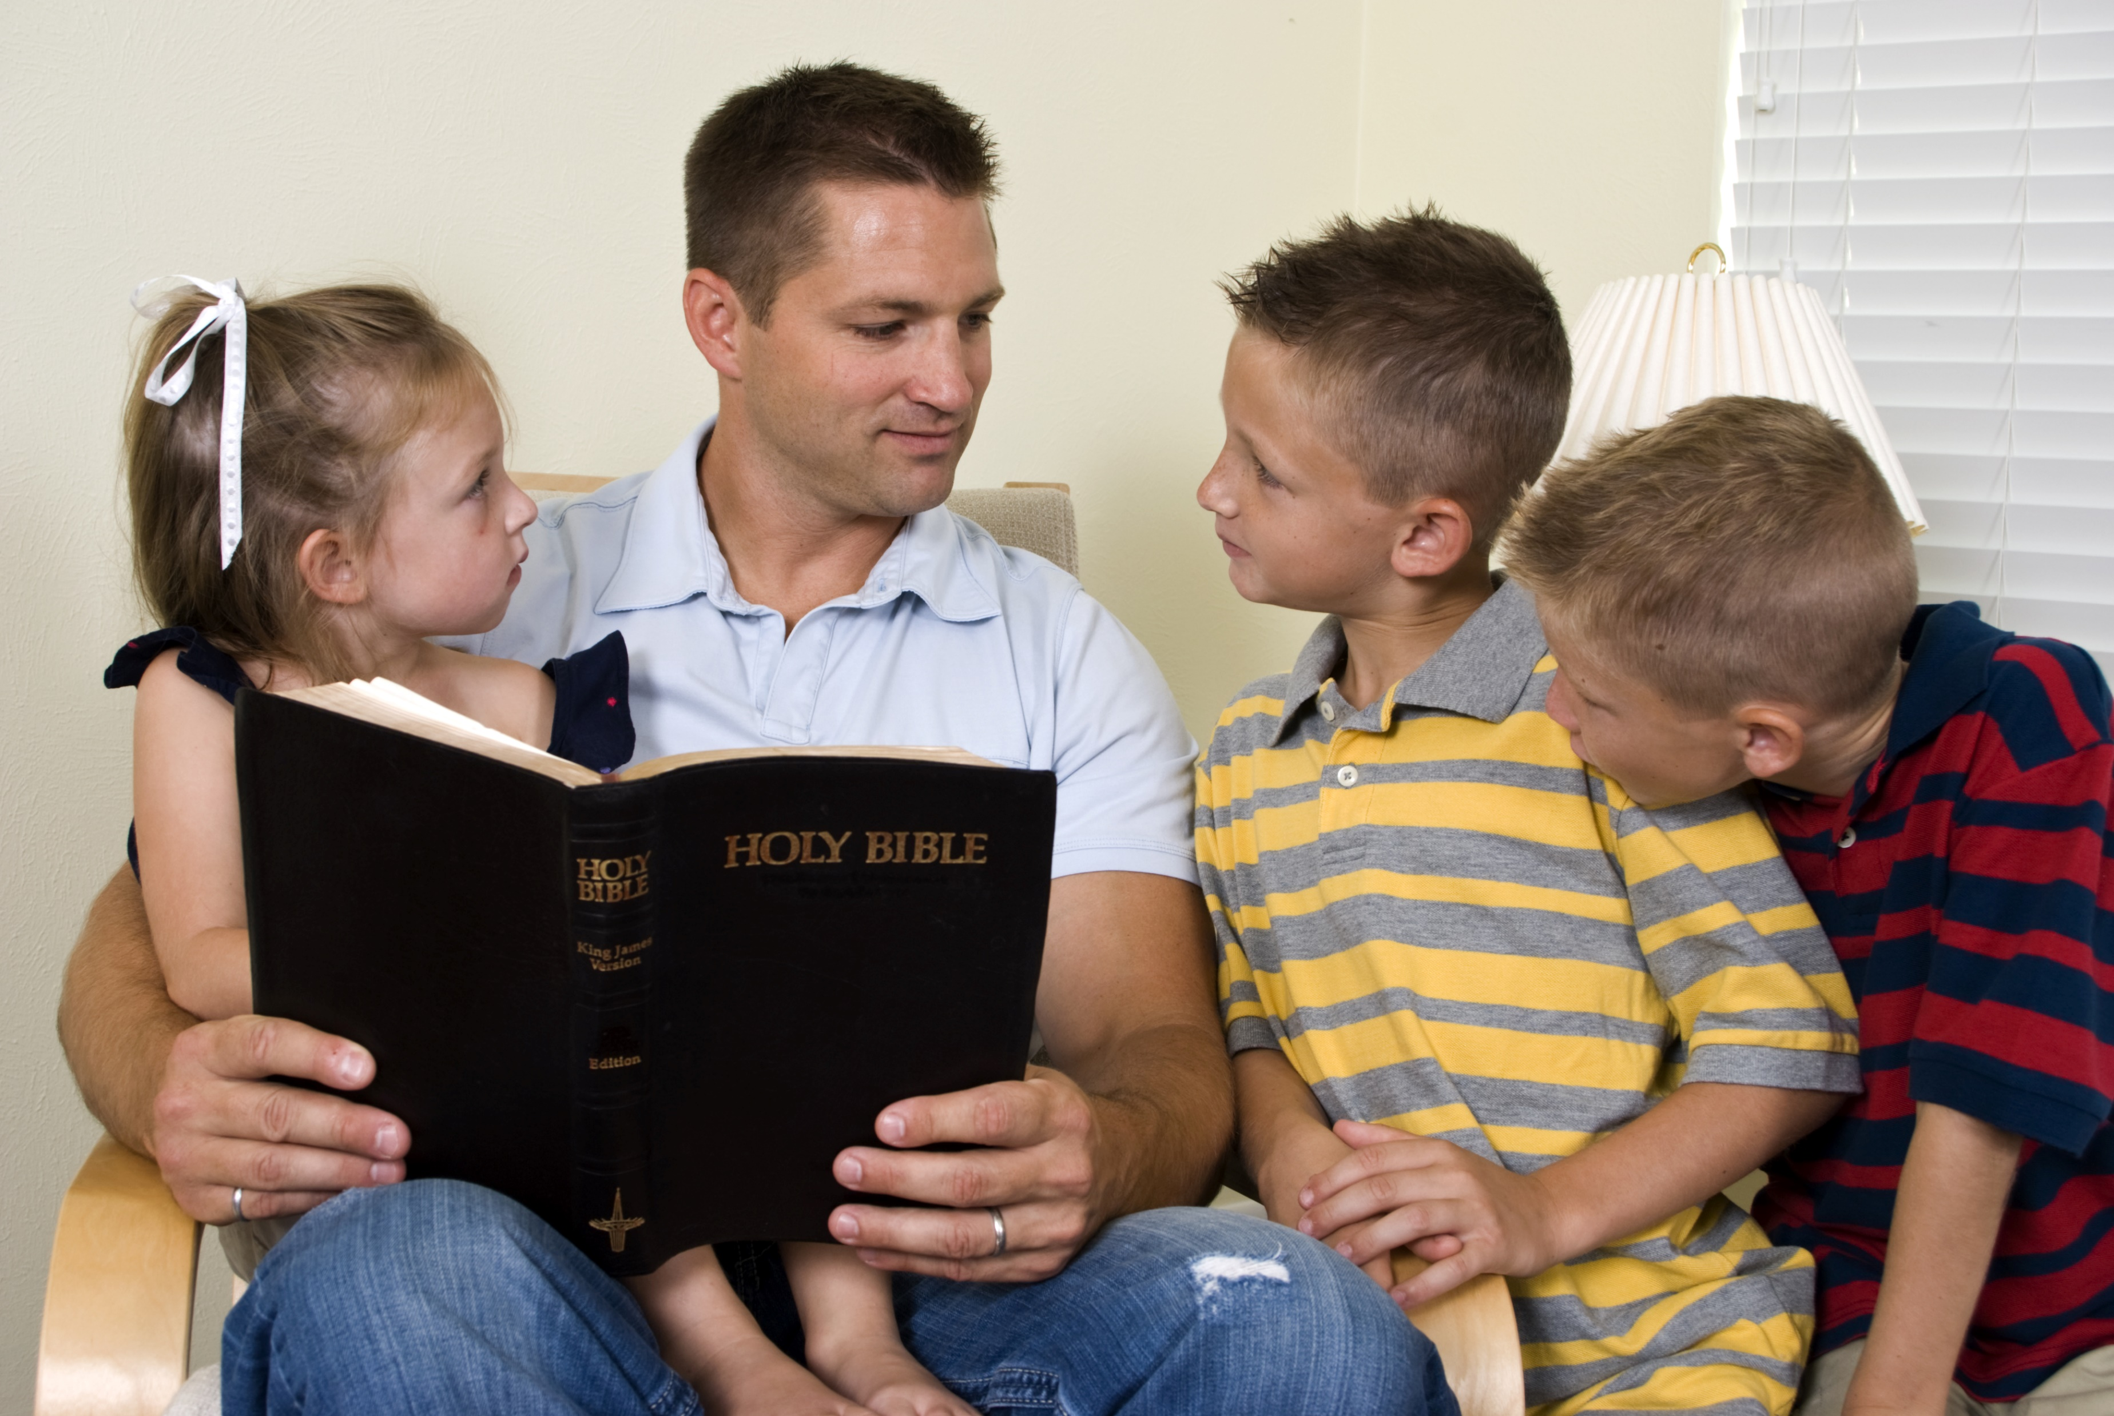
A New Diet
New creature requires a new diet
1 Peter 2:1-2
Some never make the desired growth
Hebrews 5:12-14
Matthew 4:4
Richard Thetford www.thetfordcountry.com

Slide 5
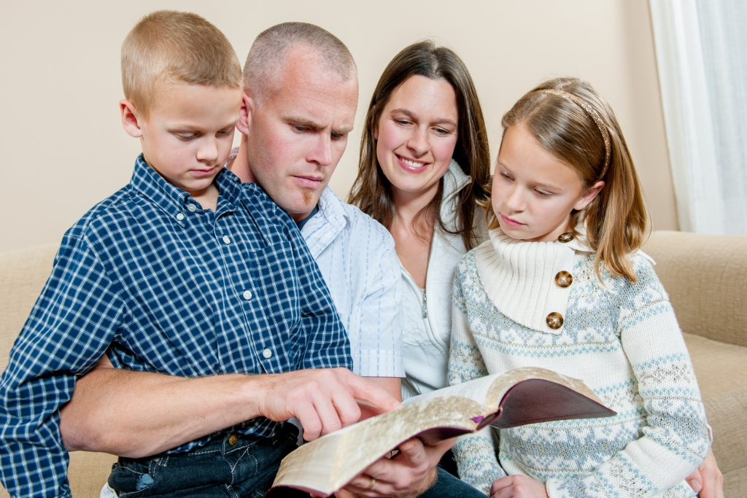
A New Name
New creature in Christ has a new name
Isaiah 62:2
Acts 11:26
Acts 26:28
Richard Thetford www.thetfordcountry.com

Slide 6


A New Employment
New creature is now ready for new employment
Philippians 2:12
Must remain steadfast
1 Corinthians 15:58
John 9:4
Looking forward to eternity!
2 Peter 3:12
Revelation 21:1
Richard Thetford www.thetfordcountry.com

Slide 7
A FEW
Although these Bible truths are not new, we need to develop our lives to live in the NEW!
Matthew 11:28-30
Richard Thetford www.thetfordcountry.com

