Slide 1

Realized Eschatology
CONSEQUENCES
of the
70 A.D.
Doctrine

Slide 2
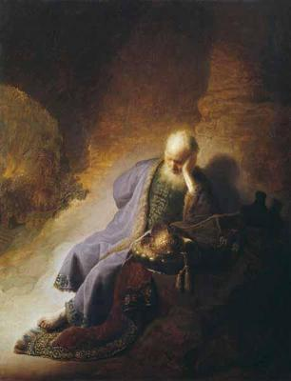
Introduction
Realized Eschatology teaches that ALL Bible prophecy has been fulfilled:
  The second coming of Christ
  The resurrection of the dead
  The day of judgment
  The end of the world
All these things were fulfilled in 70 A.D. at the destruction of Jerusalem

Slide 3

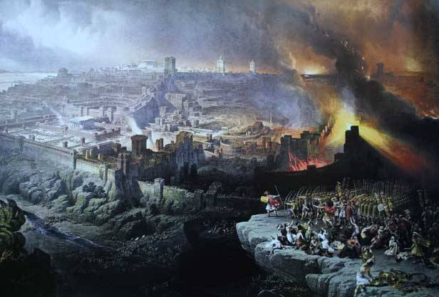
Introduction
70 A. D. Doctrine
Coming of Christ
30
AD
“Last Days”
70
AD
ETERNAL DAYS
(Transitional Period)
The Cross
Destruction of Jerusalem
This theory would have us believe that the “last days” existed from 30-70 A.D.
  Eternal days began in 70 A.D. and we are living in the “eternal days” now

Slide 4
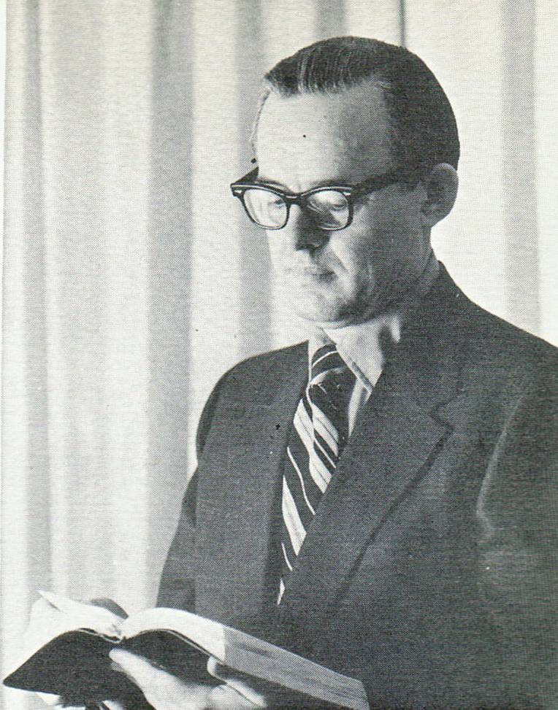
Introduction
Consider this assessment from Max King:
Max King (1971)
“The fall of Judaism (and its far-reaching consequences) is, therefore, a major subject of the Bible. The greater portion of prophecy found its fulfillment in that event, including also the types and shadows of the law. It was the coming of Christ in glory that closely followed his coming in suffering (1 Peter 1:11), when all things written by the prophets were fulfilled (Luke 21:22; Acts 3:21).

Slide 5
Introduction
Consider this assessment from Max King:
Max King (1971)
It corresponded to the perfection of the saints (1 Corinthians 13:10) when they reached adulthood in Christ, receiving their adoption, redemption, and inheritance. The eternal kingdom was possessed (Hebrews 12:28) and the new heaven and earth inherited (Matthew 5:5; Revelation 21:1, 7).” (SOP, P. 239)

Slide 6
Consequences of the 70 A.D. Doctrine
Problems Regarding the Resurrection
No marriage and no death after 70 A.D.
  Luke 20:34-36
    This consequence centers on the view that the “last days” are to be defined as the closing period of the Jewish age 30-70 A.D., with the “eternal days” continuing from that point
“We are now in that world which is to come …. Instead of being in the last days we are in the eternal days, a world without end (Eph 3:21).” (SOP, P. 81)

Slide 7
Consequences of the 70 A.D. Doctrine
Problems Regarding the Resurrection
  Those who lived between 30-70 A.D. were in the “last days” while we now live in the “eternal days”
    Jesus contrasts “this world” and “that world”
      Concludes that marriage occurs in “this world” and not in
      “that world” (Luke 20:34-36)
    Those who “are accounted worthy to attain to that world and the resurrection of the dead .... die no more”

Slide 8

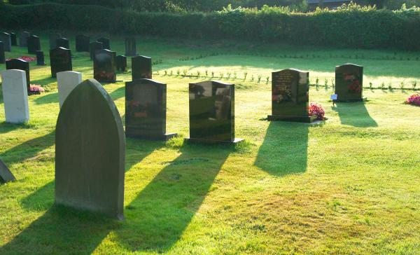
Consequences of the 70 A.D. Doctrine
Problems Regarding the Resurrection
    Are people still marrying after 70 A.D.? YES
    Are people still dying after 70 A.D.? YES
    Is the period of Christianity in which we now live termed the “eternal days” in the New Testament? NO

Slide 9
Consequences of the 70 A.D. Doctrine
Problems Regarding the Resurrection
Pharisees and Paul looked for the same kind of resurrection
  Acts 24:15
    70 A.D. doctrine teaches that the resurrection of the dead is the resurrection of Christianity out of Judaism (SOP, P. 200)
      If true – the Pharisees held a very strange hope concerning the resurrection

Slide 10
Consequences of the 70 A.D. Doctrine
Problems Regarding the Resurrection
Paul’s accusers (THE JEWS) were looking for the same kind of resurrection as he was
  Were the Jewish accusers looking forward to the day when Christianity would arise to dominance, while Judaism would be destroyed?

Slide 11
Consequences of the 70 A.D. Doctrine
Problems Regarding Human Redemption
Forgiveness of sins was not fully accomplished until 70 A.D.
“When would ungodliness be turned away from Jacob, or their sins be taken away? When Christ, the deliverer, came OUT OF ZION. When did Christ come out of Zion? Not at his first coming, but his second coming.” (SOP, P. 63)

Slide 12
Consequences of the 70 A.D. Doctrine
Problems Regarding Human Redemption
  The cross of Christ is removed as the focal point and means of accomplishing forgiveness – it is replaced by 70 A.D.
    Why make appeals to people before 70 A.D. to receive the forgiveness of sins through the death of Christ?

Slide 13

Consequences of the 70 A.D. Doctrine
Problems Regarding Human Redemption
  These Jews did not have to wait until 70 A.D. to have their sins forgiven
  Baptism puts one into the death of Christ (Romans 6:3), to enable justification by His blood
Then Peter said to them, “Repent, and let every one of you be baptized in the name of Jesus Christ for the remission of sins; and you shall receive the gift of the Holy Spirit.” Acts 2:38

Slide 14
Consequences of the 70 A.D. Doctrine
Problems Regarding Human Redemption
Maturity and completeness in Christ
  The apostle Paul taught differently:
    Colossians 2:10; 1:27-28
  70 A.D. doctrine concludes that no Christian could be mature in Christ before 70 A.D.
“Maturity and completeness in Christ was not
possible before 70 A.D.” (SOP, P. 239)

Slide 15
Consequences of the 70 A.D. Doctrine
Problems Regarding the Establishment of the Kingdom
Misapplying Hebrews 12:28:
“Therefore, since we are receiving a kingdom which cannot be shaken, let us have grace, by which we may serve God acceptably with reverence and godly fear.” (Hebrews 12:28)

Slide 16
Consequences of the 70 A.D. Doctrine
Problems Regarding the Establishment of the Kingdom
Realized Eschatology concludes that the kingdom was not FULLY established until 70 A.D.
  Isaiah prophecies the following (2:2):
“Now it shall come to pass in the latter days That the mountain
of the LORD's house Shall be established on the top of the mountains, And shall be exalted above the hills;
And all nations shall flow to it.”

Slide 17
Consequences of the 70 A.D. Doctrine
Problems Regarding the Establishment of the Kingdom
  Realized Eschatology has God’s house being only partially established in the “latter days” – fully established at 70 A.D. (their “eternal days”)
Isaiah (v.2) implies that FULL and complete establishment would occur when the law and the word went forth from Jerusalem (v.3)

Slide 18

Consequences of the 70 A.D. Doctrine
Problems Regarding the Establishment of the Kingdom
  The gospel of the kingdom was preached from Jerusalem to all nations following Jesus’ ascension
  (Luke 24:45-49; Acts 2:14-36)
Jesus said the kingdom would
“come with power”
  Mark 9:1

Slide 19
Consequences of the 70 A.D. Doctrine
Problems Regarding the Establishment of the Kingdom
At the point of baptism, individuals were being translated into the kingdom of God
  Colossians 1:13
  The Jews who were baptized and received the forgiveness of sins on Pentecost were translated into the fullness of God’s kingdom

Slide 20

Consequences of the 70 A.D. Doctrine
Problems Regarding Worship
Should the Lord’s Supper
be observed after 70 A.D.?

Slide 21
Consequences of the 70 A.D. Doctrine
Problems Regarding Worship
The Realized Eschatologist has no reason to partake of the Lord’s Supper
Jesus said – it would be observed when His kingdom was fully established
  Matthew 26:29
    To the Realized Eschatologist it could not be observed until the kingdom was fully established in 70 A.D.

Slide 22
Consequences of the 70 A.D. Doctrine
Problems Regarding Worship
The Lord’s Supper was to be observed in the kingdom – but it would NOT be observed AFTER the Lord’s return
For as often as you eat this bread and drink this cup, you proclaim the Lord's death till He comes.
1 Corinthians 11:26

Slide 23
Consequences of the 70 A.D. Doctrine
Problems Regarding Worship
The 70 A.D. doctrine makes every coming of the Lord in the New Testament mean 70 A.D.
  Based on their theory, the Lord’s Supper was never observed and could never be observed

Slide 24
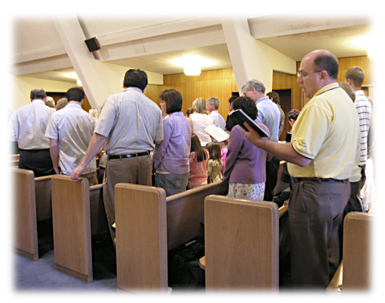
Consequences of the 70 A.D. Doctrine
Problems Regarding Worship
Most songs must be eliminated from worship
  Every song that has reference to the return of Jesus Christ, the judgment day, the end of the world, and all its events must not be sung
    They have already been realized in 70 A.D.

Slide 25


Conclusion
1 Thessalonians 4:13-18
All these events did NOT happen at the destruction of Jerusalem in 70 A.D.

