Slide 1
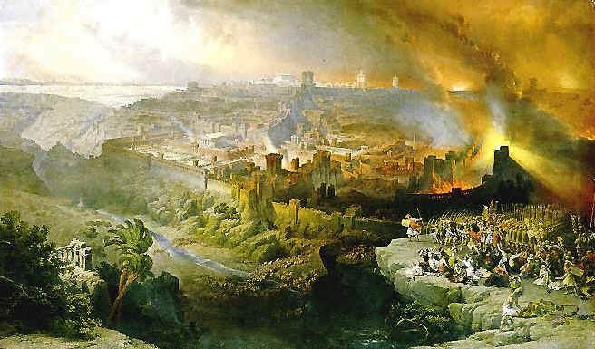
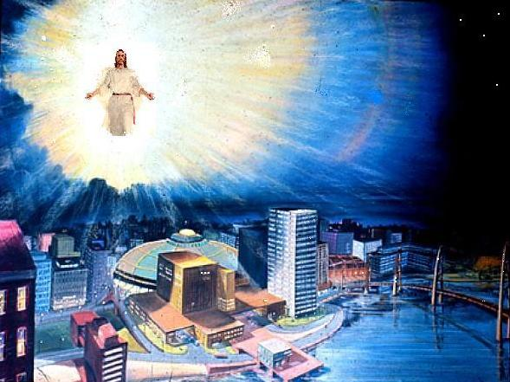
Realized Eschatology
Matthew 24:
Destruction of Jerusalem
Second Coming of Christ
or
BOTH?

Slide 2
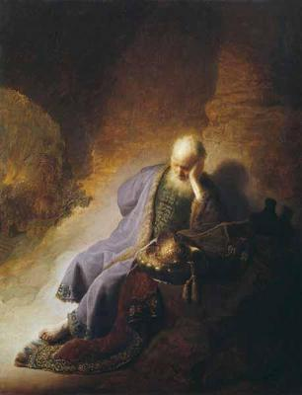
Introduction
Advocates of Realized Eschatology see ALL references to:
  The “last days”
  The “second coming of Christ”
  The “judgment Day”
  The “resurrection of the dead”
  The “end of the world”
As already taken place at the destruction of Jerusalem in
70 A.D.

Slide 3

The Disciples’ Questions
“….Do you not see all these things?
I say to you, not one stone shall be left here upon another, that shall not
be thrown down.”
(Matthew 24:2)
Matthew 24
“Now as He sat on the Mount of Olives, the disciples came to Him privately, saying, “Tell us, when will these things be? And what will be the sign of Your coming, and of the end of the age?” (Matthew 24:3)

Slide 4
The Disciples’ Questions
They first asked about the fall of Jerusalem – which seemed to imply the end of the world
  They thought a devastation so catastrophic as to include the leveling of the Temple must mean the end of the world
    It only heralded the conclusion of the Jewish economy

Slide 5
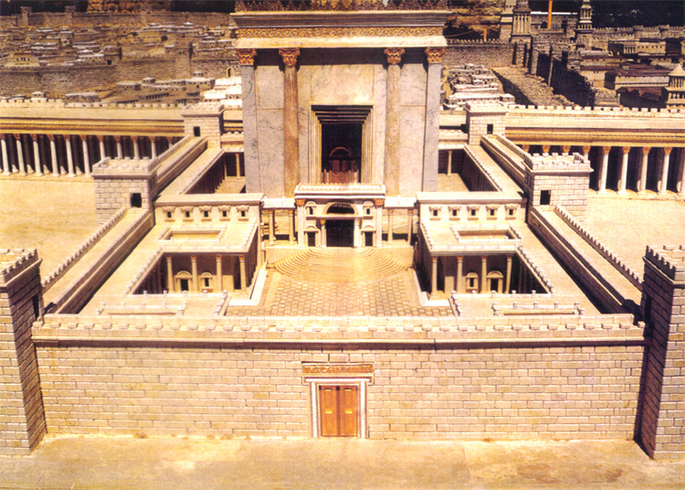
The Disciples’ Questions
Temple was the pride and glory of
the Jews
  Four to five times the size of its predecessors
  20-64 A.D. in the building process
    Stones were 50 feet long, 20 feet wide, 16 feet thick
    Cut of white and green-spotted marble that would glisten in the sun “like a white mountain”
    Jews considered it built to last, maybe even forever!

Slide 6
The Disciples’ Questions
Jesus dashed their hopes with His few words
  Portrayed the coming destruction as absolute
  Josephus (Wars of the Jews 7, 9)
“These things” in verse 3 refers to the buildings of the temple and their destruction (24:2)
  Verses 4 through 35, Jesus discusses the desolation and destruction of Jerusalem
  KEY VERSE:
“But he who endures to the end shall be saved” (24:13)

Slide 7
The Disciples’ Questions
Matthew 24:4-35
Destruction of Jerusalem
Jesus looked beyond the fall of Jerusalem to what would be the actual (literal) end of the world. This would be the section of scripture beginning in Matthew 24:36 and continuing through Matthew 25:46
Matthew 24:36-25:46
Second coming of Christ

Slide 8
“This Generation” Passage
Matthew 24:34 – Key passage in confirming the destruction of Jerusalem would take place in that generation
  Reference to “these things” and “this generation” is defined by its earlier use in the book of Matthew
    Matthew 1:17
    Matthew 11:16
    The “this generation” of this text is the “now” of Matthew 11:12
“Assuredly, I say to you, this generation will by no means
pass away till all these things take place.”

Slide 9
“This Generation” Passage
Matthew 12:39, 41, 42, 45
“An evil and adulterous generation …. this generation …. this wicked generation” is that era, that day, the generation of Christ’s personal preaching, death, burial and resurrection.
The “men of Nineveh” is the generation of Jonah.
The “queen of the south” is the generation of Solomon contrasted with
“this generation” of Jesus.

Slide 10
“This Generation” Passage
Matthew 16:4
The “generation” of this passage is the
Pharisees and Sadducees of Jesus’ day
(reference “sign” in Matthew 16:1,4)

Slide 11
“This Generation” Passage
Matthew 17:17
That “generation” was the time Christ was “with” them
Matthew 23:36
Observe that “this generation” is distinguished from
“the days of your fathers” (verse 30)

Slide 12
“This Generation” Passage
Matthew 24:34-35
All these were to take place before the end of one generation
Attempts by eschatologists to make “this generation” an end-time generation are doomed to failure on account of the context
“Assuredly, I say to you, this generation will by no means pass away till all these things take place. Heaven and earth will pass away, but My words will by no means pass away.”

Slide 13

“That Day” Versus “Those Days”
In describing the desolation of Jerusalem, Jesus spoke of the tribulation of “those days”
  Matthew 24:19, 22, 29
When discussing the judgment, He spoke of
“that day and hour”
  Matthew 24:36, 42, 44, 50; 25:13
A sharpening of the contrast is seen
“in the days that were before the flood”
as opposed to “the day that Noah entered the ark.”
Matthew 24:38

Slide 14
The “Signs” Versus “Suddenness”
Jesus told of the signs preceding the destruction of Jerusalem
  “false Christ's and false prophets”
  “wars and rumors of wars”
  “famines and earthquakes”
  “all these are the beginning of sorrows”
    Matthew 24:6-8, 23-24
Jesus also told them of “the abomination of destruction” (Roman Army)
  Matthew 24:15

Slide 15

The “Signs” Versus “Suddenness”
“So also, when you see all these things,
know that it is near – at the doors!” (Matthew 24:33)
They could KNOW that the
destruction of Jerusalem was near
  But the coming of the Son of man
  and the consequent judgment
  were to be without warning
    Matthew 24:42-43, 50; 25:13

Slide 16

The “Signs” Versus “Suddenness”
At least three times Jesus specifically indicated that He was giving tangible evidence of the destruction of Jerusalem
  Matthew 24:8, 25, 33
But the second coming and the
judgment were to be sudden,
unknown, as a thief strikes
  Matthew 24:42, 44, 50: 25:13
  1 Thessalonians 5:2-4
  2 Peter 3:10

Slide 17
Local Destruction Versus
World Wide Destruction
LOCAL DESTRUCTION
Destruction of Jerusalem was a local event
  Matthew 24:6, 15
Roman army was “in the holy place”
  Matthew 24:15
Judean saints were to “flee to the mountains”
  Matthew 24:16

Slide 18
Local Destruction Versus
World Wide Destruction
LOCAL DESTRUCTION
Commands to those on housetops and in the fields would have little relevance if the second coming and judgment are being considered
  Matthew 24:17-18
Pregnant women and mothers with infants are also unnecessary fears if the end of the world is referred to
  Matthew 24:19-20

Slide 19
Local Destruction Versus
World Wide Destruction
LOCAL DESTRUCTION
Jesus spoke of “great tribulation, such as has not been since the beginning of the world until this time, no, nor ever shall be.”
  Matthew 24:21
This implies that time will continue after “this time.” There is no sense in saying “nor ever shall be” if the end of the world and the judgment already took place once and for all in 70 A.D.

Slide 20

Local Destruction Versus
World Wide Destruction
LOCAL DESTRUCTION
Matthew
Those days evidently will “be shortened”; they will end
  Jesus decreed to bring the conflict to a close as soon as the general purpose was accomplished
  If it was the end of the world, the elect would have been saved anyway
24:22
The destruction was a local event and not world wide

Slide 21
Local Destruction Versus
World Wide Destruction
WORLD WIDE DESTRUCTION
Second coming and judgment are universal
  Matthew 24:39
  Flood was NOT a local event – it was world wide
    2 Peter 3:6
  In the destruction of Jerusalem, the saved are ordered to “FLEE” (Matthew 24:16)
  At the coming of the Lord, they are “TAKEN” (Matthew 24:40-41)

Slide 22
Local Destruction Versus
World Wide Destruction
WORLD WIDE DESTRUCTION
Matthew 25 supplements Matthew 24:36-51
  Judgment of Matthew 25 involves and includes “all nations”
    Matthew 25:32
  It is the final judgment (Matthew 25:34, 41, 46)
  Ten Virgins parable says “be prepared,” “watch”
  Parable of the Talents
    Matthew 25:21, 23, 26 compared to 24:42-51

Slide 23
Realized Eschatology
Matthew 24:
Destruction of Jerusalem
Second Coming of Christ
Tells us that Jerusalem was destroyed in 70 A.D.
It also tells us to continue to be faithful and watch
for our blessed Lord’s coming again
because we do not know when He will return!

