Slide 1
Realized Eschatology
The 70 A.D. Doctrine

Slide 2
Introduction
Warnings
“For I know this, that after my departure savage wolves will come in among you, not sparing the flock. Also from among yourselves men will rise up, speaking perverse things, to draw away the disciples after themselves.”
Acts 20:29-30

Slide 3
Introduction
Warnings
“I marvel that you are turning away so soon from Him who called you in the grace of Christ, to a different gospel, which is not another; but there are some who trouble you and want to pervert the gospel of Christ. But even if we, or an angel from heaven, preach any other gospel to you than what we have preached to you, let him be accursed.”
Galatians 1:6-8

Slide 4
Introduction
Warnings
“Beloved, do not believe every spirit, but test the spirits, whether they are of God; because many false prophets
have gone out into the world.”
1 John 4:1

Slide 5
What is Realized Eschatology?
“Eschatology”, or doctrine of last things, means the ideas entertained at any period on the future life, the end of the world (resurrection, judgment…), and the eternal destinies of mankind. (International Standard Bible Encyclopedia)
“Realized” signifies accomplishment

Slide 6
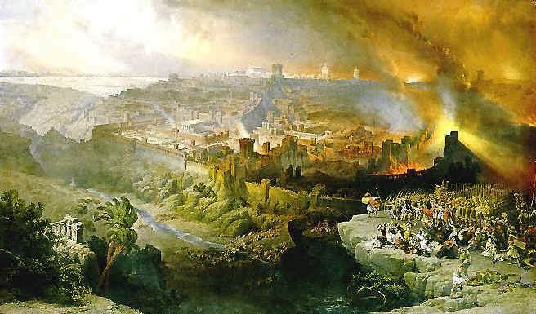
What is Realized Eschatology?
Realized Eschatology
is a doctrine of completed last things
The end times were realized and accomplished in 70 A.D. at the destruction of Jerusalem

Slide 7

What Does This Doctrine Teach?
When the destruction of Jerusalem took place in September of 70 A.D.,
ALL Bible prophecy was
fulfilled at that time!

Slide 8
What Does This Doctrine Teach?
THE SECOND COMING OF CHRIST
  All New Testament passages about the second coming of Christ have nothing to do with the actual return of Jesus for the saved
  Instead, all the second coming passages have to do with a spiritual (invisible) coming of Jesus in 70 A.D.

Slide 9
What Does This Doctrine Teach?
THE RESURRECTION OF THE DEAD
  The resurrection does not involve the physical body
  Instead, the resurrection of the dead actually refers to a resurrection of the Christian system (or the church) from persecution inflicted by the Jews between 30 and 70 A.D.

Slide 10
What Does This Doctrine Teach?
THE DAY OF JUDGMENT
  Not a time in the future when all men and women will give an account to God for the deeds done in these bodies
  Instead, the judgment day is the destruction of Jerusalem, which occurred in 70 A.D.

Slide 11
What Does This Doctrine Teach?
THE END OF THE WORLD
  Not the passing away of the earth
  Instead, the dissolving of the Jewish world
“But the day of the Lord will come as a thief in the night, in which the heavens will pass away with a great noise, and the elements will melt with fervent heat; both the earth and the works that are in it will be burned up.”
2 Peter 3:10
70 A.D. Doctrine: Speaking of the destruction of Jerusalem
and the Jewish system – not the end of the literal world

Slide 12
What Does This Doctrine Teach?
THE KINGDOM OF CHRIST
  Not fully established on Pentecost
  Instead, the kingdom was born, or established on Pentecost but it did not come with “power” and in its fullness until Jerusalem was destroyed in 70 A.D.

Slide 13
What Does This Doctrine Teach?
This doctrine teaches that ALL New Testament references to the following refer and apply to the destruction of Jerusalem in 70 A.D.
  LAST DAYS: “the last days, therefore never apply to the Christian age, but always to the closing period of the Jewish age, which ran from Pentecost to the fall of Jerusalem”
  (SOP, P. 79)

Slide 14
What Does This Doctrine Teach?
  THE END OF THE WORLD: “The world marked for destruction in prophecy, the end of which involved the second coming of Christ, and resulted in the redemption of true Israel, was the Jewish world. Therefore, it is the end of the Jewish world, not this material earth”
  (SOP, P. 83)

Slide 15
What Does This Doctrine Teach?
  THE DAY OF JUDGMENT: “the world reserved unto fire against the day of judgment and perdition of ungodly men (2 Peter 3:7), was the Jewish world”
  (SOP, P. 131)
  THE SECOND COMING OF CHRIST: “the fall of Jerusalem was the last day, and therefore the second coming of Christ”
  (SOP, P. 150)

Slide 16
This Is Not A New Doctrine
Paul had to battle a form of this doctrine
“But shun profane and idle babblings, for they will increase to more ungodliness. And their message will spread like cancer. Hymenaeus and Philetus are of this sort, who have strayed concerning the truth, saying that the resurrection is already past; and they overthrow the faith of some.”
2 Timothy 2:16-18

Slide 17

This Is Not A New Doctrine
Hymenaeus and Philetus believed and taught that the resurrection has already occurred – This is the cornerstone of the 70 A.D. doctrine
  Teach that the resurrection occurred in 70 A.D. with the destruction of Jerusalem
    “profane and idle babblings”
    “increase to more ungodliness”
    “overthrow the faith of some”

Slide 18
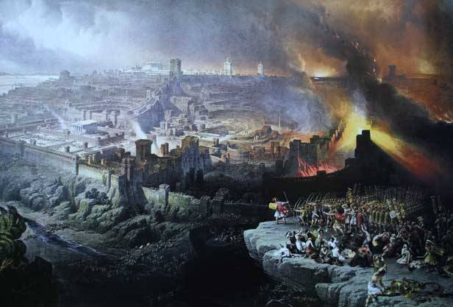
The Introduction of the 70 A.D. Doctrine
Those advancing the theory of Realized Eschatology believe that ALL prophecies pertaining to:
  The Lord’s Second Coming
  The Resurrection of the Dead
  The Judgment Day
  The End of the World
Have ALL been fulfilled in the past, specifically in
70 A.D. at the destruction of Jerusalem

Slide 19
The Introduction of the 70 A.D. Doctrine
Two men infecting churches of Christ with this doctrine:
  C. D. Beagle and son-in-law Max R. King
    First to introduce this doctrine at a preacher’s meeting in Ohio on April 22, 1971
    Max King became the leading proponent
      Wrote “The Spirit of Prophecy” in 1971 (updated in 2002) and a 784 volume entitled “The Cross and The Parousia of Christ” in 1987

Slide 20
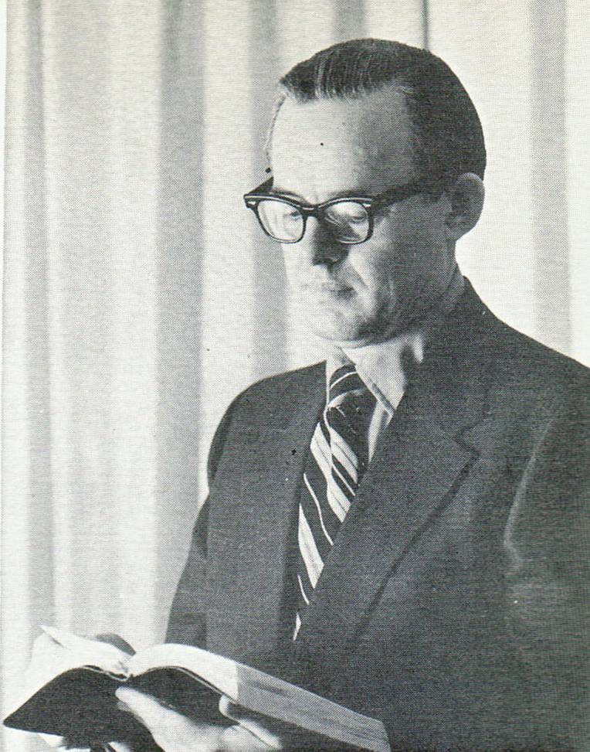
The Introduction of the 70 A.D. Doctrine
Max King’s material relating to Realized Eschatology is a perversion of scripture
Max R. King (1971)
  Very critical of what they call “traditional views” of Bible teachings on the last things
  They expect to stimulate interest by a “new view of the scriptures,” or
  “a fresh approach”

Slide 21

The Introduction of the 70 A.D. Doctrine
In the introduction of “The Spirit of Prophecy” by Max R. King,
C.D. Beagle writes:
“To say that this book is controversial is putting it mildly...”

Slide 22
Point of Emphasis:
Dates of New Testament Books
Contention of those who support the 70 A.D. doctrine that ALL the New Testament books were written prior to 70 A.D.
  If ANY of the books were written after 70 A.D. and they mention the end of things yet to come, the theory under consideration would be proved false.

Slide 23
Point of Emphasis:
Dates of New Testament Books
It MUST be admitted by those who support the 70 A.D. doctrine as well as those who oppose it, that the precise dating ultimately comes down to one’s opinion supported by whatever internal and external data one has at command to assist in the matter.
  Would be arrogant on the part of anyone to base a position on the absolute certainty that EVERY book was written prior to 70 A.D.

Slide 24

Point of Emphasis:
Dates of New Testament Books
There is much evidence, based on the work of many
Bible scholars, that the following books were written
after 70 A.D.
  Gospel of John (80-98 A.D.)
  1, 2, 3 John (70-96 A.D.)
  Jude (70-90 A.D.)
  Revelation (80-96 A.D.)

Slide 25

Point of Emphasis:
Dates of New Testament Books
Assuming that each of these books were written after 70 A.D., then the following scriptures would deal this false doctrine a death blow!

Slide 26

Point of Emphasis:
Dates of New Testament Books
“In My Father's house are many mansions; if it were not so, I would have told you. I go to prepare a place for you. And if I go and prepare a place for you, I will come again and receive you to Myself; that where I am, there you may be also.”
John 14:2-3

Slide 27
Point of Emphasis:
Dates of New Testament Books
“And now, little children, abide in Him, that when He appears, we may have confidence and not be ashamed before Him at His coming.”
1 John 2:28

Slide 28
Point of Emphasis:
Dates of New Testament Books
“Beloved, now we are children of God; and it has not yet been revealed what we shall be, but we know that when He is revealed, we shall be like Him, for we shall see Him as He is.”
1 John 3:2

Slide 29
Point of Emphasis:
Dates of New Testament Books
“Now Enoch, the seventh from Adam, prophesied about these men also, saying, “Behold, the Lord comes with ten thousands of His saints, to execute judgment on all, to convict all who are ungodly among them of all their ungodly deeds which they have committed in an ungodly way, and of all the harsh things which ungodly sinners have spoken against Him.”
Jude 14-15

Slide 30
Point of Emphasis:
Dates of New Testament Books
“He who testifies to these things says, “Surely I am coming quickly.” Amen. Even so, come, Lord Jesus!
Revelation 22:20

Slide 31
Conclusion
Those advancing the theory of Realized Eschatology believe that ALL prophecies pertaining to:
  The Lord’s Second Coming
  The Resurrection of the Dead
  The Judgment Day
  The End of the World
Have ALL been fulfilled in the past, specifically in
70 A.D. at the destruction of Jerusalem

