Slide 1
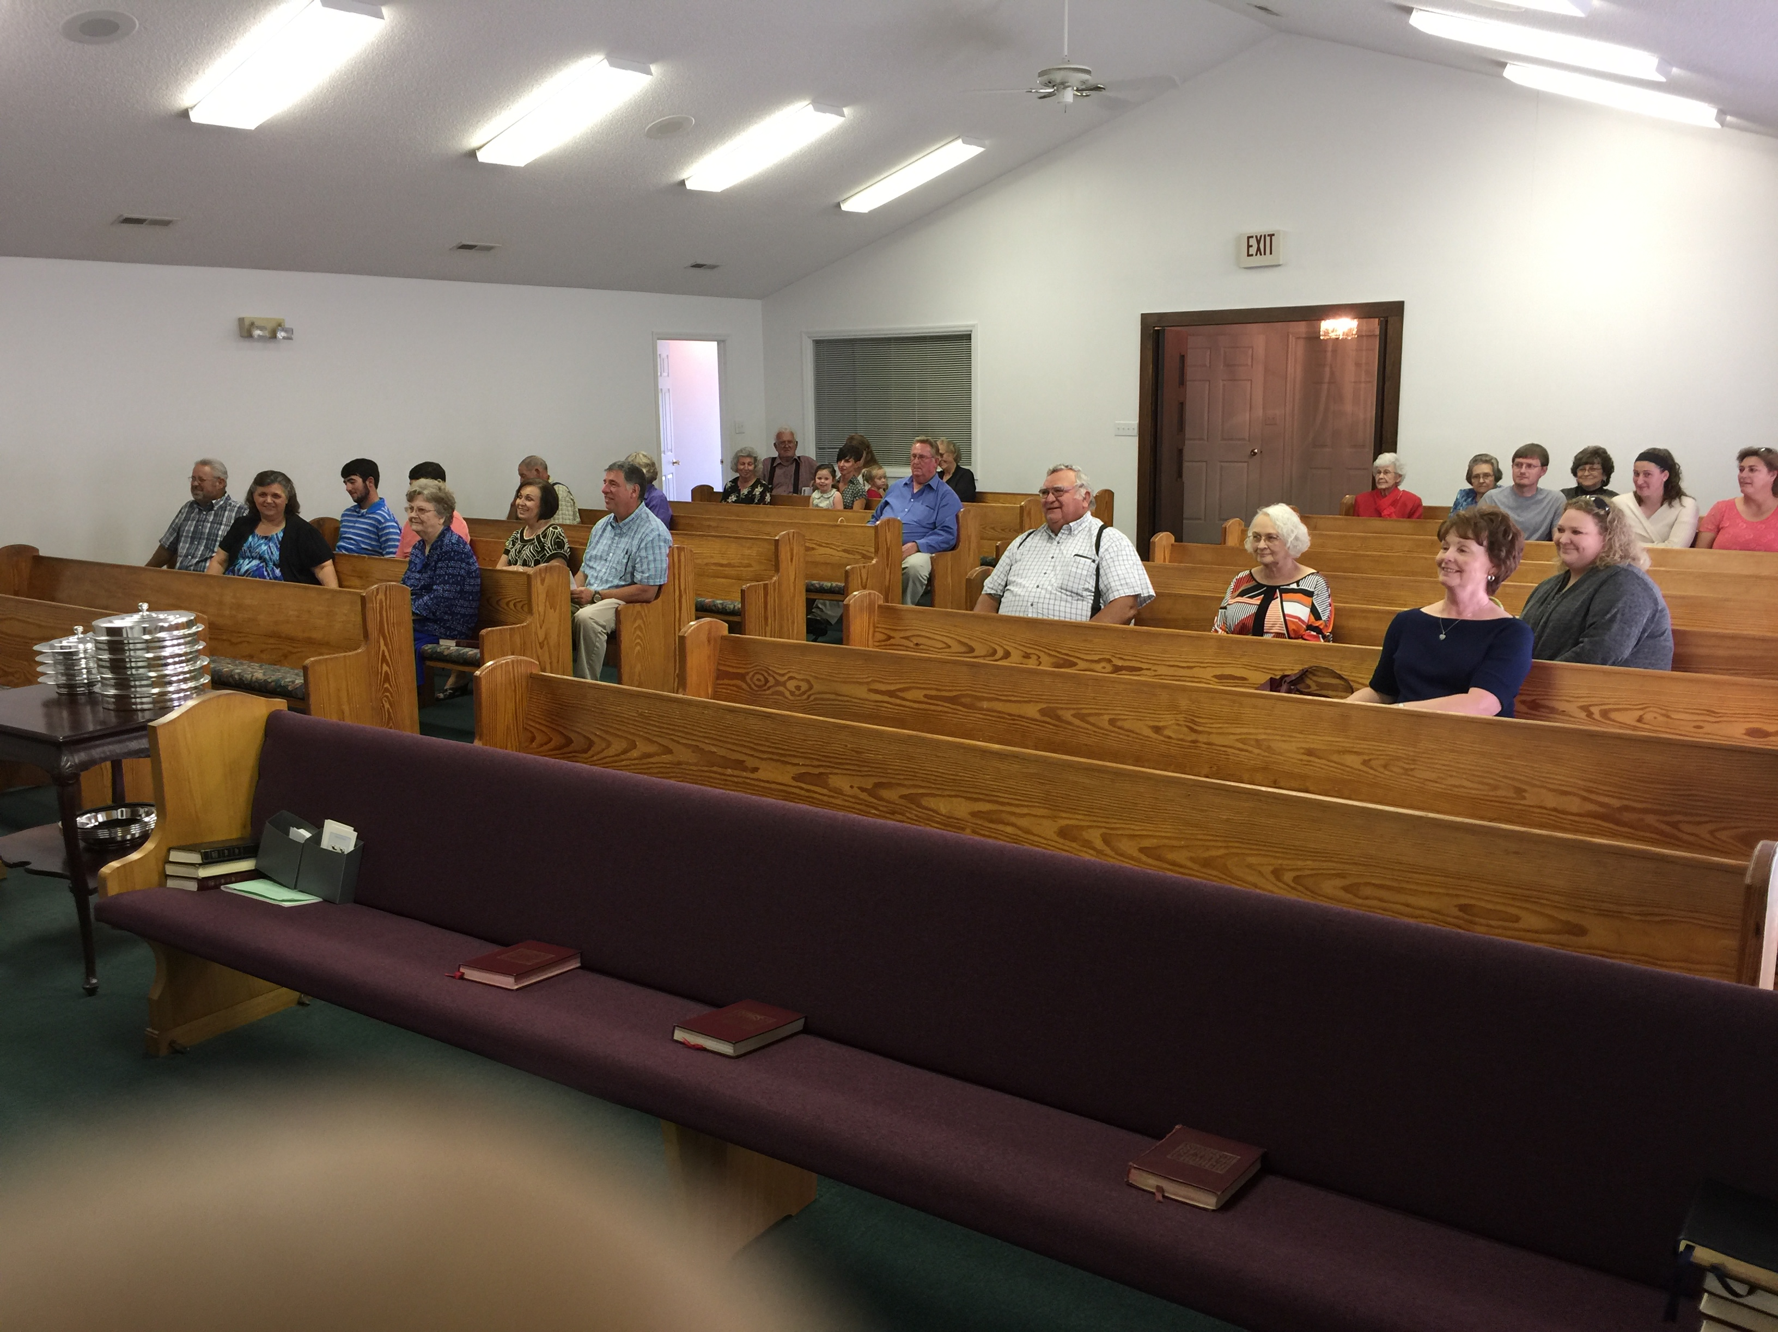
Why Does the Church Lose Young People?
“Train up a child in the way he should go, and when he is old he will not depart from it.”
Proverbs 22:6
Richie Thetford www.thetfordcountry.com

Slide 2
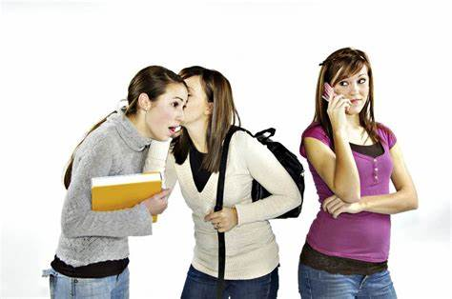
Bad Influence of Their Friends
The warnings:
  Proverbs 1:10-15
  Proverbs 12:26
  Proverbs 22:24-25
  1 Corinthians 15:33
There is power in friendship
Richie Thetford www.thetfordcountry.com

Slide 3
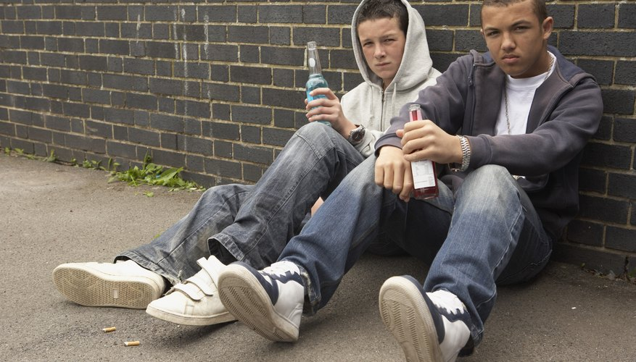
Bad Influence of Their Friends
How Does This Happen?
  Hebrews 2:1
  Psalms 1:1-3
  Exodus 23:2
  Romans 12:2
  Proverbs 23:20-21
Richie Thetford www.thetfordcountry.com

Slide 4
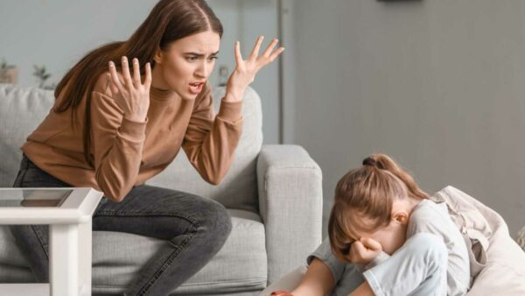

Poor Example of Their Parents
The young learn by what they see
  Matthew 5:13-16
  1 Timothy 4:12
  Ezekiel 16:44
“Actions ALWAYS
speak louder than words.”
Richie Thetford www.thetfordcountry.com

Slide 5

Poor Example of Their Parents
Young people often see parents who:
  Don’t go to Bible class
  Don’t go at other service times
  Miss a lot of services when they don’t feel good
  Miss a lot for work
  Emphasize material things over the spiritual
  Stress the importance of schoolwork over spiritual matters
  Toy with sin (straddling the fence)
Not surprising when children turn out to be just like they were really trained
Richie Thetford www.thetfordcountry.com

Slide 6
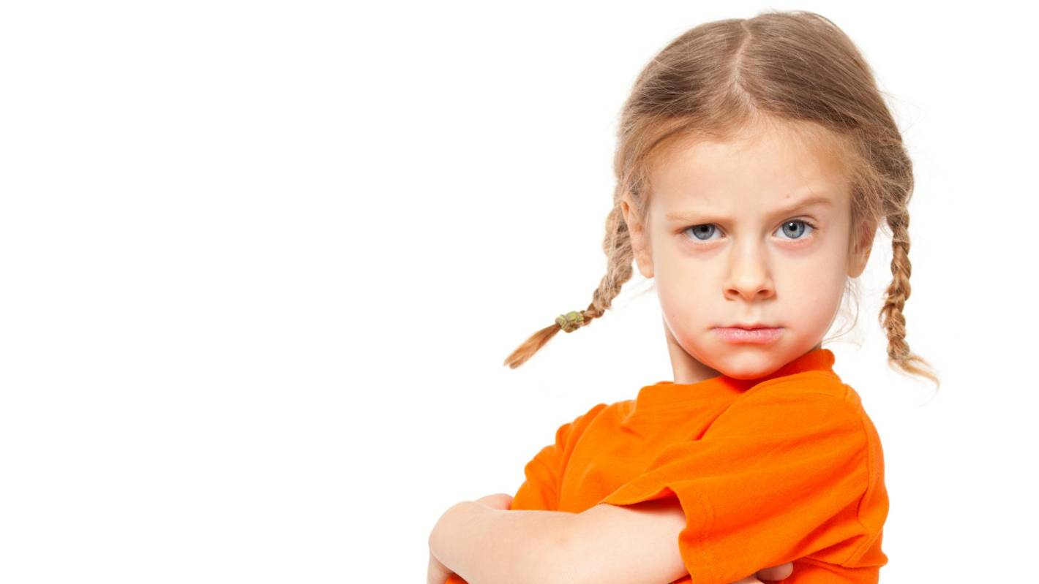
Lax Standards at Home
Training young people requires high standards
  Proverbs 22:6
  Ephesians 6:4
Some common lax standards:
  Little corrective discipline in younger years
    Proverbs 22:15
    Proverbs 19:18
  Carelessness in oversight
  Little effort to communicate – Proverbs 29:15
Richie Thetford www.thetfordcountry.com

Slide 7

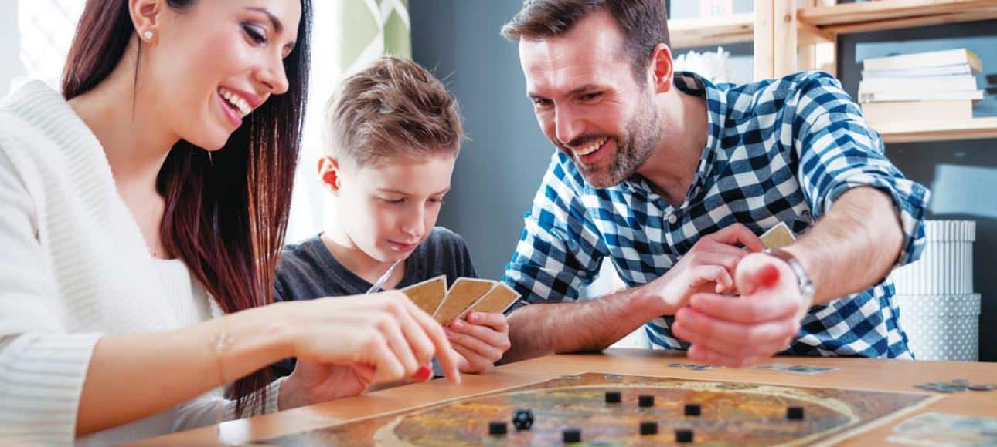
Little Time is Spent Together as a Family
It takes time to be an example
  To teach our children
  To help them through problems
  To understand our children
  To communicate
  To build a relationship with them
Must redeem the time
  Ephesians 5:15-16
Richie Thetford www.thetfordcountry.com

Slide 8

The Weak Image of the Church
The young form an image of the church
A strong image of the church is powerful
  Learning the Bible and understanding it
  Seeing the truth in action
  Seeing conviction and strength
  Seeing people who love and respect
  the Lord
Richie Thetford www.thetfordcountry.com

Slide 9
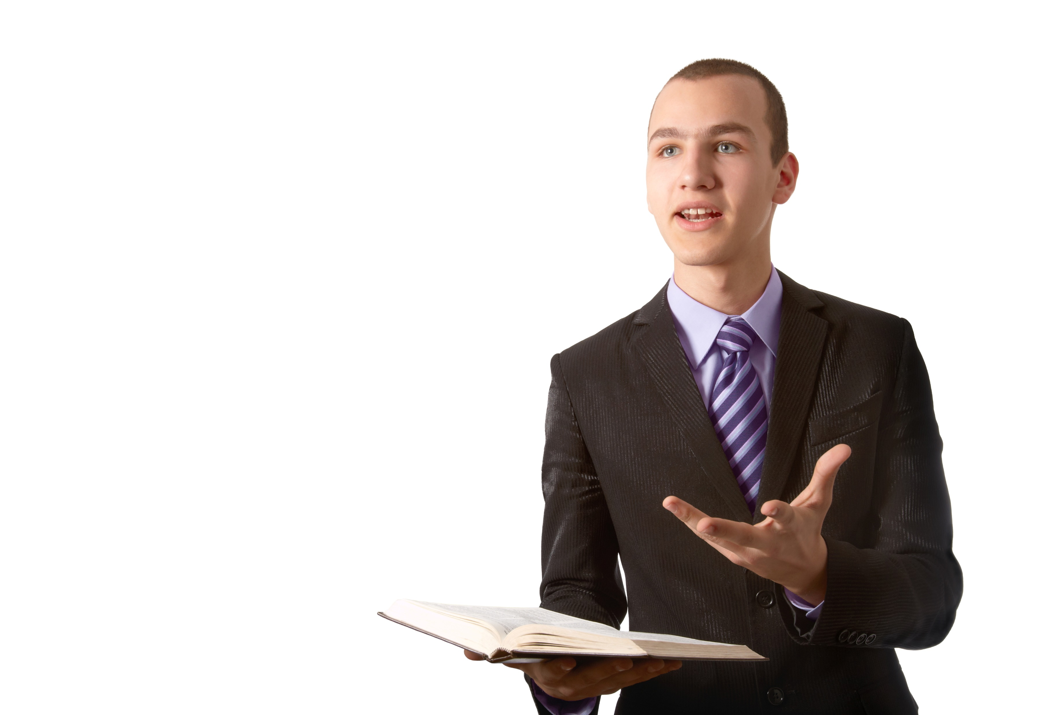
The Weak Image of the Church
Unfortunately, too many see a weak image of the church
  Preaching that is weak and watered down
  Preaching that is hard to follow
  Unprepared Bible class teachers
  Seeing hypocrisy in some members
  Hearing grumbling about others
Parents – assess what may be happening to our children before it is too late
Strive to not only follow Jesus, but also applying all
of His examples and teachings to our children
Richie Thetford www.thetfordcountry.com

