Slide 1
What Do You See?
Genesis 1:6-27
Richie Thetford www.thetfordcountry.com

Slide 2
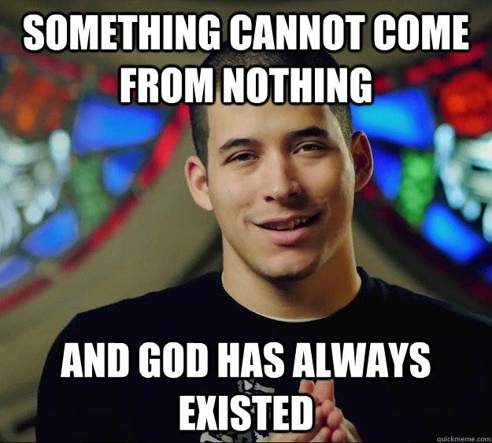
Something Did Not Come from Nothing!
Genesis 1:1
Isaiah 42:5
Genesis 1:6-27 (scripture reading)
John 1:3
Colossians 1:16
Richie Thetford www.thetfordcountry.com

Slide 3
Every Effect Must Have an Adequate Cause!
Job 26:7
Psalms 19:7
Psalms 19:1
Hebrews 1:1-3
Acts 17:22-29
Richie Thetford www.thetfordcountry.com

Slide 4
A Design Implies a Designer!
Isaiah 40:22
Genesis 1:3-5
Genesis 1:26-27
John 4:24
Psalms 104:24
Richie Thetford www.thetfordcountry.com

Slide 5
Conclusion
What did you see through those unique eyes while they flashed?
How did your brain perceive the world while you lived?
You didn’t see God when you walked along the path.
You never saw God while you lived on this earth.
So, I guess,
You never saw anything after all.
Open the Bible, cherish the word that God gave us.
“In the beginning, GOD created the heavens and the earth”
Richie Thetford www.thetfordcountry.com

