Slide 1

The Perversions and Diversions
of Christmas
Richard Thetford www.thetfordcountry.com

Slide 2

Perversions and Diversions
Perversion
“to lead astray; to misuse; to distort; to twist or turn from what is true.”
Diversion
“turning aside; distraction of attention.”
During the Christmas season there are diversions that take us away from the gospel of Christ
Richard Thetford www.thetfordcountry.com

Slide 3
Perversions
December 25th is Jesus’ birthday
Shepherds NOT in fields at that time
Luke 2:8
Jesus’ birthday – not stated in the Bible
Wise men were at the manger
Matthew 2:11
Three wise men? (gold, frankincense and myrrh)
of Christmas
Richard Thetford www.thetfordcountry.com

Slide 4
Perversions
Jesus approves it
Matthew 28:19-20
We are only to teach to others those things in which we have been authorized to teach
The New Testament teaches it
Where are we told to observe Christmas as a religious holiday?
of Christmas
Richard Thetford www.thetfordcountry.com

Slide 5
Perversions
The church is to observe it
1 Corinthians 4:6, 17; 11:2, 23-26
If we are to observe it, why is it not mentioned?
We should celebrate Christmas as a religious holiday
Colossians 3:17; 2 Thessalonians 2:15
of Christmas
Richard Thetford www.thetfordcountry.com

Slide 6
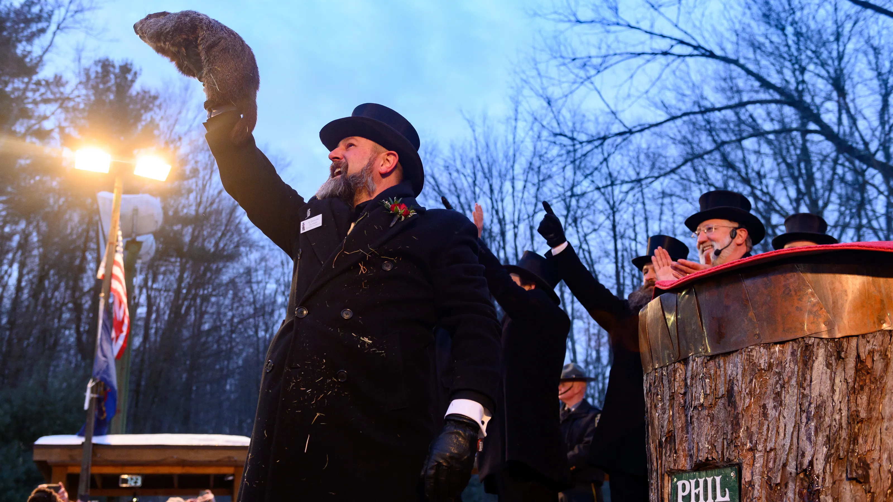
Perversions
of Christmas
Ground Hog Day is a tradition – but do we celebrate it religiously?
2 John 9-11
Richard Thetford www.thetfordcountry.com

Slide 7
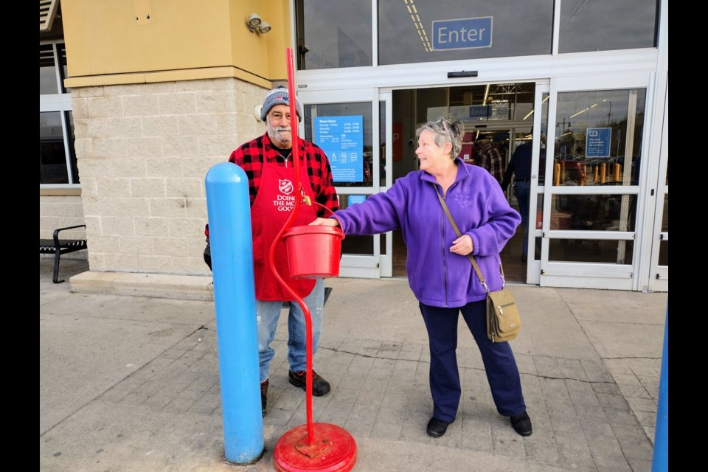
Diversions
Rituals = Righteousness
Matthew 6:2-7; 7:21-23; 23:5, 23
Colossians 2:18
Traditions = Truth
Matthew 15:8-9
Colossians 2:4-8
Giving = Godliness
Ephesians 2:13
Colossians 1:20
of Christmas
Richard Thetford www.thetfordcountry.com

Slide 8
Diversions
Benevolence = Brotherhood
Cornelius was a benevolent, devout man
Acts 10:2
Was his benevolent acts his salvation?
Acts 11:14
of Christmas
Richard Thetford www.thetfordcountry.com

Slide 9
Diversions
Christmas Unity = Christian Unity
Many denominations become united during the Christmas season
Ephesians 4:4-6
John 17:20-22
1 Corinthians 1:10 (same mind and judgment)
of Christmas
Richard Thetford www.thetfordcountry.com

Slide 10

Diversions
Observing Christmas makes me a Christian
Shooting fireworks on July 4th makes me an American?
of Christmas
Richard Thetford www.thetfordcountry.com

Slide 11
Diversions
His birth gives me a new birth
His death does
Romans 4:25; 5:6-10
New birth means – being baptized into Christ
Romans 6:3-4, 17-18
1 Peter 1:22-25
of Christmas
Richard Thetford www.thetfordcountry.com

Slide 12
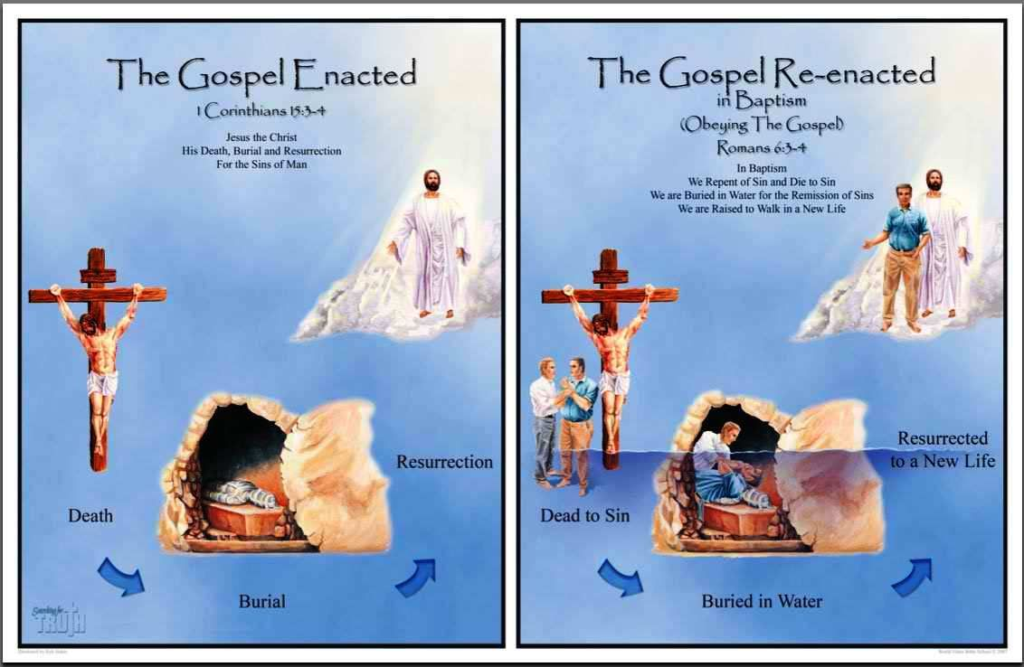
New Birth in Jesus Christ
Richard Thetford www.thetfordcountry.com

Slide 13
The Perversions and Diversions
of Christmas
Don’t let traditions of men PERVERT and DIVERT you from becoming and being only a Bible Christian
Keep the traditions of Jesus – as was taught by the apostles
Richard Thetford www.thetfordcountry.com

