Slide 1

Living Like We Want to Go to HELL
Matthew 7:13-14
Richie Thetford www.thetfordcountry.com

Slide 2

The Use of the Word “Hell”
A grave
  Psalms 9:17; 16:10; Luke 10:15
The realm of the dead (hades)
  The righteous and unrighteous are there
    Luke 16:23-24
  The place that could not hold Jesus
    Acts 2:27-31
  Will be defeated at the end of time
    1 Corinthians 15:54-55; Revelation 20:13-14
Richie Thetford www.thetfordcountry.com

Slide 3

The Use of the Word “Hell”
A place where fallen angels are bound (tartarus)
  2 Peter 2:4
The eternal destiny of the wicked (Gehenna)
  Matthew 5:22, 29-30
Richie Thetford www.thetfordcountry.com

Slide 4

Living with a View Toward Hell
Evil and careless deeds lead us on a pathway to hell
  1 Timothy 5:24
  Spiritual contempt will lead us there
    Matthew 5:22
  Certain hindrances will lead us there
    Matthew 5:29-30
Our tongue could lead us to hell
  James 3:6
“Religious people” can become sons of hell
  Matthew 23:15
Richie Thetford www.thetfordcountry.com

Slide 5
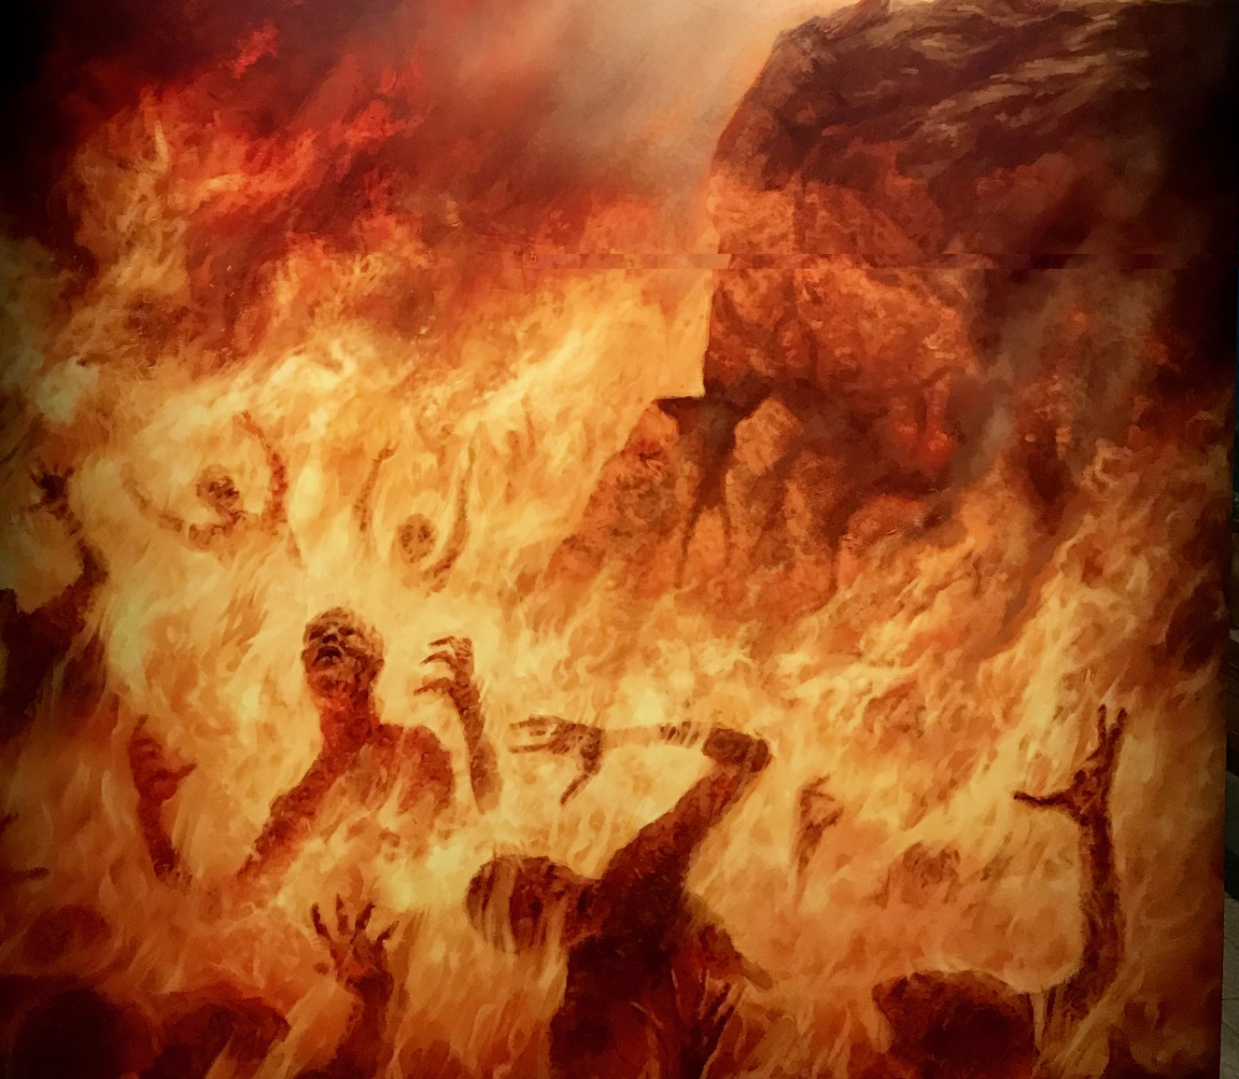
What Awaits the Soul in Hell?
Eternal punishment
  Romans 2:8-9
Destruction of body and soul
  Luke 12:4-5
Eternal separation
  2 Thessalonians 1:6-9
An eternal habitation with evil
  Matthew 25:41
Richie Thetford www.thetfordcountry.com

Slide 6
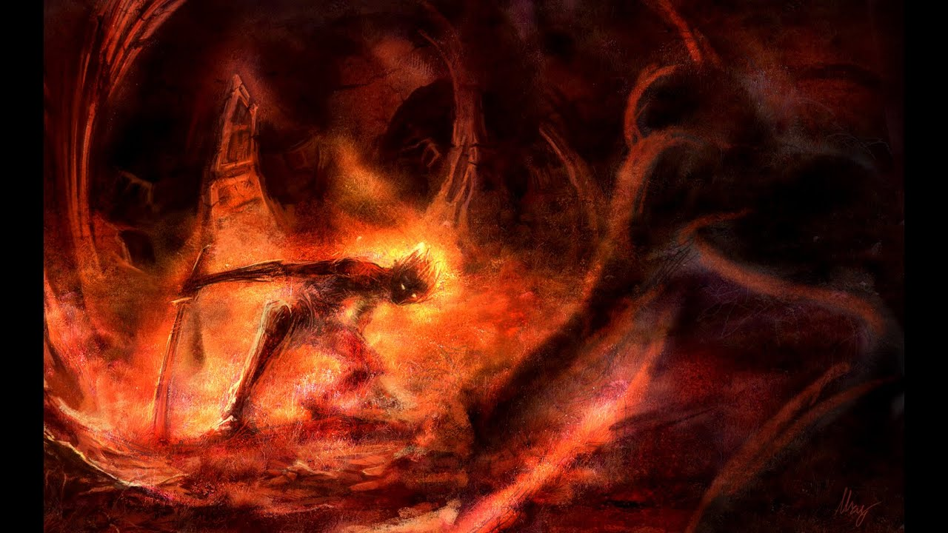
What Awaits the Soul in Hell?
A furnace of fire!
  Revelation 21:8
Where the worm does not die
  Mark 9:43-48
Continuous darkness and weeping
and gnashing of teeth
  Matthew 22:13
A lake of fire and brimstone
  Revelation 20:11-15
Richie Thetford www.thetfordcountry.com

Slide 7

Who Are Destined for Hell?
The Devil and his angels
  Matthew 25:41
The morally corrupt
  Revelation 21:8
The apostates
  Hebrews 6:4-8; 10:26-31
The hypocrites
  Romans 2:1-9
Richie Thetford www.thetfordcountry.com

Slide 8

Who Are Destined for Hell?
Unfruitful Christians
  John 15:1-8
The Unprepared and unfaithful Christians
  Matthew 25:1-13
Those who do not know God or obey the gospel
  2 Thessalonians 1:7-9
Are we living like we want to go to Hell?
Richie Thetford www.thetfordcountry.com

