Slide 1
Inconsistencies in Religion
Matthew 7:1-5
Romans 2:22-23
1 Corinthians 15:1-8, 12-14
Richie Thetford www.thetfordcountry.com

Slide 2
“A man’s life is always more forcible than his speech. When men take stock of him, they recon his deeds as dollars and his words as pennies. If his life and doctrine disagree the mass of onlookers accept his practice and reject his preaching.”
-- C. H. Spurgeon
Richie Thetford www.thetfordcountry.com

Slide 3
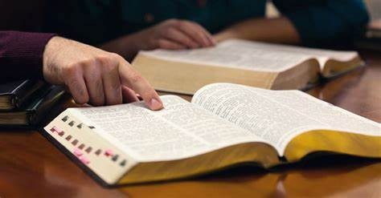
Some Religious Inconsistencies Among Us
Some emphasize obedience, but fail to study the Bible
2 Timothy 2:15
1 Timothy 4:13
1 Thessalonians 5:27
Matthew 5:6
Matthew 6:33
Richie Thetford www.thetfordcountry.com

Slide 4
Some Religious Inconsistencies Among Us
Many pray for the lost, but do nothing for them
Matthew 7:21
Hebrews 5:9
2 Thessalonians 1:7-9
1 Corinthians 13:8-10
Genesis 3:19
2 Thessalonians 3:10
Romans 2:1
Romans 2:21
Preach to the lost (Hebrews 5:12)
Visit the sick (Matthew 25:36, 43)
Help the needy (James 1:27; Galatians 6:10)
Richie Thetford www.thetfordcountry.com

Slide 5
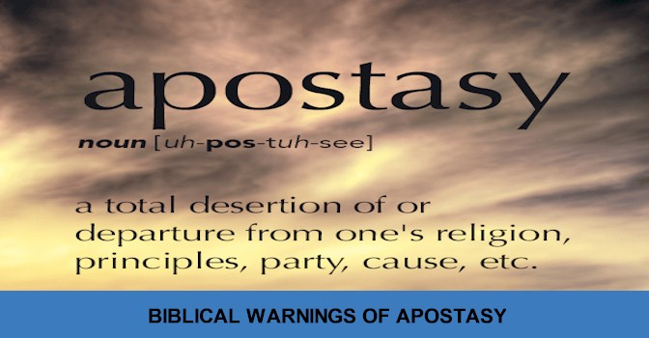
Some Religious Inconsistencies Among Us
Some emphasize the need for the Lord’s Supper, but neglect the assembly
Acts 20:7
Some teach that apostasy is possible, but live as though it is not
Luke 8:13
1 Corinthians 10:12; Galatians 5:4
Romans 6:3-6
Colossians 3:1-2
Richie Thetford www.thetfordcountry.com

Slide 6
Some Religious Inconsistencies Among Us
Some condemn those in denominations for having non-biblical standards, but then having other standards themselves
2 Timothy 3:16-17
Galatians 1:13-14
Acts 23:1
Matthew 7:13-14
Revelation 22:18-19
“And why do you look at the speck in your brother's eye, but do not consider the plank in your own eye? Or how can you say to your brother, 'Let me remove the speck from your eye'; and look, a plank is in your own eye? Hypocrite! First remove the plank from your own eye, and then you will see clearly to remove the speck from your brother's eye.”
Matthew 7:3-5
Richie Thetford www.thetfordcountry.com

Slide 7
Conclusion
We can see what we WANT to see
Are we religiously inconsistent in our belief and practice?
“O Consistency, Thou Art A Jewel!”
Richie Thetford www.thetfordcountry.com

