Slide 1
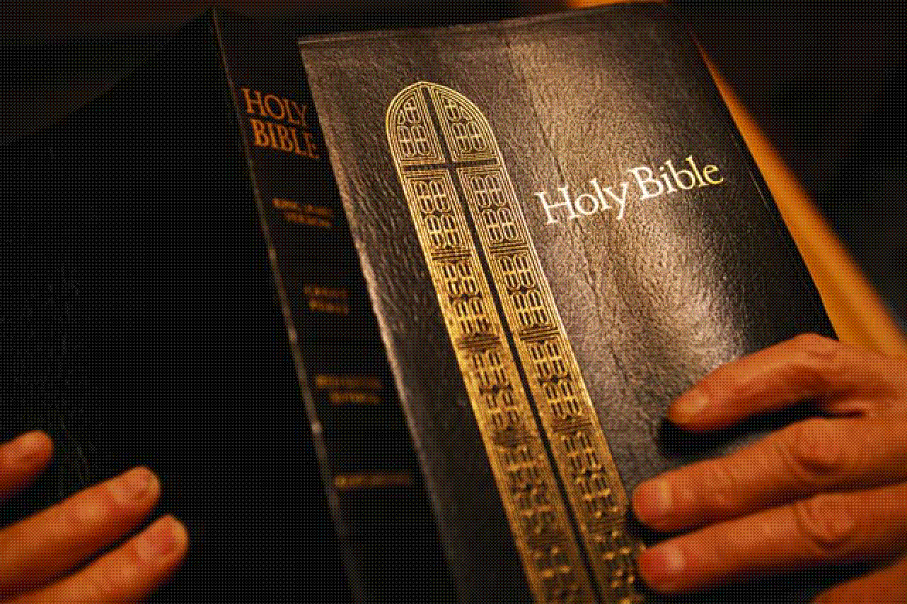
Hearing the
Word of God
God’s Plan of Salvation
“Therefore, take heed how you hear. For whoever has, to him more will be given; and whoever does not have, even what he seems to have will be taken from him.”
Luke 8:18
Richie Thetford www.thetfordcountry.com

Slide 2

God Has Spoken and Does Speak Today
Spoke to the fathers and prophets – now speaks through Jesus
  Hebrews 1:1-2
Jesus taught:
  John 12:48-50
God instructs us to listen
  Matthew 17:5
Richie Thetford www.thetfordcountry.com

Slide 3

God Has Spoken and Does Speak Today
When we reject Jesus then we reject God
  Luke 10:16
Jesus spoke through the apostles
  John 17:8; 16:12-13; 2 Timothy 2:2
Richie Thetford www.thetfordcountry.com

Slide 4
God Has Spoken So That We Will Hear
We are to hear and know about Jesus
“if indeed you have heard of the dispensation of the grace of God which
was given to me for you, how that by revelation He made known to me the mystery (as I have briefly written already, by which, when you read,
you may understand my knowledge in the mystery of Christ),
which in other ages was not made known to the sons of men,
as it has now been revealed by the Spirit to His holy apostles and prophets:”
Ephesians 3:2-5
Richie Thetford www.thetfordcountry.com

Slide 5
Some Contend That the Sinner Can’t Hear
Not that one can’t – but in many cases won’t
  Romans 1:16; Mark 16:15
Those contending they can’t hear – contradict the Word of God
  Matthew 18:1-3
Some claim direct operation of the Holy Spirit
  Would make God responsible for the lost
  Be no need to preach the gospel
  We read of no conversions without the Word first preached
Richie Thetford www.thetfordcountry.com

Slide 6

Why Is It That Some Don’t Hear?
Possibly because of ignorance
  Romans 10:1-3
Some have a lack of interest
  Matthew 22:1-5
Religious prejudice also closes many ears. Many people do not listen to anything that contradicts their set theory
– even when it is clearly stated.
Richie Thetford www.thetfordcountry.com

Slide 7

Motives That Induce Us to Hear
Curiosity
  Acts 17:19-21
A desire for gain
  Acts 24:24-27
A genuine love of the truth
  Acts 8:29-31
“Do you understand what you are reading?“ And he said, "How can I, unless someone guides me?”
Richie Thetford www.thetfordcountry.com

Slide 8
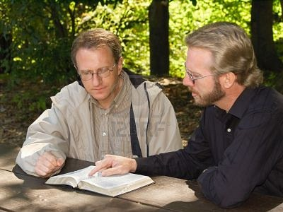
How Shall We Hear God’s Word?
Make sure it is “THE” truth
  1 John 4:1; Matthew 7:15
With an “OPEN” heart and frequently
  Acts 17:11; Psalms 1:1-2
With reverence
  1 Thessalonians 2:13
Richie Thetford www.thetfordcountry.com

Slide 9

Results of Hearing the Word Correctly
We learn of God
  John 17:1-3
It increases our faith
  Romans 10:17; John 20:30-31
It arouses the guilty conscience
  Some will obey – Acts 2:37
  Some will rebel – Acts 7:51-54
Hearing God’s Word
AND acting properly brings:
Happiness, Blessings,
Fruitfulness, Faithfulness
Richie Thetford www.thetfordcountry.com

