Slide 1
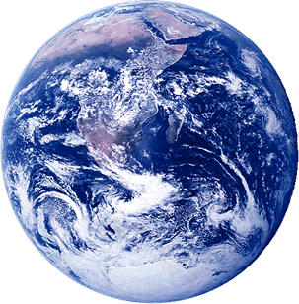
The God of Heaven Does Exist
“He stretches out the north over empty space;
He hangs the earth on nothing.”
Job 26:7
Richie Thetford www.thetfordcountry.com

Slide 2
“In the beginning God created the heavens and the earth.”
Logic
  If the brain of man is a product of chance, is it reliable?
Design
  A house is not built without a builder
    2 Peter 3:5
Right and Wrong
  All of mankind tends to have a sense of right and wrong
Richie Thetford www.thetfordcountry.com

Slide 3
“In the beginning God created the heavens and the earth.”
Inner Being
  It is natural for man to believe in the existence of God
    Acts 17:24-27
God Has Spoken
  In order that we may know of Him and His purpose for us
    Hebrews 1:1-2
Richie Thetford www.thetfordcountry.com

Slide 4
“In the beginning God created the heavens and the earth.”
The Prophets
  Prophecy fulfilled centuries following the death of a prophet indicates a source of knowledge beyond man
    Psalms 22:18
  Many examples cited
    Isaiah (Isaiah 52:13-53:12)
    Abraham, Isaac, Jacob
    Moses (Exodus 3:14)
Richie Thetford www.thetfordcountry.com

Slide 5
“In the beginning God created the heavens and the earth.”
The Prophets
  Personal name of God (YAHWEH)
  God caused Job to think by asking questions (Job 38:4-31)
    Where were you when I laid the earth’s foundation?
    Who shut up the sea behind doors when it burst forth?
    Have you journeyed to the springs of the sea?
    Have you entered the storehouses of the snow?
    Can you bind the beautiful Pleiades?
Richie Thetford www.thetfordcountry.com

Slide 6
“In the beginning God created the heavens and the earth.”
The Heavens
  Intricate design of the universe
    Psalms 19:1
The Powerful Word
  Which of the writings of men could be described as perfect?
    Psalms 19:7
Richie Thetford www.thetfordcountry.com

Slide 7
The God of Heaven Does Exist
Matthew 7:21-23
“and having been perfected, he became the author of eternal salvation to all who obey him”
Hebrews 5:9
Richie Thetford www.thetfordcountry.com

